Slide 1
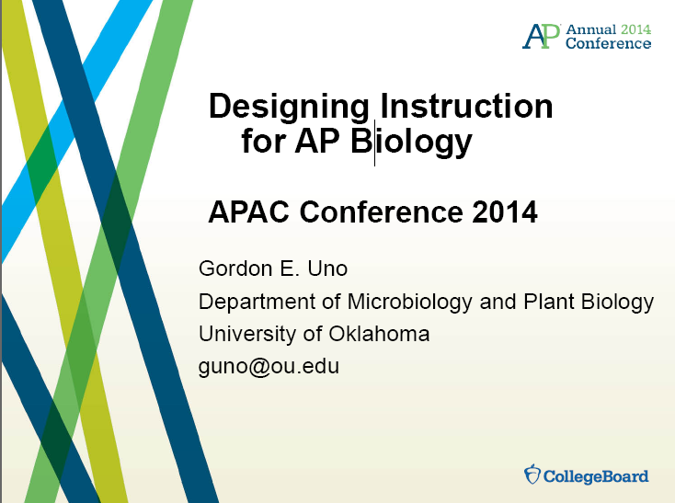

Slide 2
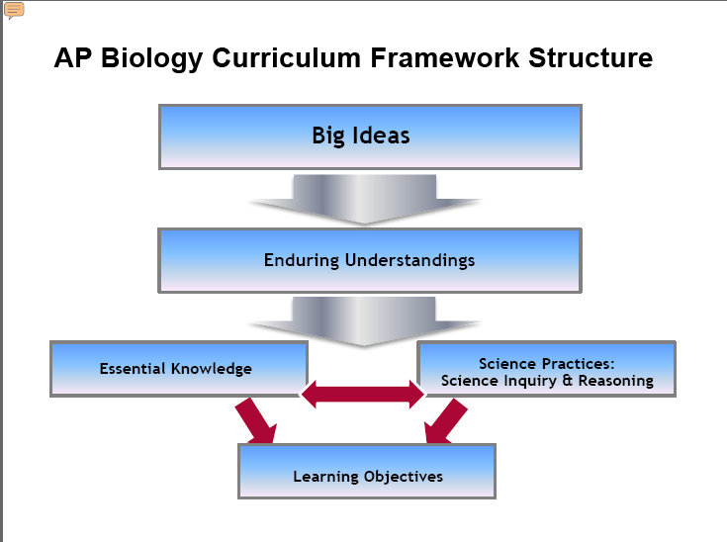

Slide 3
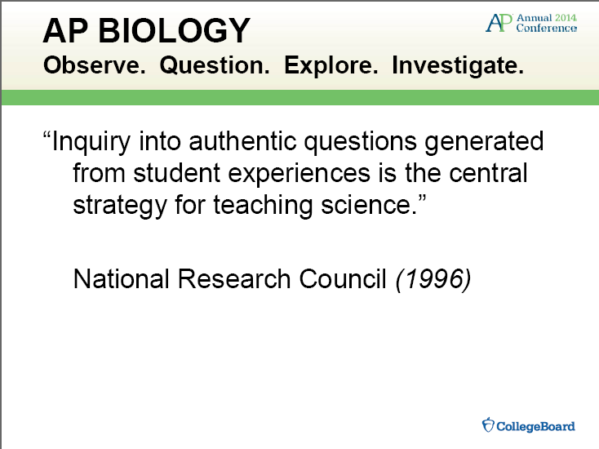

Slide 4
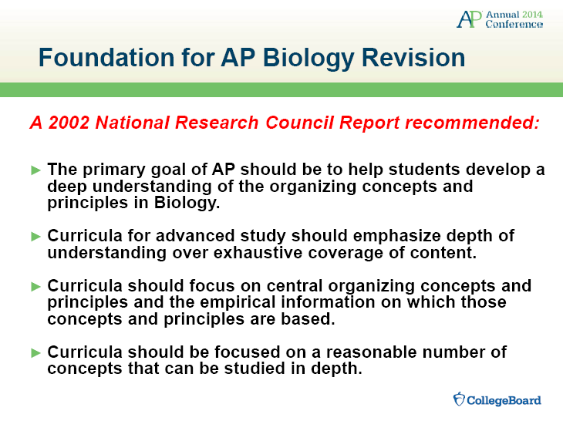

Slide 5
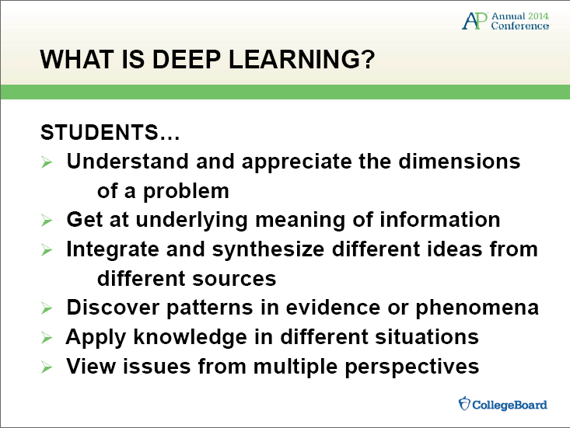

Slide 6
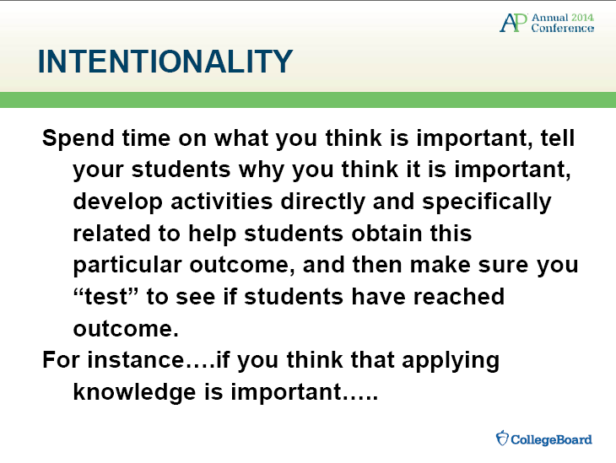

Slide 7
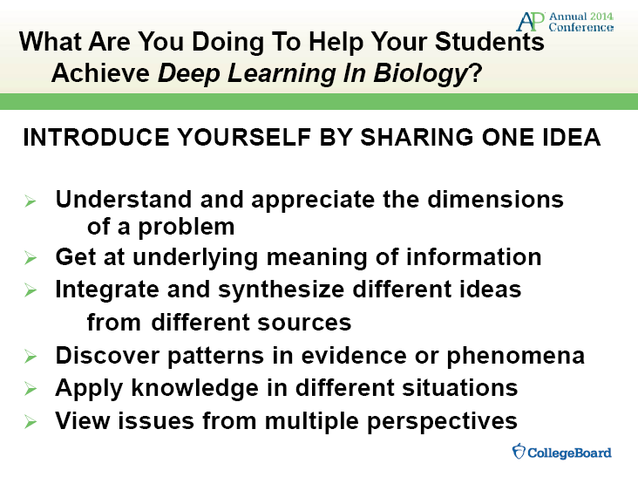

Slide 8
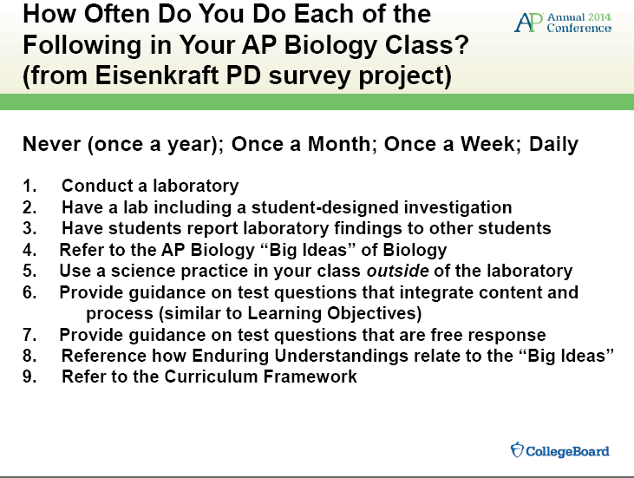

Slide 9
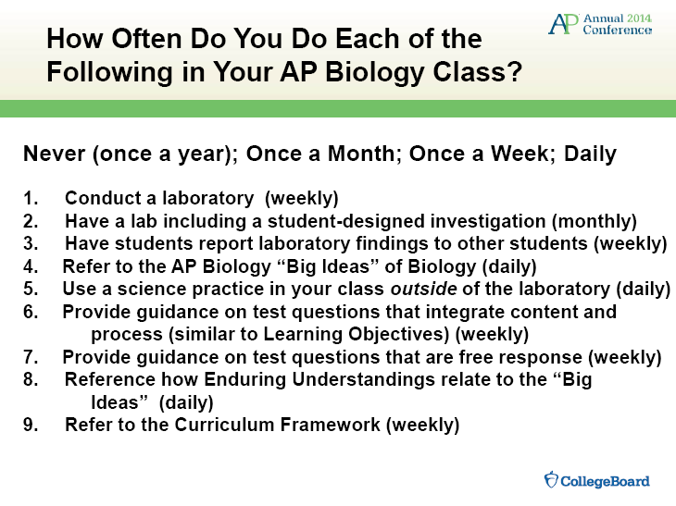

Slide 10
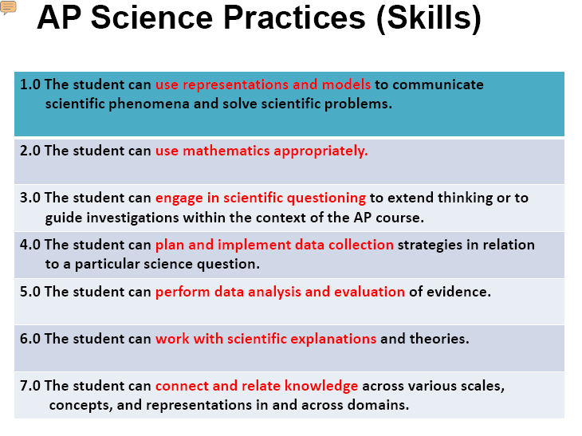

Slide 11
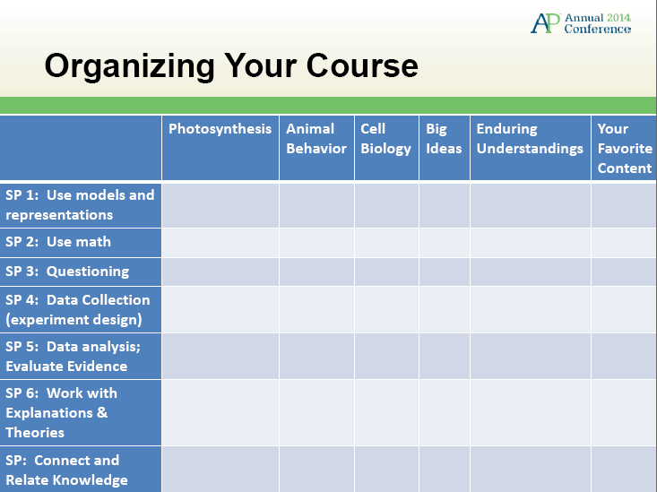

Slide 12
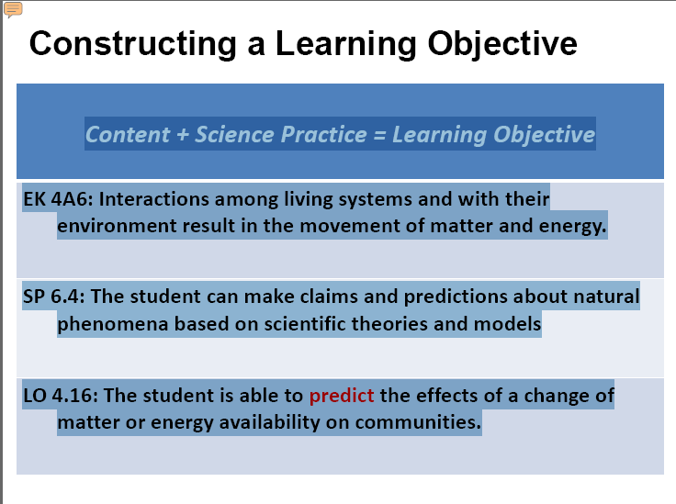

Slide 13
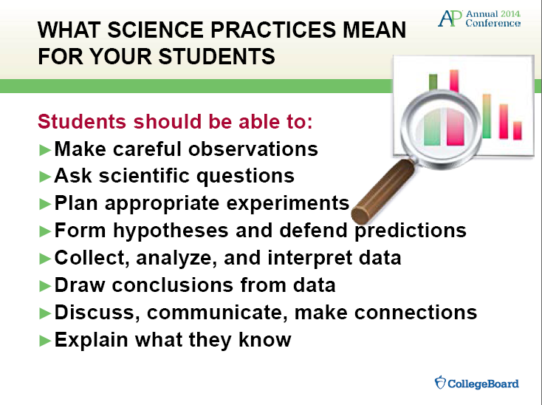

Slide 14
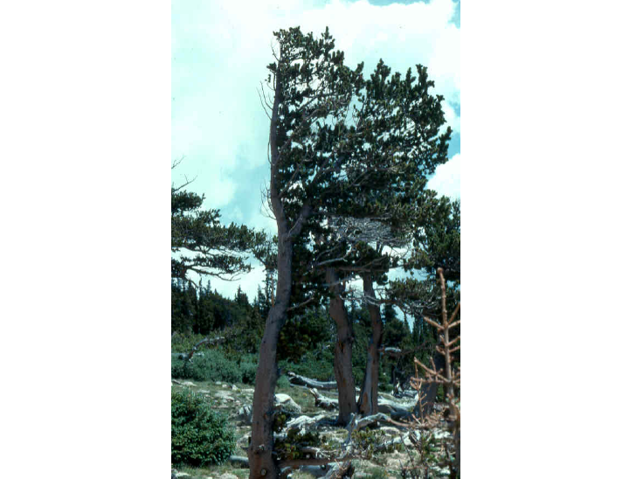

Slide 16
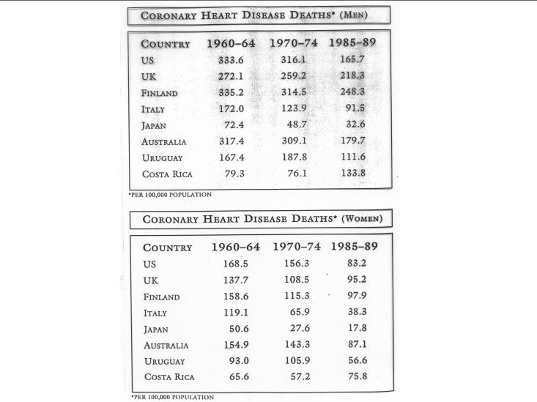

Slide 18
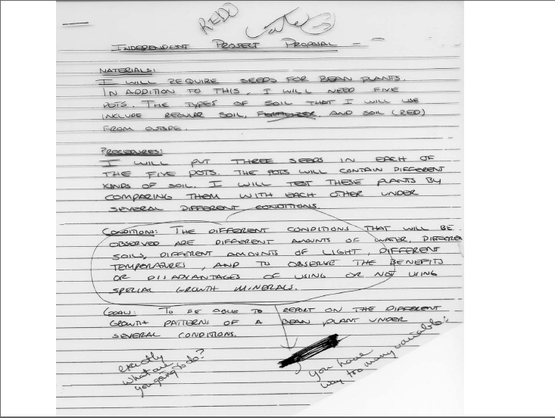

Slide 19
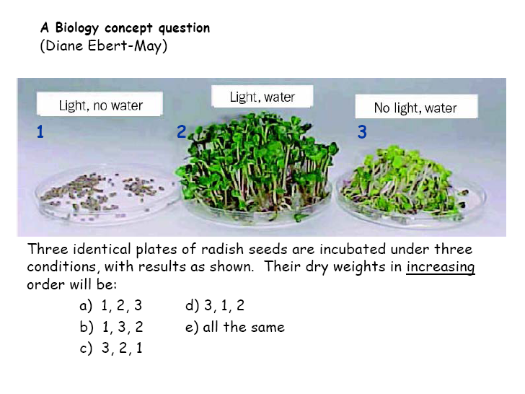

Slide 21
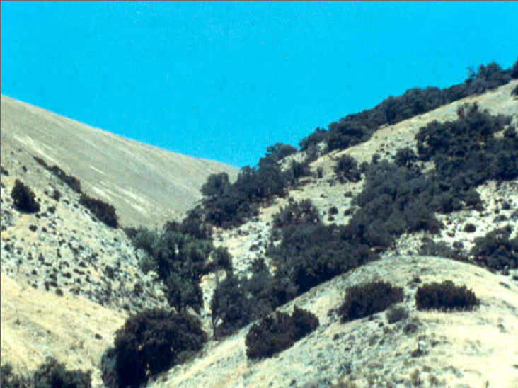

Slide 23
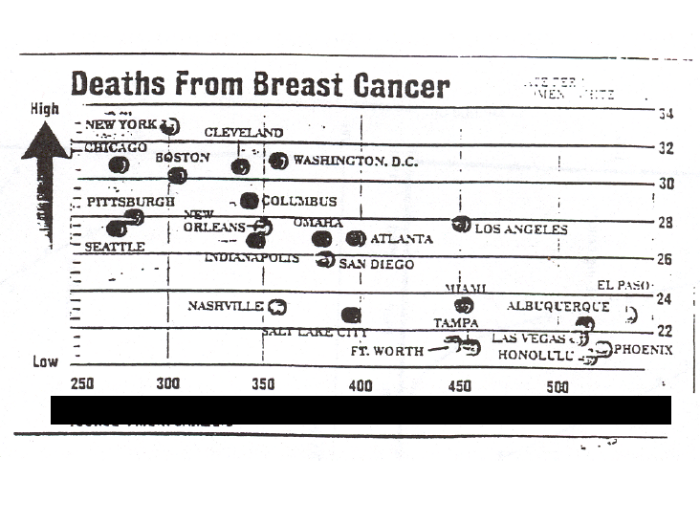

Slide 24
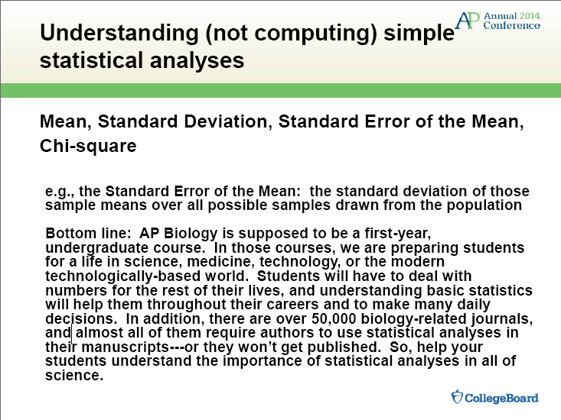

Slide 26
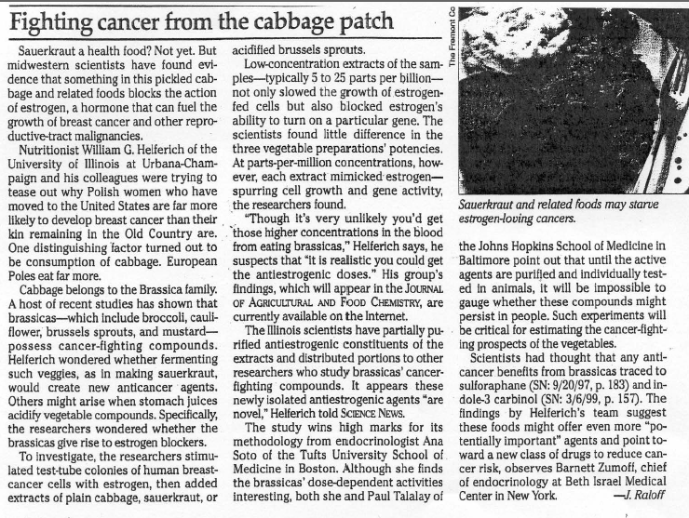

Slide 27
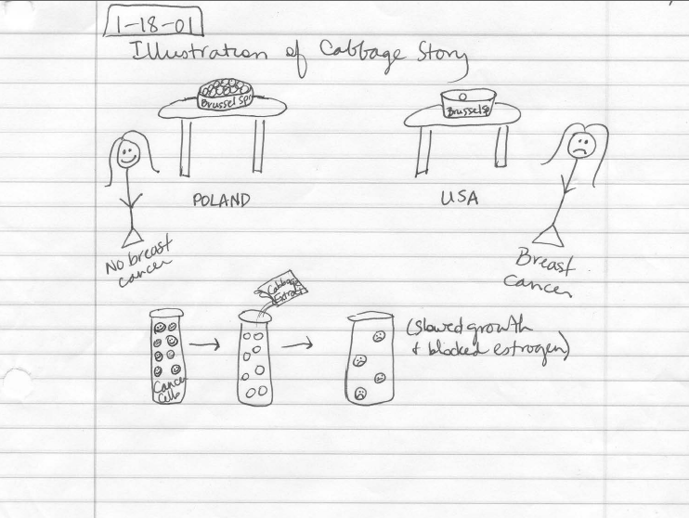

Slide 28
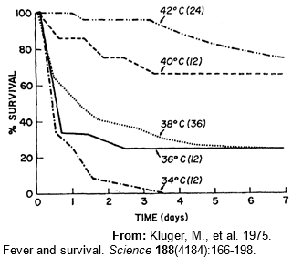

Slide 29
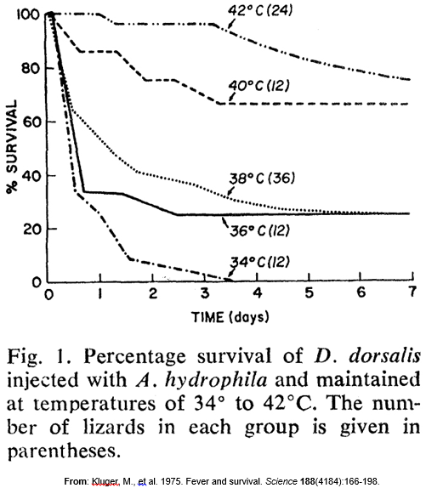

Slide 31
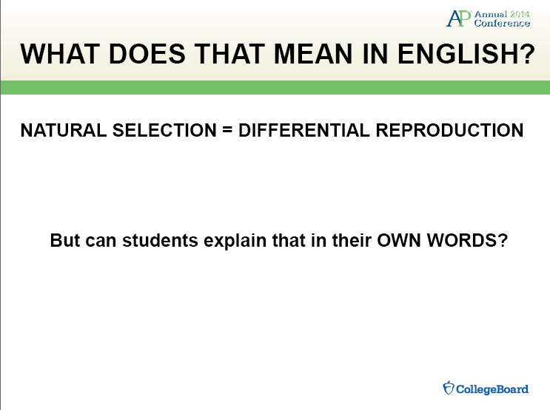

Slide 33
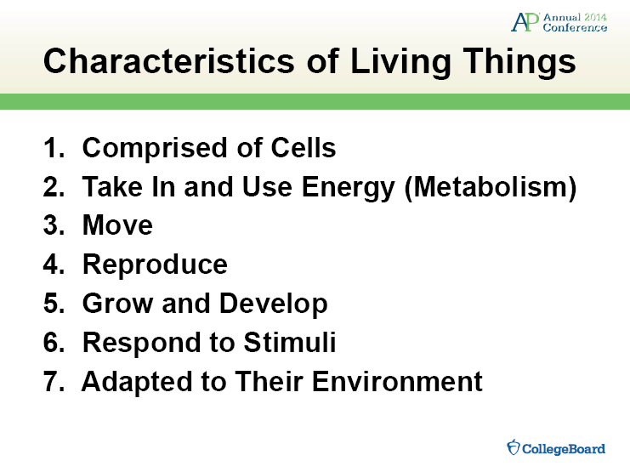

Slide 35
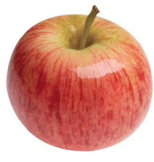
Is This Living? From “Inquiring About Plants”
And, How Can You Tell?
Design and carry out at least two investigations that would help you determine if this apple is

Slide 36
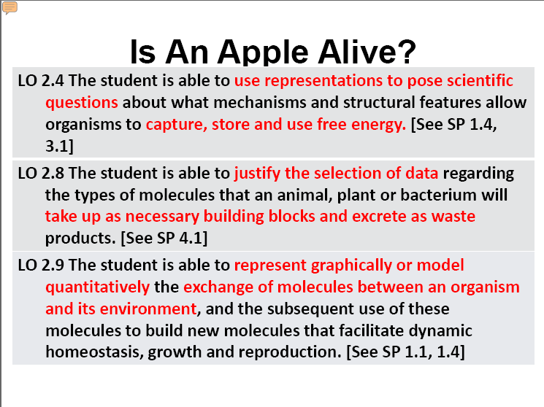

Slide 37
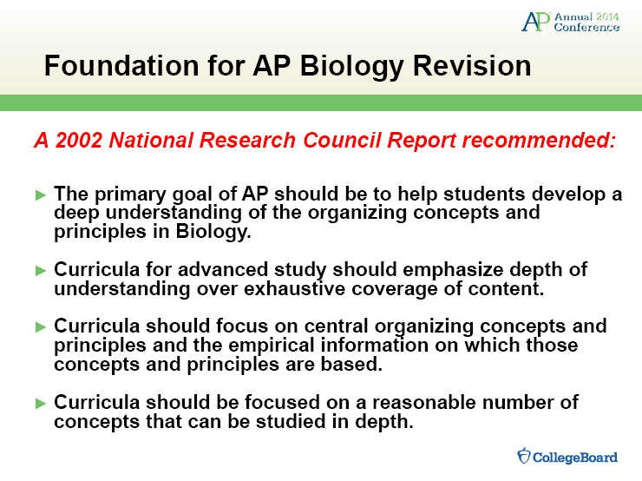

Slide 38
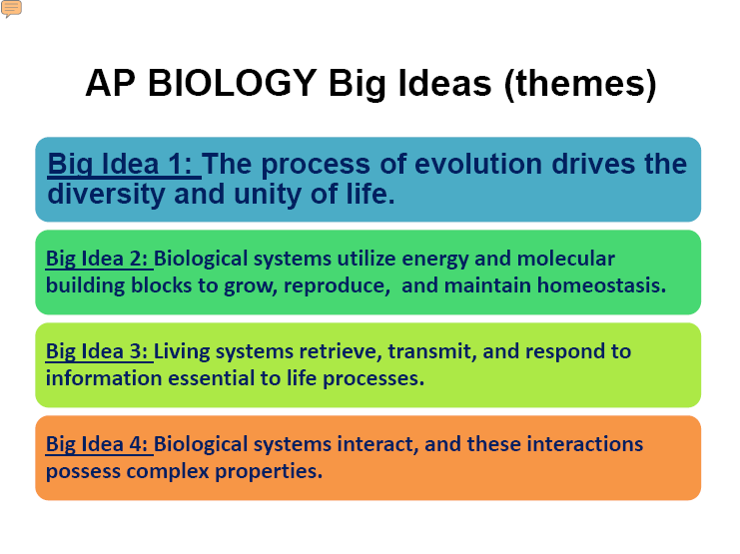

Slide 39
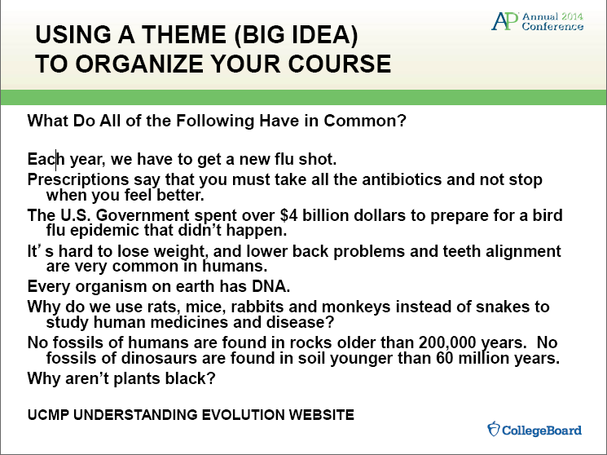

Slide 40


Slide 41
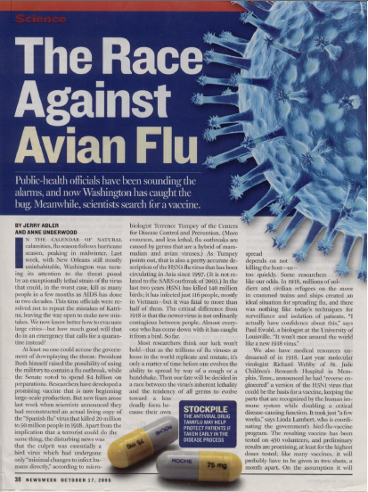

Slide 42
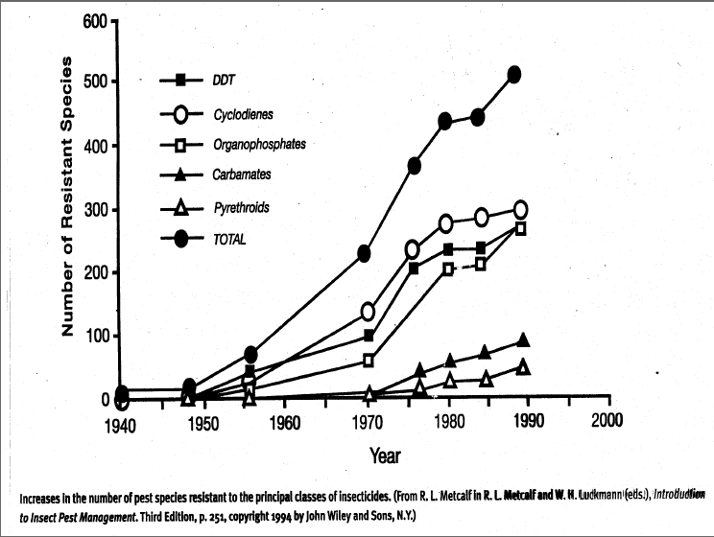

Slide 43
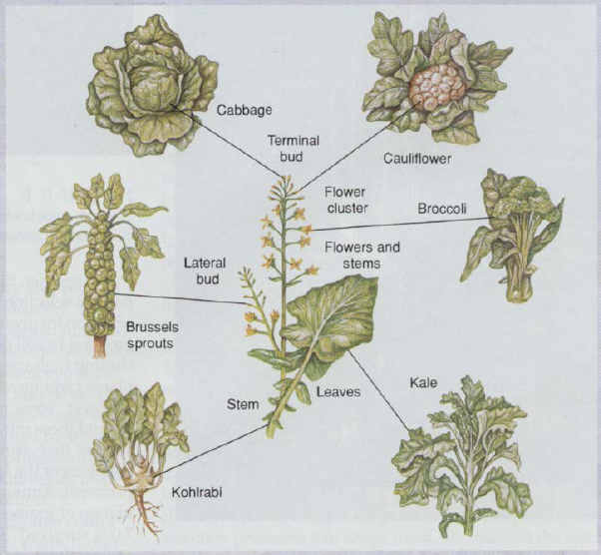

Slide 44
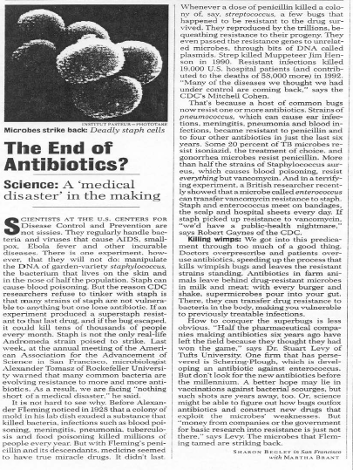

Slide 45
What was the
Common Theme?
(Big Idea)

Slide 48
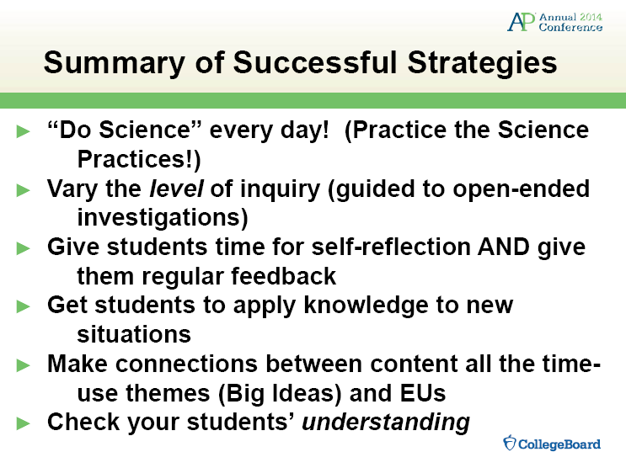

Slide 49
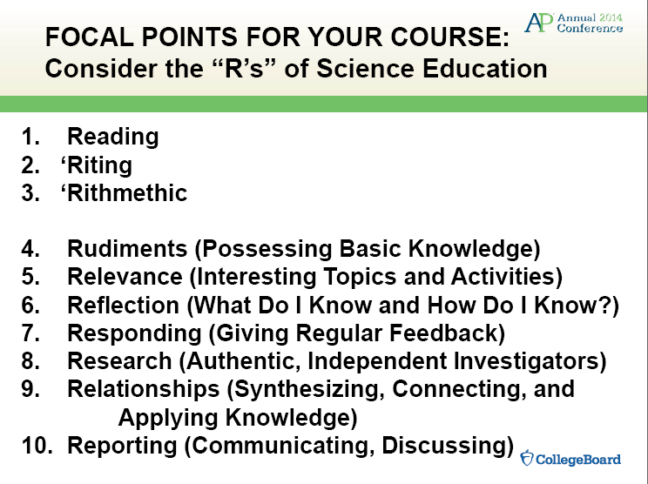

Slide 50
Unit | Essential Knowledge | Reading | Assignments | Labs | Length
1-Biochemistry Bonding Water and Buffers Organic Chemistry Macromolecules | 2.A.3, 1.D.1,2.A.3, 4.A.1, 4.C.1, 4.B.1, 3.A.1 | 3: 46-56 4: 58-63 5: 68-89 | Organic Molecules POGIL 1,3 Case Study Acids HHMI-Deep History | H₂O and Buffers Mung Beans | 4 weeks
2-The Cell Membranes and Transport Gas Exchange Prokaryotes/Eukaryote Cell Structure and Function Plant/Animal Cells Endomembrane System /Plant Transport | 2.A.3, 2.B.1, 2.B.2, 2.B.3, 4.A.2, 4.B.2 | 6:98-111 7:125-138 36:767-778 42:915-919 | Cellular Tour POGIL 4,5,2 Case Study | AP-Diffusion and Osmosis Plasmolysis Finding Stomates Transpiration Lab | 4 weeks
3-Cellular Energetics Enzymes Digestive Systems Cellular Energy: Photosynthesis & Respiration Thermal Regulation Feedbacks | 2.A.1, 2.A.2, 4.B.1 | 8:142-159 9:162-179 10:186-199 41:875-879 | Respiration Set Photosynthesis Set Mitochondria Function POGIL 6-11 Case Study | AP-Enzyme Catalysis AP-Photosynthesis AP-Cellular Respiration Yeast Fermentation Temperature on Ecothermic Organisms | 4 weeks
4-Cellular Development Cellular Communication Cell Cycle & DNA Replication Meiosis & Animal Reproduction | 2.E.1, 3.A.2, 3.B.2, 3.C.2, 3.D.2, 3.D.3 3.D.4, 3.C.3, 3.A.1 | 11:206-227 12:228-243 13:248-258 | POGIL 12, 18 Case Study | AP-Cell Division Cell Size and Regulation Chi-Square and Mitosis | 4 weeks
5-Genetics and Molecular Biology Mendel and the Gene Idea Chromosomal Basis of Inheritance Molecular Basis of Inheritance From Gene to Protein /DNA Technology | 2.E.1, 3.A.1, 3.A.2, 3.A.3, 3.A.4, 3.B.1 3.B.2, 3.C.1, 3.C.2, 3.C.3, 4.A.3, 4.C.2 4.C.4 | 13:258-260 14:262-281 15:286-302 16:305-319 17:325-346 18:351-373 19:381-390 20:396-411 | StarGenetic Simulator POGIL 14-17, 19, 20 Case Study Genetic Code Simulation | TOPS-Fly Eye Genetics TOPS-DNA Restriction TOPS-Plasmid simulation TOPS-Protein Electrophoresis AP-Molecular Biology | 4 weeks
6-Responding to the Environment Cell Signaling and Regulation Hormones Nerves and Nervous System Immune System Animal Behavior/ Feedback Loops | 2.A.1, 2.C.1, 2.C.2, 2.D.2, 2.D.3, 2.D.4 2.E.1, 2.E.2, 2.E.3, 3.B.2, 3.D.1, 3.D.2 3.E.1, 3.E.2 4.A.4, 4.B.2 | 38:801-811 39:821-847 40:852-874 43:930-951 45:975-984 47:1038-1044 48:1047-1061 51:1120-1133 | POGIL 27-32 Case Study | Cell Signaling Virtual Lab AP-Animal Behavior HHMI-Immunology Biochemical Evidence for Evolution C.elegans behavior | 4 weeks
7-Ecology Ecosystem Structure and Function Population Ecology Community Ecology Human Impact | 2.A.1, 2.D.1 2.D.2, 2.D.3 2.E.3, 4.A.5 4.A.6, 4.B.3 4.B.4, 4.C.4 | 52:1151-1159 53:1174-1195 54:1198-1219 55:1223-1242 56:1246-1264 | POGIL 25-26 Cicadas Predator Virtual Populations Case Study Butcher the Biomes | Water Cycle/Nitrogen Cycle Primary Productivity Eutrophication Owl Pellet Global Climate Change | 4 weeks
8-Evolution Darwin and Evolution Earth’s Origins Speciation Life’s History Phylogeny Biological Diversity Evolution of Populations | 1.A.1, 1.A.2 1.A.3, 1.A.4 1.B.1, 1.B.2 1.C.1, 1.C.2 1.C.3, 1.D.1 1.D.2, 2.E.1 2.E.2, 2.E.3 3.C.1, 4.B.3 4.C.3, 4.C.4 | 22:455-466 23:468-485 24:487-504 25:507-529 26:537-553 51:1133-1142 | POGIL 21-24 HHMI Geological Time Case Study National Geographic Following Humans | Population Genetics and Evolution Artificial Selection – Plants Biogeography of Lizards Phylogenetic Trees Strawfish and Hardy Weinberg AP-Natural Selection AP-BLAST | 4 weeks

