Slide 1
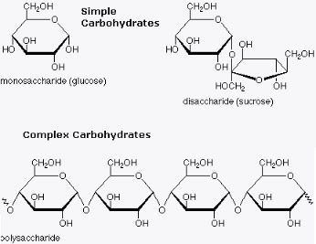
Macromolecule Matrix Presentation: Carbohydrates
Macromolecule | Definition | Function | Examples | Drawn structure
Carbohydrates -Monomer: | It is a biological molecule made up of carbon, hydrogen, and oxygen and the hydrogen to oxygen ratio is usually 2:1; the same as water. | They produce energy, store energy, build other macromolecules therefore sparing proteins, and help in lipid metabolisms | Sucrose, Lactose, Chitin, Cellulose Lactose, Lactulose, Maltose, Maltulose, Sucrose, Galactose, Glucose, Arabinose, Arabitol, Allose, Altrose , Galactosamine hydrochloride, Acetylgalactosamine
https://en.wikipedia.org/wiki/Carbohydrate
By: Matthew Yu, Alec Lourenco, Kamden Gray, Nick Samaha

Slide 2
Sucrose
Sucrose supplies the body with the energy it needs to carry out daily functions
When it is extracted from cane sugar or beet sugar and put through the bleaching process, Sucrose can be used as table sugar
It is also common additive in foods because it is an effective sweetener
It is a carbohydrate and can be found in several plants
It is a disaccharide made from both the monosaccharides glucose and fructose
The processed form of sucrose is white and has no odor or vitamins and minerals
C₁₂H₂₂O₁₁
https://en.wikipedia.org/wiki/Sucrose

Slide 3
Lactose
Disaccharide sugar derived from condensation of galactose and glucose through a 𝜷1-4 Glycosidic linkage
Makes up 2-8% of milk
Extracted from sweet or sour whey, which is a byproduct of the manufacture of cheese
Name is derived from lac or lactis, which in Latin means milk
Formula: C₁₂H₂₂O₁₁
Thus, an isomer of sucrose
Lactose crystals have a tomahawk shape that can be analyzed through a light microscope
Notes:
Click on the title for the link.

Slide 4
Chitin
Long-chain polymer derived from glucose
Component of exoskeletons, beaks, cell walls of fungi, and internal shells
Structurally similar to cellulose, and functionally similar to keratin
Forms strong crystalline nanofibrils
Found as a structural substance that can protect inner organs and prevent loss of fluids
Has applications in medicine and pharmaceuticals
https://en.wikipedia.org/wiki/Chitin

Slide 5
Cellulose
A polymer and polysaccharide made up of ß-Glucose sugars
ß-Glucose linked together through dehydration reactions to form cellulose
Examples of almost pure glucose include cotton and paper
Concentrated in the cell walls of most plants
Humans are unable to digest cellulose because we lack the necessary enzymes
Gives wood its strength along with lignin
Food additive to reduce calories consumed

