Slide 1
Macromolecules
Charlotte, Justin, Juliette and Sarah

Slide 2
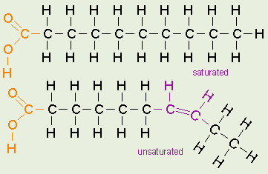
Lipid
Definition - any of a class of organic compounds that are fatty acids or their derivatives and are insoluble in water but soluble in organic solvents. They include many natural oils, waxes, and steroids.
Function - The main biological functions of lipids include signaling, storing energy, and acting as structural components of cell membranes. Lipids have applications in the cosmetic and food industries as well as in nanotechnology.

Slide 3
Saturated Fat
http://courses.washington.edu/conj/membrane/fattyacids.htm
Example: Propionic acid
Function: A saturated fat is a fat that consists of triglycerides containing only saturated fatty acids. Saturated fatty acids have no double bonds between the individual carbonatoms of the fatty acid chain. That is, the chain of carbon atoms is fully "saturated" with hydrogen atoms.
Interesting Fact about Example:
Saturated fats are found in commercial baked goods such as cookies, pies, cakes, eclairs, cupcakes, brownies and alluring pastries.
Sat-fats come from red meat marbling and the hard fat surrounding the organs of lamb, chicken and pork.

Slide 4
Unsaturated Fat
Example: Oleic Acid
Function: This plays a role in the activation of the pathways in the immune system’s competent cells as an Anti-inflammatory fatty acid. Oleic Acid also reduces the development of breast cancer, slows the development of heart disease, and improves the functionality of the heart and circulatory system.
Interesting Fact about Example: The Oleic Acid is found in Animal Tissues and also in Olive Oil. It also gives you smooth skin.

Slide 5
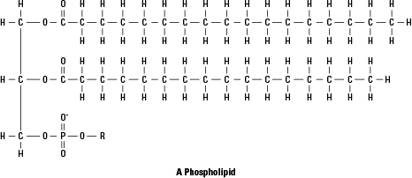
Phospholipid
Example -
Phosphatidic Acid
Function -
Phospholipids are composed of two fatty acid chains and one glycerol compound. The fatty acid chains act as the tails of the phospholipid while glycerol acts as a head. The glycerol molecule also attaches to a phosphate group, which causes that glycerol head to become hydrophilic, attracting water. This makes phospholipids both hydrophilic and hydrophobic.
Interesting Facts -
In our biological systems, the bilayer phospholipid makes up our cell membranes, allowing them to be fluid.
They can be split into separate parts that function as second messengers in cellular systems. They can stop neurons and signal antibodies and leukocytes to infected areas.
Phospholipids are found in plants and produce specific plant hormones.

Slide 6
Cholesterol
Cholesterol is an organic compound that is a member of the steroid family. It has a molecular formula of C27H46O. It is an essential molecule for life for multiple reasons. It is present in the membrane that surrounds cells and is a building block with which the body creates bile acids, steroid hormones, and vitamin D.
Cholesterol is produced in the liver within the body as well as other organs, but it is also often consumed as part of human diet. This intake helps to supplement and decrease the production levels of the compound by the liver.
Fun Facts:
-You will never get cholesterol from plants.
-Cholesterol in lotions can help protect against UV radiation.

