Slide 1
Nucleic Acids
by Luke Stefan, Maddie Braun, and Hannah Johnson

Slide 2
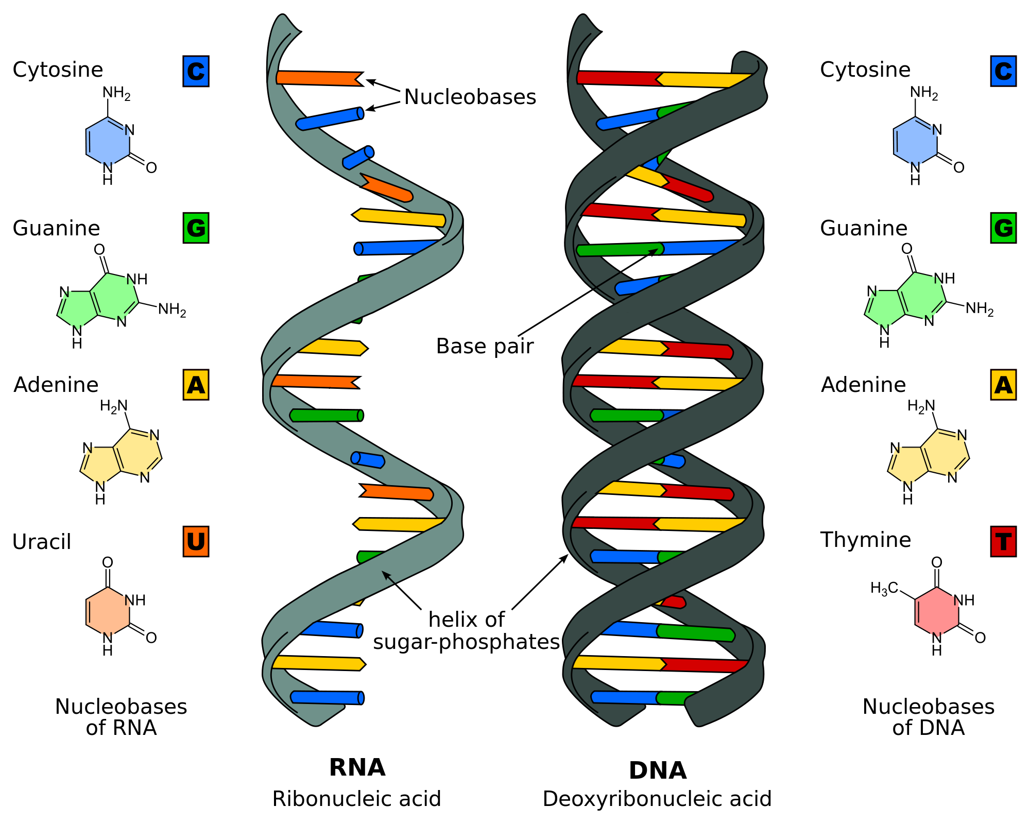
Name: Nucleic Acids
Definition: biopolymers containing genetic information that are essential to all known forms of life.

Slide 3
Nucleic Acids Cont.
Function:
Nucleic acids function as a code for genetic information.

Slide 4
DNA
Deoxyribonucleic acid chain formed in the shape of a double helix.
Made up of nucleotides, that hold biological makeup of living things, except some viruses.
Strands of coiled DNA are called chromosomes which, in humans, are inherited half from each parent.

Slide 5
DNA Fun Facts:
Because DNA is made up of the same four nucleotides, all humans share 99% of our DNA codes.
Humans and cabbage share about 40-50% common DNA.

Slide 6
RNA
Function:
Ribonucleic Acid, or RNA, is a chain of nucleotides responsible coding and decoding genetic material. RNA displays genetic information using the specific letters G, U, A, and C, which represent guanine, uracil, adenine, and cytosine.

Slide 7
RNA Facts
-RNA nucleotides each consist of phosphate, a ribose sugar, and a nitrogenous base.
-There are a few different variations of RNA: Messenger RNA (mRNA), Ribosomal RNA (rRNA), and transfer RNA (tRNA).

Slide 8
mRNA
Function:
Transporting genetic information from DNA to the ribosome, where they aid in protein production by specifying the order of amino acids.
Facts:
Described in 1956
Described by scientists Elliot Volkin and Lazarus Astrachan
mRNA is formed during transcription

