Slide 1
Macromolecule Matrix
Table 9
Period 6
Ethan C., Phillip L., Sarah B., Abigail L., Christian K., William C.

Slide 2
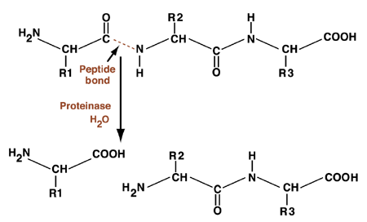
Proteins
Definition: Macromolecules made up of amino acids linked together to form polypeptides; the final structure has one or more subunits folded up into a complex shape.
Function: Proteins provide structure to cells, catalyze reactions, and help transport materials across and between cells.
http://human-anatomy101.net/wp-content/uploads/2014/08/simple-protein-molecule-structure.gif

Slide 3
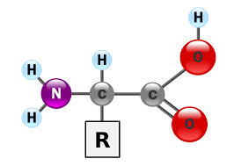
Protein Monomer: an amino acid

Slide 4
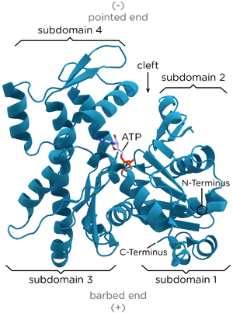
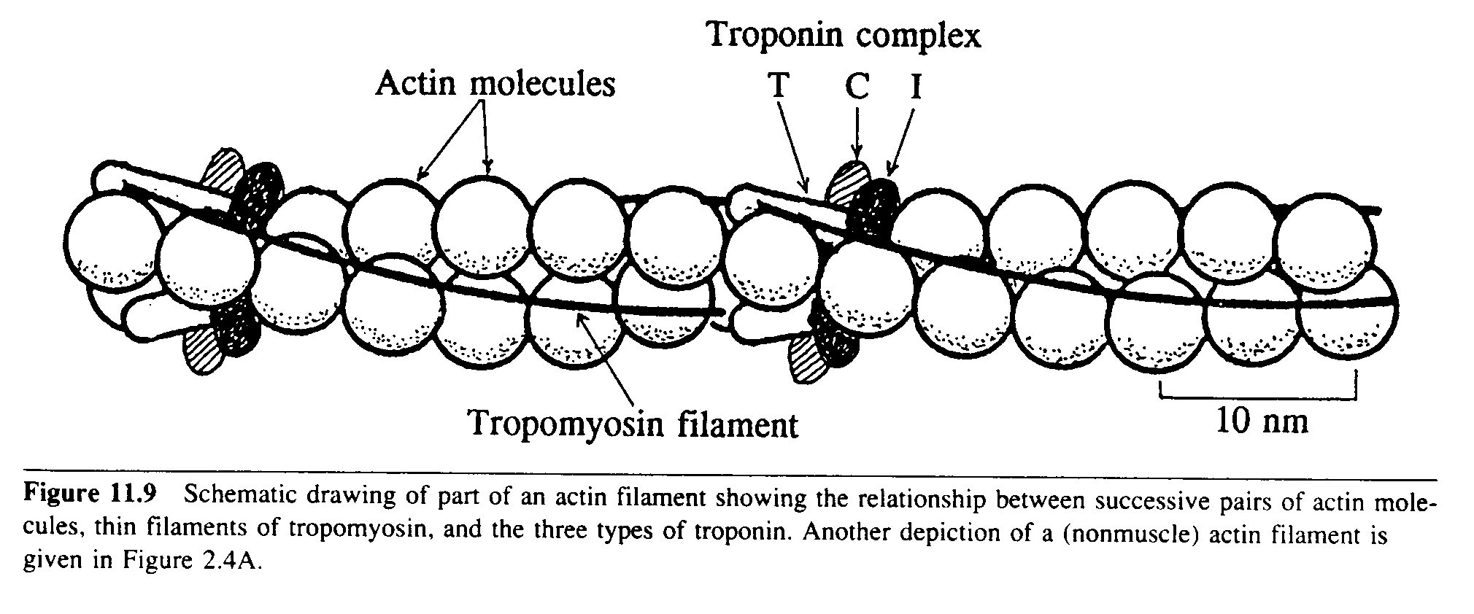
Actin

Slide 5
Actin- Definition
A microfilament, Actin is one of the three main components of the cytoskeleton of a cell. Some important functions of actin are muscle contraction, cell movement, organelle movement, cytokinesis, and cellular junction.

Slide 6
Actin Function
Actin primarily performs as contraction agent of the muscles in the body. Actin possesses two forms: g and f. Muscle contraction occurs through the use of actin because the actin switches forms to pull the muscle back. Also, actin performs as a shaping and structure agent for the cell (mostly eukaryotic). This also applies to the cell in that it controls the polarity of the cell at a certain area.

Slide 7
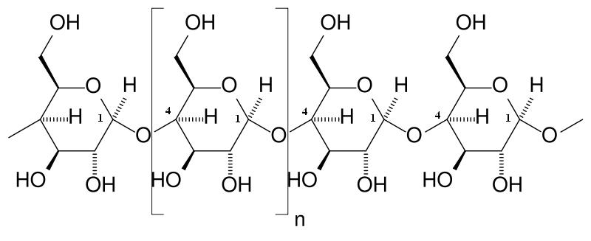
Amylase

Slide 8
Amylase - description
Definition: enzyme found mainly in saliva and pancreatic fluid
*note: salivary and pancreatic amylase are examples of alpha amylase;
there also exists beta and gamma amylase
Function: catalyzes the hydrolysis (chemical breakdown due to a reaction with water) of carbohydrates into disaccharides, and then monosaccharides such as glucose
Monomer: amino acid

Slide 9
Amylase - example
Glucoamylase:
type of digestive enzyme that breaks down starch (especially starch that occurs naturally in vegetables) by cleaving a free glucose molecule from the end of a sugar-based chain (as opposed to breaking the chains into smaller ones)
Interesting facts:
Although glucoamylase is most often produced in the mouth and pancreas, it can also be taken from non-animal sources.
When combined with other enzymes, glucoamylase has been proven to ease the effects of irritable bowel syndrome, gastrointestinal issues, some autoimmune disorders, and even food allergies.

Slide 10
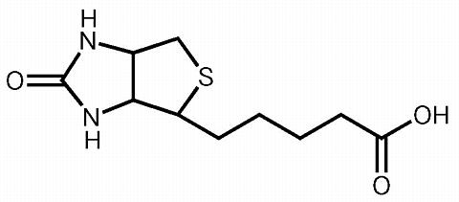
Keratin
http://www.theodora.com/drugs/images/825.jpg

Slide 11
Keratin - Function
Structural protein that strengthens fibers
Strengthens fingernails, hair, muscles, and organs
Provides protection for animals: beaks, scales, feathers, fur, quills, etc.
Keratin molecules form a tough, stable tissue in the animal’s body

Slide 12
Keratin - Interesting Facts
Covers the bones of the horns of animals such as impala (also found in hooves and claws)
Coiled helix structure formed by hydrophobic parts of keratin
Can cost up to over $100 for keratin treatment in salons for hair straightening/strengthening

Slide 13
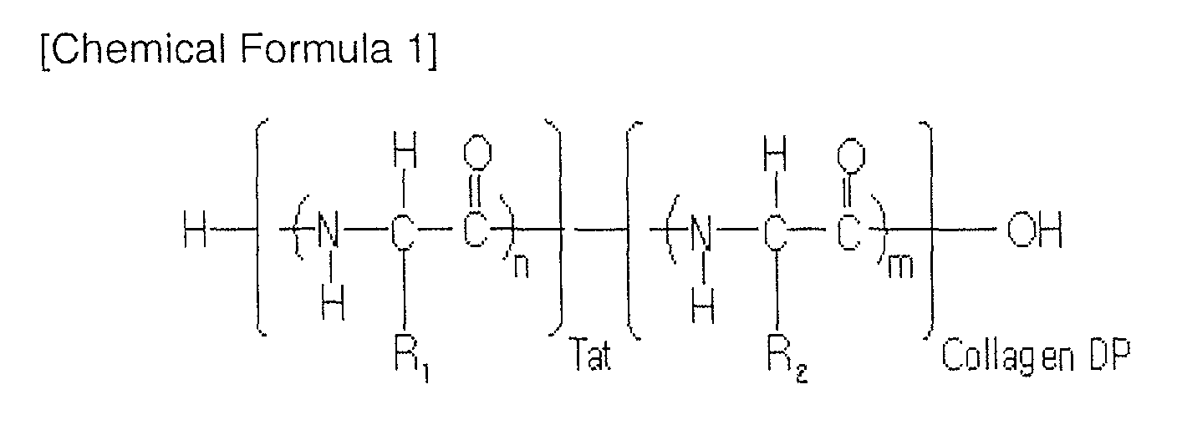
Collagen

Slide 14
Collagen
Definition- Collagen is the main structural protein tends to be found in the connective tissue of animals
Function: Collagen acts as a “glue” for animal bodies as it supports muscles, bone structure, tendons, ligaments, etc.
Monomer: Tropocollagen, a subunit for making collagen chains

Slide 15
Collagen examples
Type I Collagen: The most abundant type of collagen found in animal bodies. It is present in scar tissue when it heals.
Type II Collagen: basis for articular and hyaline cartilage
Type III Collagen: This collagen is found primarily in bones, marrow, and other connective tissue. This yields gelatin when it is boiled.

Slide 16
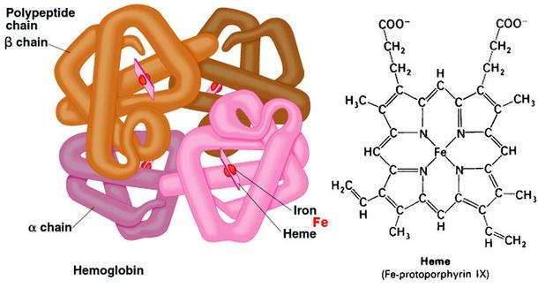
Hemoglobin

Slide 17
Hemoglobin
Definition: A protein that is responsible for the transport of oxygen in the bloodstream of vertebrates.
Function: to transport oxygen to cells
Monomer: none, but it is made of two dimers connected by an oxygen

Slide 18
Hemoglobin Examples
Myoglobin: A protein related to hemoglobin that is primarily found in muscle tissue of almost all mammals.
Hemocyanin: Also related to hemoglobin, this protein transports oxygen in invertebrates.
Hemerythrin: Transports oxygen in marine invertebrate phyla and other like organisms.

Slide 19
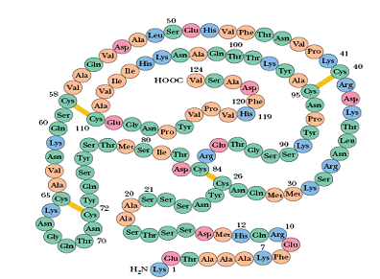
Lysozyme

Slide 20
Lysozyme
Definition- Antimicrobial enzyme in many bodily fluids of animals, i.e. egg whites, blood, tears, milk, and saliva.
Function- It kills bacteria by breaking down a part of the cell wall. The large groove in the protein binds to chitodextrins (carbohydrates) in the cell wall, causing the bonds between the saccharides to break, and it then catalyzes the hydrolysis of these molecules.
Interesting fact: It was one of the first proteins to be “solved” (scientists understood the structure)
Monomer- An amino acid

Slide 21
Bibliography
Protein monomer
http://www.google.com/imgres?imgurl=https://upload.wikimedia.org/wikipedia/commons/thumb/c/ce/AminoAcidball.svg/2000px-AminoAcidball.svg.png&imgrefurl=https://en.wikipedia.org/wiki/Amino_acid&h=1425&w=2000&tbnid=h1RrnGYHjdIGHM:&docid=3WKjYI4X6q4buM&ei=JC7aVY_iK4uWNp3-g7AF&tbm=isch&ved=0CDIQMygBMAFqFQoTCI-E39SGwMcCFQuLDQodHf8AVg
Amylase
http://www.globalhealingcenter.com/natural-health/glucoamylase/
http://www.enzymeessentials.com/HTML/amylase.html
http://science.marshall.edu/murraye/images/amylose.JPG
https://en.wikipedia.org/wiki/Actin
http://www.ncbi.nlm.nih.gov/pubmed/21314430
Lysozyme
https://www.google.com/url?sa=i&rct=j&q=&esrc=s&source=images&cd=&cad=rja&uact=8&ved=0CAcQjRxqFQoTCPXE3vyruccCFQOGDQodNjEBWQ&url=http%3A%2F%2Fwww.tutorhelpdesk.com%2Fhomeworkhelp%2FBiology-%2FStructure-Of-Enzymes-Assignment-Help.html&ei=vqnWVfXtIIOMNrbihMgF&psig=AFQjCNGtoZuYZ3G9zR8mihwt7ne7XJyAkA&ust=1440217898489778

