Slide 1
Team Lipid!
By: Harry Lee, Andy Kim, Lauren Chong
AP Biology, period 6

Slide 2
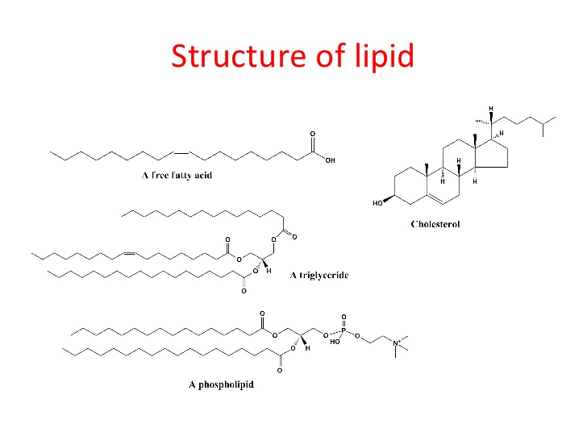
Lipid
Lipid: a group of naturally occurring molecules that include fats, waxes, sterols, fat-soluble vitamins, monoglycerides, diglycerides, triglycerides, phospholipids, and others
Lipids store energy, act as structural components of cell membranes
Monomers:
Carbohydrates - monosaccharides.
Lipids - glycerol and fatty acids.
Nucleic acids - nucleotides.
Proteins - amino acids.

Slide 3
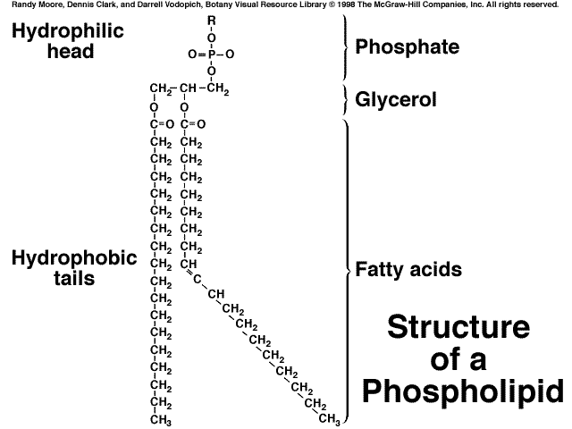
Phospholipid
Phospholipid: a class of lipids that play a major role of all cell membranes as they form cell layers.
Phospholipids form the phospholipid cell membranes that surround the cell and intracellular organelles.
Phospholipid monomers include two fatty acids and one glycerol molecule in a structure

Slide 4
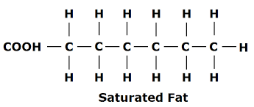
Saturated Fat
Saturated Fat: A fat that contains only saturated fatty acids, comes primarily from animal food products, and is solid at room temperature.
Saturated fat increases blood cholesterol levels.
Glycerol and fatty acids are the monomers of lipids.

Slide 5
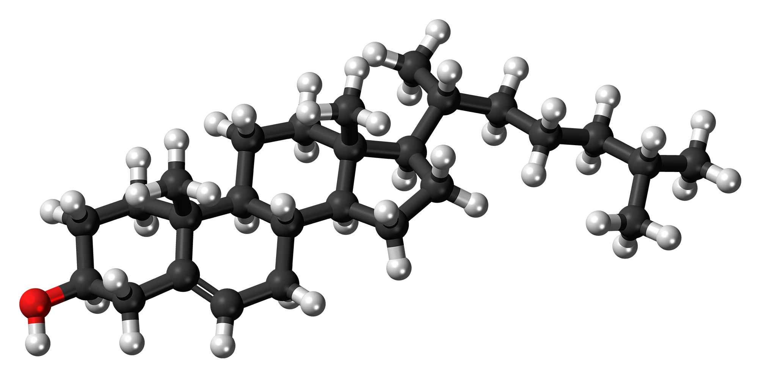
Cholesterol
An organic sterol that is biosynthesised by all animal cells
Enables animal cells to not need cell walls and serves as a precursor for the synthesis of steroids, bile acids, and vitamin D.
Acts as a monomer for other molecules.

