Slide 1
Carbohydrates
Mary M., Lyndsay S., Rachel L., Deborah Y.

Slide 2
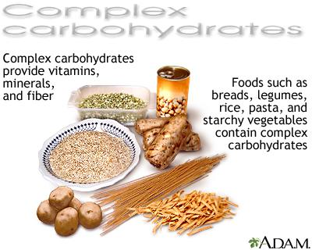
General Characteristics
-one of the three macronutrients (other two are proteins and fat)
-most abundant class of organic compounds found in living organisms
-originates as projects of photosynthesis
-range from simple with 1 or 2 sugar molecules, to complex carbohydrates with hundreds of molecules linked together
-disaccharides and polysaccharides linked by glycosidic linkage, which are covalent bonds created by dehydration
- glycosidic linkage has two types
-beta= hydroxyl group attached above carbon ring
-alpha= hydroxyl group attached below carbon ring

Slide 3
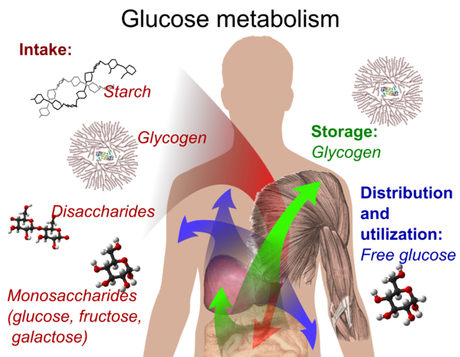
Functions
-Major source of metabolic energy for both plants and animals
-Serve as structural support for plant and bacteria cell walls
-Component of ATP
-One of the essential components of DNA and RNA
-Provide fuel for central nervous system
-Source of energy for muscle contraction
Carbohydrates in relation to the human body.

Slide 4
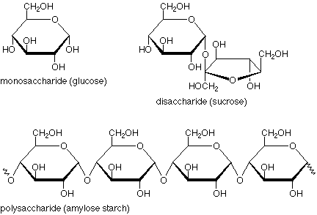
General Structure
-begin as molecules of sugar
-each molecule has a hydrogen and oxygen attached to the carbon in different locations
-steroisomerism-different positions of these atoms
-allows for different sugars while still retaining the molecular fomrula
-have chains of different lengths and can also have different orientation
-some chains can be straight and even
-others can be branched off in many directions

Slide 5
Important Reactions
Oxidation: Converts carbohydrates to carboxylic acids (known as reducing/non-reducing sugars)
Reduction: Makes ends of alditol chain identical
Osazone formation: Used to analyze aldose sugars that differ at the alpha-carbon in configuration
Chain shortening/lengthening: allow aldoses of fixed sizes to be correlated with homologous smaller and larger aldoses

Slide 6
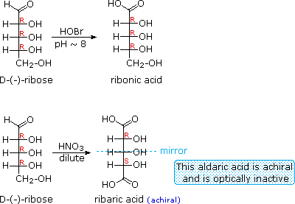
Important Reactions (cont.)
Oxidation Reduction
Derivatives of HOCH₂(CHOH)_{n}CHO
HOBr Oxidation | ——> | HOCH₂(CHOH)_{n}CO₂H an Aldonic Acid
HNO₃ Oxidation | ——> | H₂OC(CHOH)_{n}CO₂H an Aldaric Acid
NaBH₄ Reduction | ——> | HOCH₂(CHOH)_{n}CH₂OH an Alditol

Slide 7
Important Reactions (cont.)
Osazone Formation
Chain Shortening and Lengthening

Slide 8
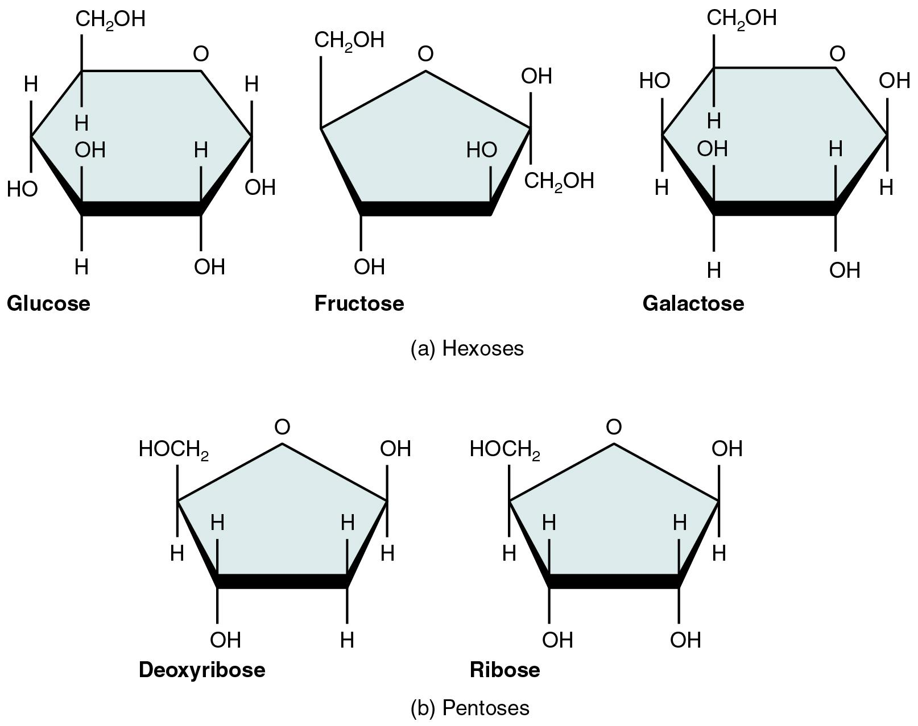
Monosaccharides
most basic unit of carbohydrates and simplest form of sugar
building blocks of disaccharides and polysaccharides
carbon atoms within that support a hydroxyl group increase number of isomeric forms

Slide 9
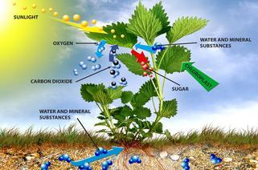
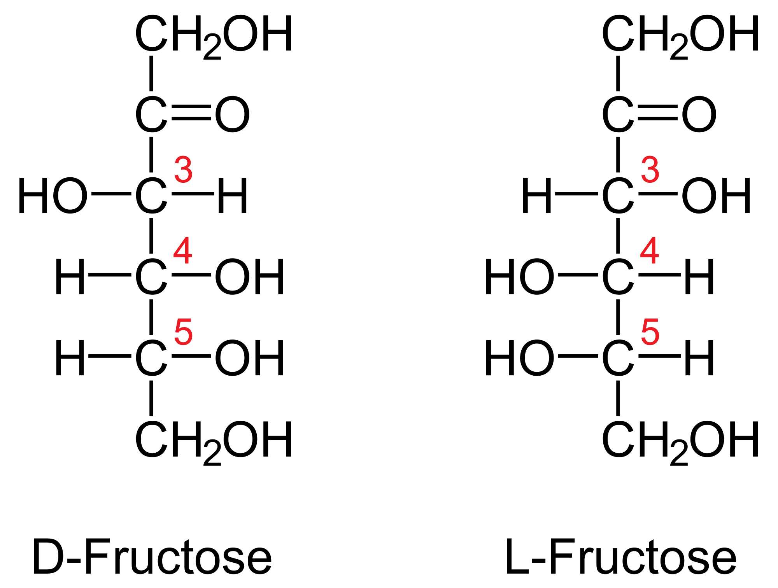
Monosaccharides Examples
Glucose: a sugar made during photosynthesis by water, carbon dioxide, and energy from the Sun
vital source of energy for cellular respiration and human body
stored as polymer (starch in plants and glycogen in animals)
used in aerobic and anaerobic respiration and fermentation
Fructose: simple ketonic monosaccharide found in plants
absorbed directly into bloodstream when digested
anaerobically fermented by yeast/bacteria to make ethanol and carbon dioxide
more soluble than other sugars and alcohols

Slide 10
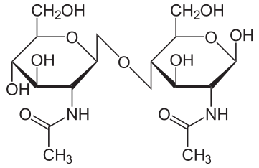
Disaccharides
-Any substance that is composed of two molecules of simple sugars
-Crystalline
-Water soluble
-Major three disaccharides:
-Sucrose (Formed through photosynthesis)
-Lactose (Found in the milk of all animals)
-Maltose (Product of the breakdown of starches during digestion)

Slide 11
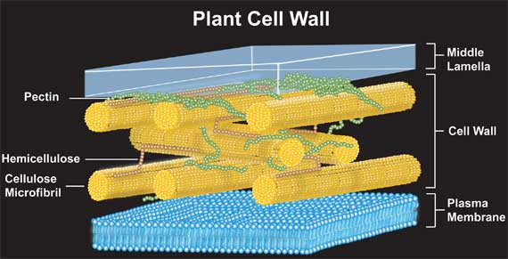
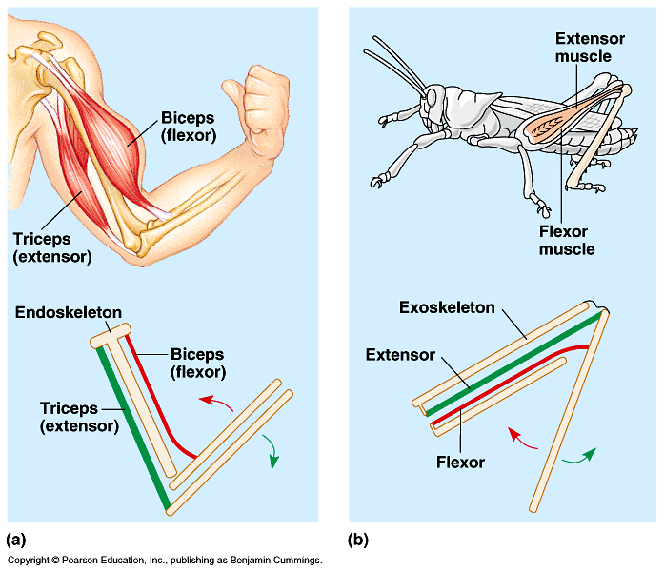
Polysaccharides (Structural Type)
compound sugars that yield more than 10 molecules of monosaccharides after hydrolysis
major component in cell walls of plants and bacteria
cellulose
a polymer of glucose
major component in plant cell walls
1-4 beta glycosidic linkages
straight formation allows for parallel linkage between cellulose molecules
cannot be digested by many enzymes
chitlin
used to build exoskeletons of arthropods

Slide 12
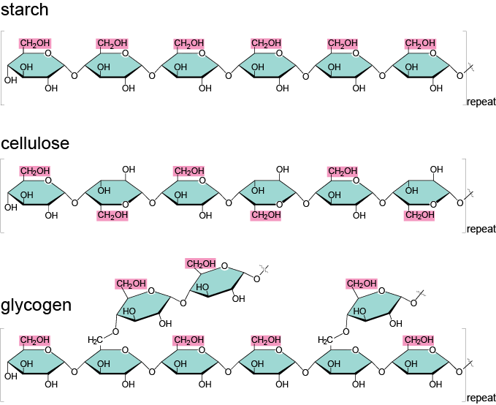
Polysaccharides (Storage Type)
-any polysaccharide functions as a form stored energy in living organisms
-include starch, phytoglycogen, fructosans in plants, and glycogen animals

Slide 13
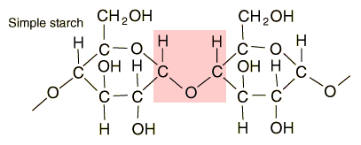
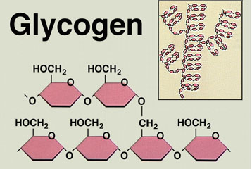
Polysaccharides Examples
- Starches-glucose polymers with glucopyranose units are bonded by alpha-linkages
-also has both amylose and amylopectin of glucose linked by alpha bonds
-the formation of starches are the way plants store glucose
-insoluble in water
-digested by enzymes by amylases in hydrolysis in humans and other animals
-potato, rice, wheat, and maize are major sources of starch in human diet
- Glycogen-principal storage form of glucose in animal cells
-a highly branched polymer of about 30,000 glucose residues
-has one reducing end and a large number of non-reducing ends with a free hydroxyl group at carbon-4
-the branches of glycogen increase the solubility of glycogen

Slide 14
Bibliography
https://www2.chemistry.msu.edu/faculty/reusch/VirtTxtJml/carbhyd.htm
http://www.livestrong.com/article/366208-what-are-the-characteristics-of-carbohydrates/
http://www.livestrong.com/article/323401-what-are-the-properties-of-carbohydrates/
http://www.oxfordreference.com/view/10.1093/oi/authority.20110803100535270
http://biology.tutorvista.com/biomolecules/carbohydrates.html
http://www.chem.ucalgary.ca/courses/351/Carey5th/Ch25/ch25-5-4.html
http://www.newworldencyclopedia.org/entry/Polysaccharide#Storage_polysaccharides
https://en.wikipedia.org/wiki/Monosaccharide
http://www.course-notes.org/Biology/Outlines/Chapter_5_The_Structure_and_Function_of_Macromolecules
http://www.extension.iastate.edu/humansciences/content/carbohydrate
http://www.britannica.com/science/disaccharide

Slide 15
Bibliography (Photos)
https://www.nlm.nih.gov/medlineplus/ency/images/ency/fullsize/19529.jpg
http://www.precisionnutrition.com/wordpress/wp-content/uploads/2009/02/1feb23.gif
https://www.google.com/search?q=cellulose+in+cell+walls&rlz=1CALEAC_enUS654&espv=2&biw=1366&bih=657&source=lnms&tbm=isch&sa=X&ved=0CAYQ_AUoAWoVChMIkZLDjI24xwIVgT6ICh28LQob&safe=active&ssui=on#imgrc=OfDf4u_ThSCN4M%3A
http://www.zo.utexas.edu/faculty/sjasper/images/49.30.gif
https://upload.wikimedia.org/wikipedia/commons/thumb/c/ce/Chitobiose.svg/361px-Chitobiose.svg.png
https://abhsscience.wikispaces.com/file/view/photosynthesis.jpg/391630736/321x212/photosynthesis.jpg
https://www2.chemistry.msu.edu/faculty/reusch/VirtTxtJml/carbhyd.htm
https://classconnection.s3.amazonaws.com/773/flashcards/3102773/jpg/217_five_important_monosaccharides-01-14813CE6F417199934E.jpg
http://hyperphysics.phy-astr.gsu.edu/hbase/organic/imgorg/starch.gif
http://www.chemistryland.com/ElementarySchool/BuildingBlocks/GlycogenForms.jpg
https://upload.wikimedia.org/wikipedia/commons/thumb/4/4c/Glucose_metabolism.png/600px-Glucose_metabolism.png

