Slide 1
Lipids
Hannah Chong, Sharyse Watanabe, Julia Liu
Christina Shimoda, Sarah Rhee

Slide 2
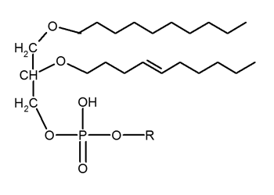
Lipids
A group of naturally occurring hydrophobic molecules
include fats, waxes, sterols, fat-soluble vitamins, phospholipids and others
Main function of lipids
Storing Energy
Signaling
Structural component of cell membranes
Monomers of lipids
glycerol
fatty acids

Slide 3
Saturated Fats
Function: Increases blood cholesterol levels
Facts: 1) solid at room temperature
2) no double bonds
3) “saturated” of hydrogen bonds
4) majority of saturated fats come from
animal products ex. meat

Slide 4
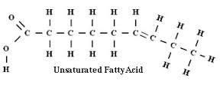
Unsaturated Fats
triglyceride with at least one unsaturated fatty acid
Function: supplies energy and maintains bodily functions
Facts: 1) One of three nutrients (with protein and carbohydrates
2) Two types of healthy fats: monounsaturated and polyunsaturated
3) Omega-3, a polyunsaturated fat, lowers blood pressure and risk of heart disease

Slide 5
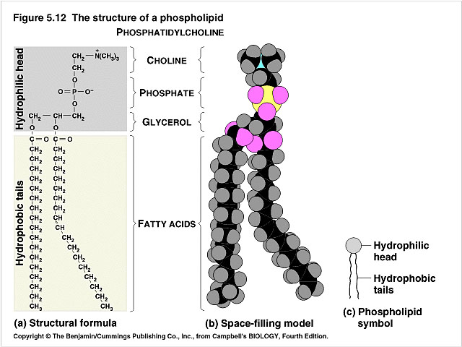
Phospholipids
A phospholipid is any of the compounds that include fatty acids, a phosphate group and a simple molecule of glycerol
The most important function of the phospholipids is to form the phospholipid bilayer that makes up all cell membranes.
The cell membrane must be flexible and plays an important role in allowing materials in and out of the cell membrane
A monomer of a phospholipid includes two fatty acids attached to one glycerol to form a diglycerides

Slide 6
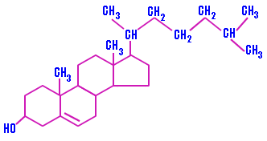
Cholesterol
A waxy substance that comes from two sources: your body and food.
used for structure and fluidity in cell membranes.
compound found in most body tissues.

Slide 7
Steroids
Steroids are considered lipids because they are hydrophobic and insoluble in water but they are different structurally
Roles
Reproduction
Absorption
Metabolism regulation
Brain activity
Steroids that are used for athletic purposes are called anabolic steroids and are related to male testosterone

Slide 8
Works Cited
https://en.wikipedia.org/wiki/Lipid
http://chemistry.tutorvista.com/biochemistry/cholesterol-structure.html
http://upload.wikimedia.org/wikipedia/commons/8/81/Ether_lipid.png
https://www.boundless.com/biology/textbooks/boundless-biology-textbook/biological-macromolecules-3/lipids-55/steroids-301-11434/
http://www.drugabuse.gov/publications/research-reports/anabolic-steroid-abuse/what-are-anabolic-steroids
http://www.heart.org/HEARTORG/GettingHealthy/NutritionCenter/HealthyEating/Saturated-Fats_UCM_301110_Article.jsp
http://iws.collin.edu/biopage/faculty/mcculloch/1406/outlines/chapter%208/5-12.jpg
http://dictionary.reference.com/browse/phospholipid
http://time.com/96626/6-facts-about-saturated-fat-that-will-astound-you/

