Slide 1
Nucleic Acids
William Fu, Chris Motia, Albert Zhai, Woojoo Jung

Slide 2
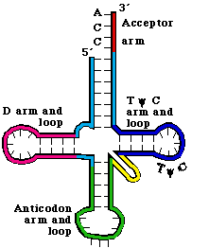
t.R.N.A.
-Transfer R.N.A that bonds using the anticodon loop to read messenger R.N.A
- TRNA brings protein subunits (amino acids) to the ribosome, where proteins are constructed.
-4 Nucleotides: Adenine, Guanine, Uracil, Cytosine.
http://www.uic.edu/classes/bios/bios100/lecturesf04am/tRNA.gif

Slide 3
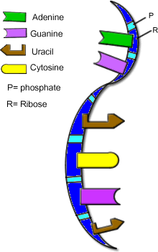
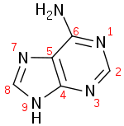
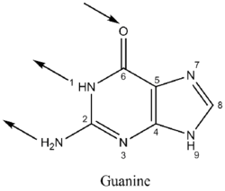
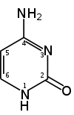
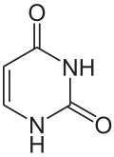
m.R.N.A. (messenger)
-The result of DNA splitting into two strands and then being processed in the nucleus.
-Its function is to transfer genetic data, which tells the amino acids sequences of proteins. from the DNA to the ribosome.
-4 Nucleotides: Adenine, Guanine, Uracil, Cytosine.
http://www.biologycorner.com/bio2/genetics/notes_DNA.html
Adenine >A purine nucleobase and pairs with U. >Forms ATP with phosphate and ribose. | Guanine >The other purine nucleobase. >Easily hydrolyzed and oxidized.
Cytosine >Cofactor of enzymes and ATP. >Pyrimidine derived, pairs with G. | Uracil >Demethylated form of DNA’s thymine. >Helps synthesize many enzymes.

Slide 4
Macromolecule: Macro-questions!
A macromolecule is a big molecule made of smaller molecules and atoms. How do smaller molecules make up larger molecules? What keeps them together? How do they fit together?
A lot of these macromolecules, like proteins made from a lot of amino acids, stick together by peptide bonds. For the example of protein, the peptide bond is created when two amino acids bond covalently and release a water molecule. The covalent bonding keeps them together, but a lot of them have polar branches so they will attract with each other and fold in different shapes. It will form primary, secondary, and tertiary structures through attractions like the hydrogen bonds. For nucleic acids, they are just pieces held together by bonding, with a sugar, phosphate, and a nitrogen base. To stick together like A-T and G-C, they use attractions between the nitrogen bases to attach.
The four primary macromolecules of life work together in living organisms just like cells do. How do you think these molecules would work together to complete a function in the human body? For example, how are carbohydrates, lipids, and proteins related to metabolism? Homeostasis?
The four primary macromolecules either provide energy or the building blocks or both for most of the processes in the human body. Carbohydrates provide energy by getting processed into sugar through metabolism and also used to power metabolism, the fats give us amino acids and fatty acids, which are used to make proteins and enzymes to use for metabolism.
Every molecule and macromolecule has a unique shape. Some are long like lipids; others are huge and branch in every direction like proteins. How does the shape of a macromolecule relate to its function?
Based on the structure, the macromolecule would have different reactions with different molecules. For example, in each base in the DNA, the phosphate and sugar creates a good backbone for DNA to link together while the nitrogen bases that stick out allow for attractions between purine and pyrimidine structures to allow the DNA to zip up. Also, a lot of enzymes have an indentation in their structure to catch molecules to allow them to stay in position for quicker reactions.
How and why are the shapes of the macromolecules determined? Macromolecules are usually shaped depending on how the bonds are connected and the order in which the amino acids are connected. The shapes are determined by how each individual amino acid interacts with each other through molecular forces. For the example of protein, many different protein structures (tertiary, primary, secondary) can be formed, like flat sheets, spherical clusters, etc. The shapes are so important because it determines their function.

