Slide 1
Nucleic Acids
Kyle Kevorkian, Aslan Ahmed, Graham Paull, and David Gee

Slide 2
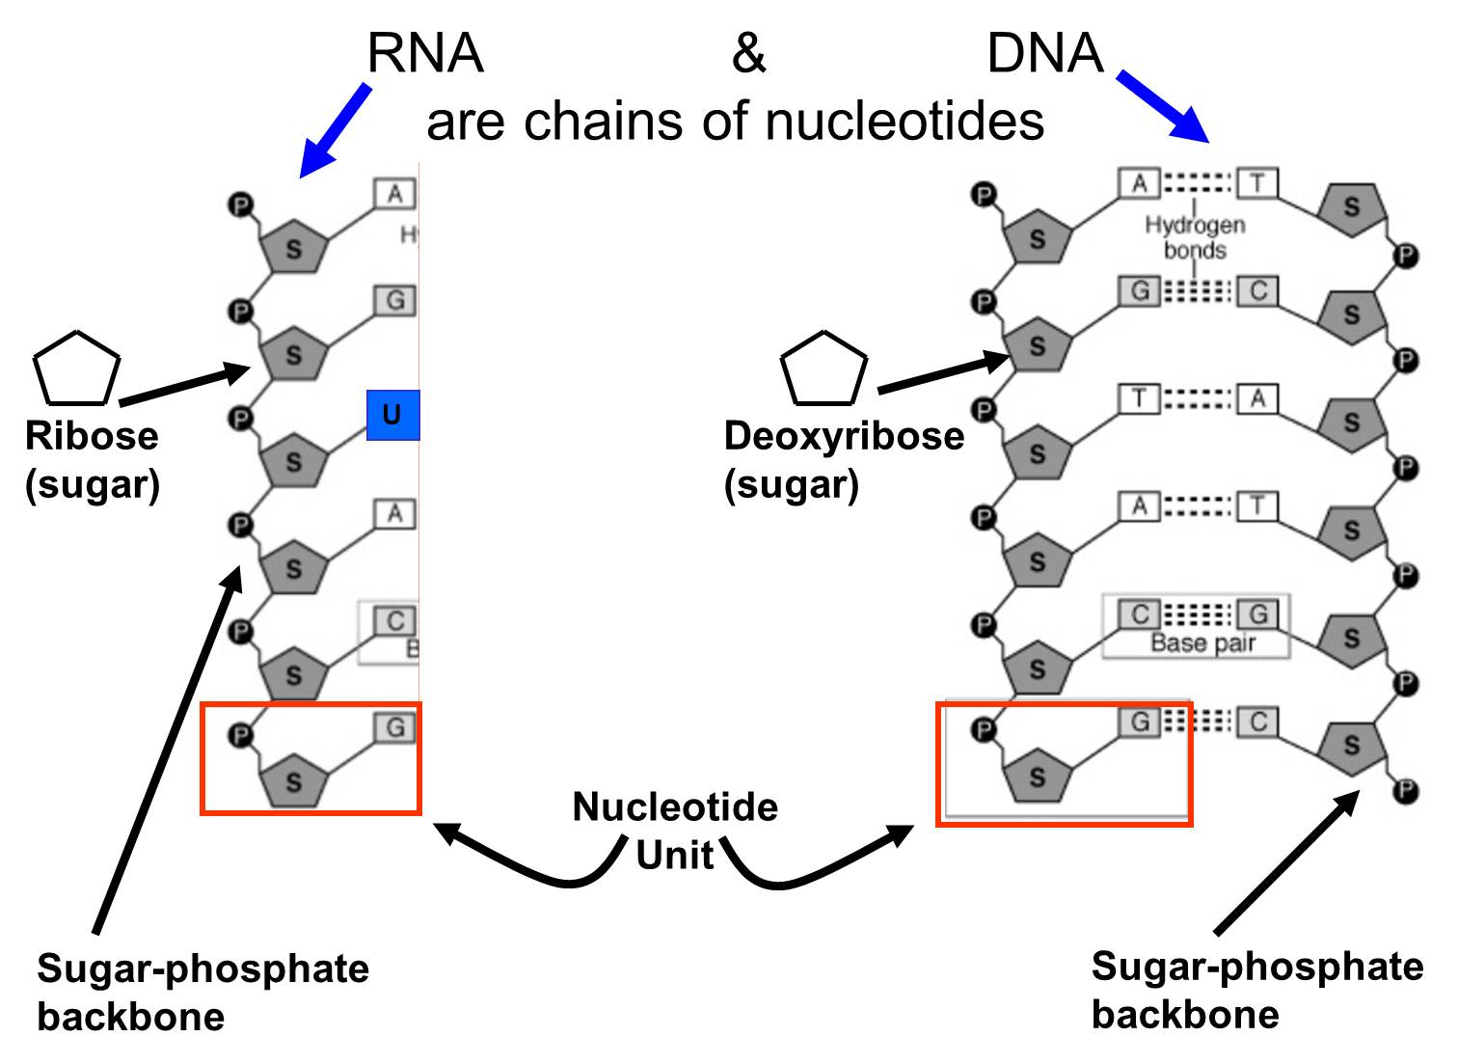
General Nucleic Acids
Definition and Monomer: Nucleic acids are macromolecules which are abundant in living creatures. They are biopolymers composed of monomers called nucleotides, which contain a 5-Carbon sugar, phosphate group, and nitrogenous base.
Function: Nucleic acids are one of the most important macromolecules, as they function in living organisms in encoding, transmitting, and expressing genetic information. Nucleic acids are the mechanisms for storing and transmitting hereditary information via protein synthesis.
General Structure:

Slide 3
Example: DNA
Function: DNA is a nucleic acid which contains most of the genetic instructions used in the development, functioning, and reproducing of organisms. It is vital because it determines the genetic background of the organism as well as that of its offspring as it reproduces.
Facts: The DNA backbone is resistant to cleavage, and both strands of the double-stranded structure store the same biological information. Biological information is replicated as the two strands are separated. DNA in cells are organized inside long chromosomes. It is during cell division that the DNA molecules are separated and replicated. The sequence of the four nucleobases of DNA determine the genetic makeup of the individual organsim.

Slide 4
Example: RNA
Function: RNA is a nucleic acid used in organisms in coding, decoding, regulating, and expressing genes. RNA also is used in cells by catalyzing biological reactions, controlling gene expression, or sensing and responding to cellular signals.
Facts: RNA, unlike DNA, is more often found in nature as a single-strand folded onto itself, rather than a paired double-strand. RNA also has several variations which serve various tasks in organisms, messenger RNA (mRNA) and transfer RNA (tRNA). The thymine in DNA is replaced with uracil in RNA

Slide 5
Example: tRNA
Function: tRNA is a type of RNA molecule that helps decode a messenger RNA (mRNA) sequence into protein. The molecule functions at specific sites in the ribosome during translation, which is a process that synthesizes protein from a mRNA molecule.
Facts: Each tRNA is transcribed from a different gene but the tRNA genes are clustered in the genome of some organisms. These clusters of genes are transcribed as a single unit, which results in the production of one large precursors RNA molecule.

Slide 6
Example: mRNA
Function: Messenger RNA (mRNA) is a large family of RNA molecules that convey genetic information from DNA to the ribosome, where they specify the amino acid sequence of the protein products of gene expression.
Facts: Each molecule of mRNA encodes the information for one protein with each sequence of three nitrogen-containing bases in the mRNA specifying the incorporation of a particular amino acid within the protein, The molecules are transported through the nuclear envelope into the cytoplasm, where they are translated by the rRNA ribosomes.

