Slide 1
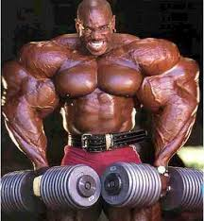
Proteins (MUSCLES!!!!!!!!!! And other functions)
by Eddie Tian, Alec Vartanians, Ali Sahimi, Alek Lichucki

Slide 2
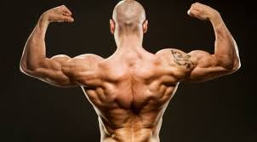
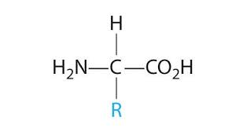
General Protein
Definition: Nitrogenous
compound chain composed
of sequences of linking
amino acids.

Slide 3
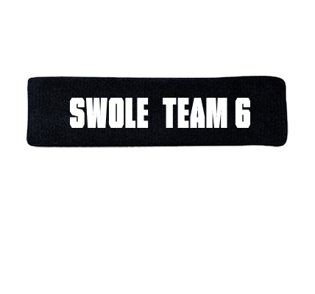
Protein Functions
Antibodies: Protects the body from foreign threats
and diseases
Contractile Proteins: Responsible for movement
Enzymes: Responsible for facilitating and
speeding up chemical reactions
Structural: Form hair, nails, and other parts and also contribute to the structure of the body
Transport Proteins: Carries other molecules to parts of the body such as hemoglobin
Storage: stores amino acids

Slide 4
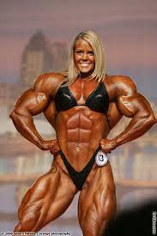
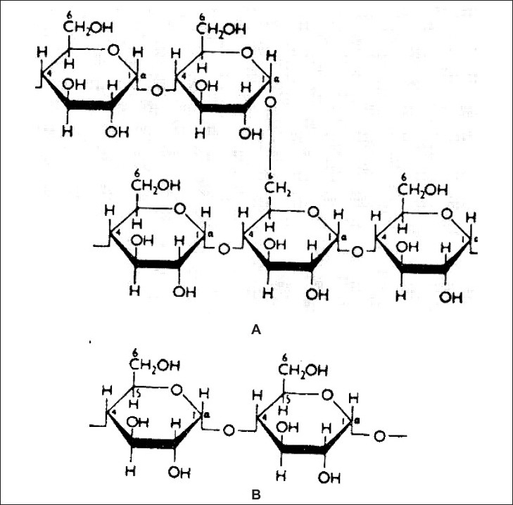
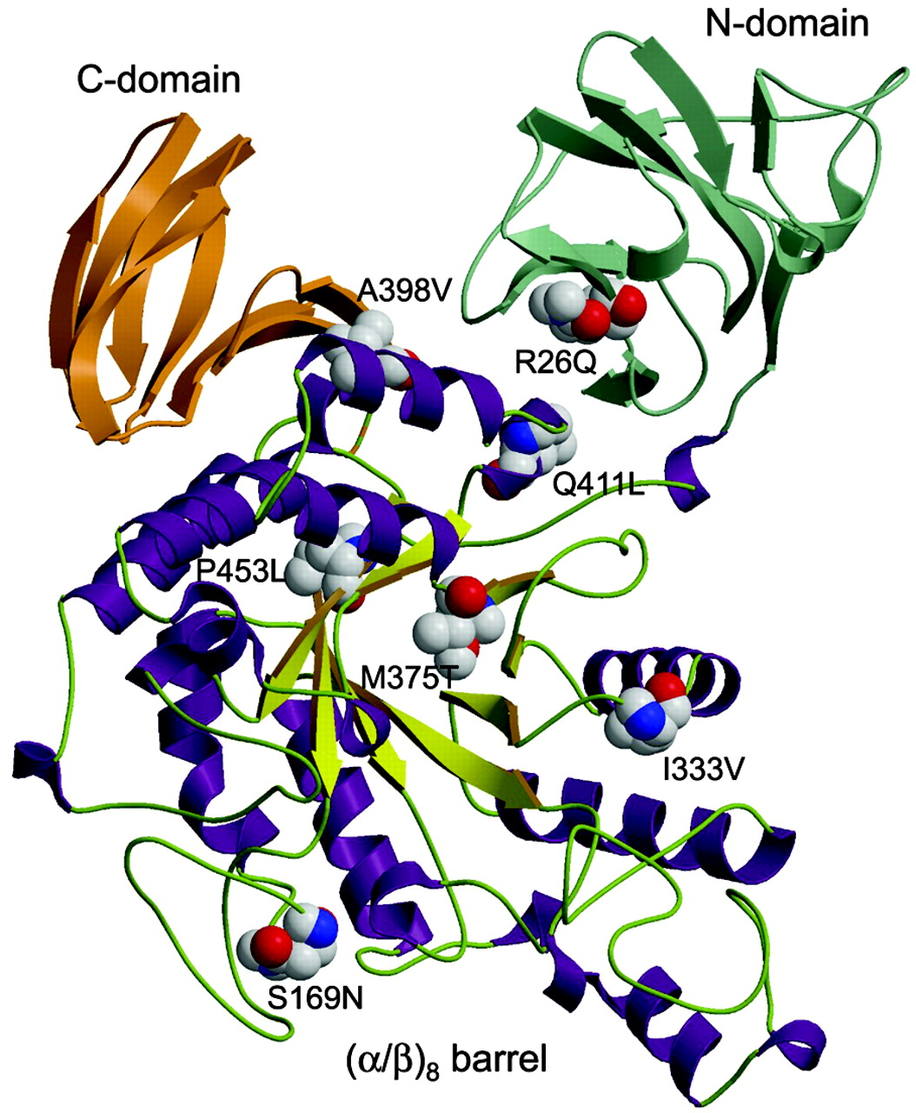
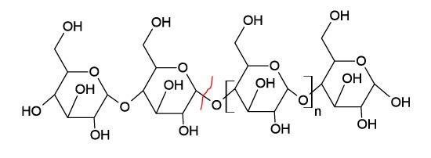
Amylase
Amy ---------->
Enzyme used to break down complex sugars into more simpler ones during digestion
Amylase levels can be viewed in the bloodstream to monitor diseases and damage to the digestive system such as liver and intestines.
Two types: Pancreatic and Alpha
Alpha found in saliva and is used in mouth while pancreatic is released into intestines.

Slide 5
Actin
Actin is a multifunctional protein that forms microfilaments. Found in all eukaryotic cells, except one. It participates in my important processes including muscle contractions, cell division, cell cytokinesis, establishing and maintaining cell shape. Actin participates in the most protein to protein interactions. Actin is the main building block of cytoskeleton.

Slide 6
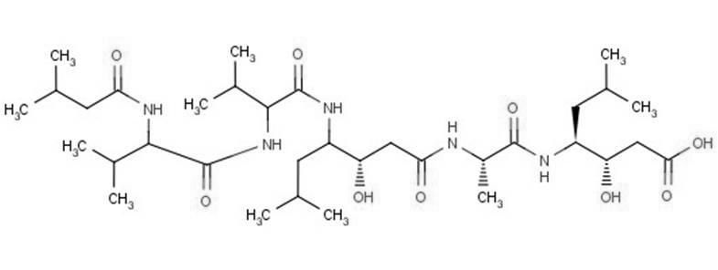
Pepsin
This is an enzyme that is found in the stomach that breaks down proteins and turns them into polypeptides.
Facts:
-This is one of the three main enzymes present in the digestive system
-This helps break down proteins to just amino acids and peptides
-This is an enzyme that helps break down proteins
-Pepsin is made in the stomach lining, but in an inactive form
-Pepsin is only active between a pH of 1.5-2.5
Chemical Structure -------->

Slide 7
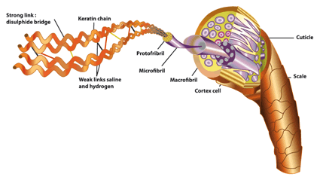
Keratin
Keratin is a protein that serves as structure to tissues. It is found in the mammalian hair and nails.
The protein derives its durability from its format. It twists into coils termed alpha helices which maintain their rigidity with the use of disulphide bonds. The disulphide bonds are those that allow keratinous to maintain their structure so well. Hair that is straightened must first be treated with chemicals to break the disulphide bonds.
Keratin forms from a base of skin or bone. Human nails, for example, are based in the skin.
Unfortunately, keratin does not make you swole. :(
Keratin is found in hair, as shown here - ---------------->

Slide 8
http://www.encyclopedia.com/topic/keratin.aspx
https://encrypted-tbn0.gstatic.com/images?q=tbn:ANd9GcS-BYMTKO3dD0WK2KT-KHXiQ62VdytbgG-1y-ofcxC42UfM-HFr
http://www.claudebell.co.uk/media/res/keratine_structure_en.png
General Protein:
http://www.nature.com/scitable/topicpage/protein-function-14123348
http://images.customplanet.com/UserCreatedImages/MainDisplayImages/Front/12f17a5b-c2e2-4c7d-af5e-5cebbb9df0eb.png
Pepsin:
http://www.encyclopedia.com/topic/pepsin.aspx#5
http://dictionary.reference.com/browse/pepsin
http://cdn2.hubspot.net/hub/121745/file-16850934-jpg/images/pepstatin_a_structure1.jpg
Amylase:
http://www.webmd.com/hw-popup/amylase
http://krauthammerlab.med.yale.edu/imagefinder/ImageDownloadService.svc?articleid=2792536&file=IJPhS-70-415-g002&size=LARGE
http://aem.asm.org/content/69/8/4866/F2.large.jpg
http://www.aaltoscientific.com/purifiedhumanproteins/images/alpha-amylase.jpg

