Slide 1
Proteins
Christy Lim, Grace Han, Ashley Kim, Ryan Chen
Period 2

Slide 2
What Are Proteins?
large, complex molecules made up of carbon, nitrogen, hydrogen, oxygen, and one or more chains of amino acids
20 different types of amino acids (monomer) that can form a protein
3 types-fibrous, globular, membrane

Slide 3
Function
Each protein within the body performs a specific function. Some proteins provide structural support, while others are function to aid bodily movement, while some serve as in defense against germs.
Proteins make up muscles, bone, hair, nails, and meat products

Slide 4
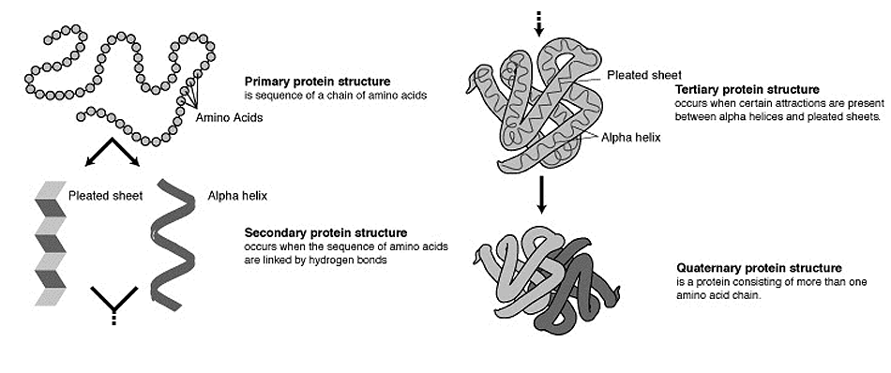
Structure

Slide 5
Actin
most abundant in eukaryotic cells
highly conserved
participates in more protein-protein interactions than any other protein
major cytoskeletal protein

Slide 6
Amylase
it is an enzyme that catalyzes the hydrolysis of starch into sugars
it begins the chemical process of digestion (ex. saliva)
helps our bodies to digest carbohydrates

Slide 7
Pepsin
an enzyme that is the principal component of gastric acid. Used to help digest food in the stomach
a catalyst in the breakdown of protein to form polypeptides
formed from pepsinogen

Slide 8
Keratin
Highly durable protein that provides structure to several types of living tissue
It is able to flex in multiple directions without breaking
It is the key structural material making up the outer layer of human skin

Slide 9
Question 1
A macromolecule is a big molecule made of smaller molecules and atoms. How do smaller molecules make up larger molecules? What keeps them together? How do they fit together?
A macromolecule is created by polymerization of smaller subunits called isomers. There are typically composed of thousand and more atoms. The 4 main types of macromolecules in the cell are carbohydrates, lipids, proteins, and nucleic acids (DNA+RNA).
carbohydrates-made from thousand of simple sugars all linked together
lipids-large molecules made up of two types of molecules:glycerol and fatty acid
proteins-diverse group of molecules (20 polymers) The amino acids are joined together by peptide bonds.
nucleic acids-DNA and RNA are polymers of nucleotides. Nucleotides are made up of three parts: phosphate, pentose sugar, and nitrogenous base.

Slide 10
Question 2
How do you think the 4 major macromolecules work together to complete a function in the human body? For example, how are carbohydrates, lipids, and proteins related to metabolism and homeostasis? The 4 macromolecules make up every cell in the body. In metabolism, the carbohydrates are used up quickly by the body because they are the primary source of energy, lipids are fats that will be later used for energy, and proteins will help create hormones, muscle, etc after being broken down into amino acids. In homeostasis, the absence of proteins would make too little or too much nutrients. The lack of fats would create a lack of insulation and inhibit the process of storing energy while the lack of carbohydrates would require the body to use other important macromolecules, distrupting our bodies homeostasis.

Slide 11
Question 3
How does the shape of a macromolecule relate to its function? The shape of a macromolecule will fit to the purpose of the macromolecule. Its shape benefits its function. Most macromolecules function in relation to other macromolecules. Like locks and keys, without right shape, it would not have the ability to function with its intended partner. Also, for example proteins, the variation between the amino acids will vary the protein and its function.

Slide 12
Question 4
How and why are the shapes of the macromolecules determined?
Macromolecules form chainlike molecules called polymers. A polymer is a long molecule consisting of many similar or identical building blocks linked by covalent bonds. The repeated units are small molecules called monomers. Body cells use dehydration reaction to assemble the monomers into new polymers that carry out functions specific to the particular cell type. Each cell has thousands of different kinds of macromolecules. The monomers can be connected in a great many combinations to create diversity. This diversity comes from 40-50 different combinations of monomers.

Slide 13
Bibliography
http://www.ncbi.nlm.nih.gov/pubmed/21314430
http://biology.about.com/od/molecularbiology/a/aa101904a.htm
http://ghr.nlm.nih.gov/handbook/howgeneswork/protein
http://www.rcsb.org/pdb/101/motm.do?momID=12
http://medical-dictionary.thefreedictionary.com/pepsin
https://www.nlm.nih.gov/medlineplus/ency/article/003464.htm
http://www.webmd.com/digestive-disorders/amylase-17444
http://faculty.fmcc.suny.edu/mcdarby/majors101book/chapter_03-chemistry/05-Important_Molecules_in_Living_Systems.htm

Slide 14
Biography continued
http://www.olemiss.edu/courses/bisc102/macromol.html
http://www.encyclopedia.com/topic/keratin.aspx
http://healthyeating.sfgate.com/body-absorb-carbohydrates-lipids-fats-proteins-8943.html
http://www.angelfire.com/linux/macromolecules/

