Slide 1
Homeostasis Review

Slide 2
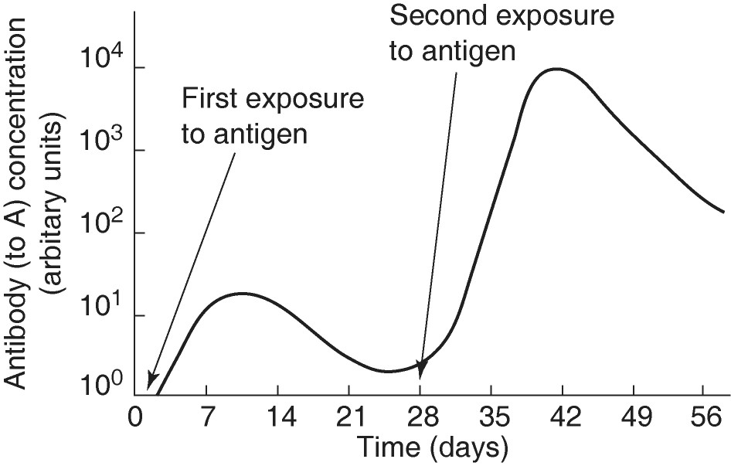
When would you find antibodies being produced?
a. between 3 and 7 days
b. between 14 and 21 days
c. between 28 and 35 days
d. 14-21 and 42-56 days
e. both A and C
Notes:
e

Slide 3
When would memory cells be produced?
a. between 0 and 7 days
b. between 7 and 14 days
c. between 28 and 35 days
d. between 35 and 42 days
e. both A and C
Notes:
e

Slide 4
When would B cells produce effector cells?
a. between 0 and 7 days
b. between 7 and 14 days
c. between 28 and 35 days
d. A and B
e. A and C
Notes:
a

Slide 5
When a cell releases a signal molecule into the environment and a number of cells in the immediate vicinity respond, this type of signaling is
a. endocrine signaling.
b. typical of hormones.
c. paracrine signaling.
d. synaptic signaling.
e. autocrine signaling.
Notes:
c

Slide 6
Although many chimpanzee populations live in environments containing oil palm nuts, members of only a few populations use stones to crack open the nuts. The most likely explanation for this behavioral difference between populations is that
a. the cultural tradition of using stones to crack nuts has arisen in only some populations.
b. members of different populations have different nutritional requirements.
c. the behavioral difference is caused by genetic differences between populations.
d. members of different populations differ in manual dexterity.
e. members of different populations differ in learning ability.
Notes:
a

Slide 7
Prolactin stimulates mammary gland growth and development in mammals and regulates salt and water balance in freshwater fish. Many scientists think that this wide range of functions indicates which of the following?
a. Prolactin is an evolutionary conserved hormone.
b. Prolactin interacts with many different receptor molecules.
c. Prolactin is derived from two separate sources.
d. Prolactin has a unique mechanism for eliciting its effects.
e. Prolactin is a nonspecific hormone.
Notes:
a

Slide 8
In Belding's ground squirrels, it is mostly the females that behave altruistically by sounding alarm calls. What is the likely reason for this distinction?
a. Females settle in the area in which they were born, so the calling females are warning kin.
b. Females invest more in foraging and food stores, so they are more defensive.
c. The sex ratio is biased.
d. Males have smaller vocal cords and are less likely to make sounds.
e. Males forage alone; therefore, alarm calls are useless.
Notes:
a

Slide 9
Phosphorylation cascades involving a series of protein kinases are useful for cellular signal transduction because
a. they counter the harmful effects of phosphatases.
b. they always lead to the same cellular response.
c. they amplify the original signal many fold.
d. they are species specific.
e. the number of molecules used is small and fixed.
Notes:
c

Slide 10
Why is it that some body cells respond differently to the same peptide hormones?
a. The circulatory system regulates responses to hormones by routing the hormones to specific targets.
b. Each cell knows how it fits into the body's master plan.
c. Different target cells have different genes.
d. A target cell's response is determined by the product of a signal transduction pathway.
e. The hormone is chemically altered in different ways as it travels through the circulatory system.
Notes:
D

Slide 11
Of the following, a receptor protein in a membrane that recognizes a chemical signal is most similar to
a. genes making up a chromosome.
b. the active site of an allosteric enzyme in the cytoplasm that binds to a specific substrate.
c. RNA specifying the amino acids in a polypeptide.
d. a particular metabolic pathway operating within a specific organelle.
e. an enzyme with an optimum pH and temperature for activity.
Notes:
b

Slide 12
Which of the following differentiates T cells and B cells?
a. T cells but not B cells are stimulated to increase the rate of their cell cycles.
b. T cells but not B cells can directly attack and destroy invading pathogens.
c. T cells but not B cells have surface markers.
d. Only B cells take part in cell-mediated immunity.
e. Only B cells are produced from stem cells of the bone marrow.
Notes:
b

Slide 13
In which of the following situations will helper T cells be activated?
a. when an antigen is displayed by a dendritic cell (macrophage)
b. when natural killer (NK) cells come in contact with a tumor cell
c. when B cells respond to T-independent antigens
d. in the bone marrow during the self-tolerance test
e. when a cytotoxic T cell releases cytokines
Notes:
a

Slide 14
When antibodies attack antigens, clumping of the affected cells generally occurs. This is best explained by
a. disulfide bridges between the antigens.
b. denaturation of the antibodies.
c. complement that makes the affected cells sticky.
d. bonds between class I and class II MHC molecules.
e. the shape of the antibody with at least two binding regions.
Notes:
e

Slide 15
For one person to produce over a million different antibody molecules could not possibly require over a million different genes. Instead, this variability is accounted for by which processes?
a. increased rate of mutation in the RNA molecules
b. DNA rearrangements followed by alternative splicing of the transcripts
c. DNA rearrangements in the thymus cells
d. crossing-over between the light and heavy chains of each antibody molecule during meiosis I
e. alternative splicing of exons after transcription
Notes:
b

Slide 16
Which of the following is true of active but not passive immunity?
a. acquisition and activation of antibodies.
b. requires direct exposure to a living or simulated pathogen.
c. proliferation of lymphocytes in bone marrow.
d. transfers antibodies from the mother across the placenta.
e. requires secretion of interleukins from macrophages.
Notes:
b

Slide 17
A cage containing male mosquitoes has a small earphone placed on top, through which the sound of a female mosquito is played. All the males immediately fly to the earphone and thrust their abdomens through the fabric of the cage. What is the best explanation for this behavior?
a. The sound from the earphone irritates the male mosquitoes, causing them to attempt to sting it.
b. Copulation is a fixed action pattern, and the female flight sound is a sign stimulus that initiates it.
c. The males learn to associate the sound with females.
d. Through classical conditioning, the male mosquitoes have associated the inappropriate stimulus from the earphone with the normal response of copulation..
Notes:
b

Slide 18
Testosterone functions inside a cell by
a. acting as a signal receptor that activates ion-channel proteins.
b. coordinating a phosphorylation cascade that increases glycogen metabolism.
c. binding with a receptor protein that enters the nucleus and activates specific genes.
d. acting as a steroid signal receptor that activates ion-channel proteins.
e. becoming a second messenger that inhibits adenylyl cyclase.
Notes:
c

Slide 19
Lipid-soluble signal molecules, such as testosterone, cross the membranes of all cells but affect only target cells because
a. only target cells possess the cytosolic enzymes that transduce the testosterone.
b. most cells lack the Y chromosome required.
c. only in target cells is testosterone able to initiate the phosphorylation cascade leading to activated transcription factor.
d. intracellular receptors are present only in target cells.
e. only target cells retain the appropriate DNA segments.
Notes:
d

Slide 20
After the depolarization phase of an action potential, the resting potential is restored by
a. the opening of sodium activation gates.
b. a brief inhibition of the sodium-potassium pump.
c. the opening of more voltage-gated sodium channels.
d. the opening of voltage-gated potassium channels and the closing of sodium activation gates.
e. a decrease in the membrane's permeability to potassium and chloride ions.
Notes:
d

Slide 21
In which of the cases could the mother exhibit an anti-Rh-factor reaction to the developing fetus?
a. Case 1 only
b. Cases 1, 2, and 3
c. Cases 1 and 2 only
d. Case 3 only
Notes:
a

Slide 22
Which statement best describes the difference in responses of effector B cells (plasma cells) and cytotoxic T cells?
a. B cells confer active immunity; cytotoxic T cells confer passive immunity.
b. B cells respond the first time the invader is present; cytotoxic T cells respond subsequent times.
c. B cells secrete antibodies against a virus; cytotoxic T cells kill virus-infected cells.
d. B cells accomplish the cell-mediated response; cytotoxic T cells accomplish the humoral response.
e. B cells kill viruses directly; cytotoxic T cells kill virus-infected cells.
Notes:
c

Slide 23
In general, a signal transmitted via phosphorylation of a series of proteins
a. allows target cells to change their shape and therefore their activity.
b. cannot occur in yeasts because they lack protein phosphatases.
c. requires binding of a hormone to a cytosol receptor.
d. brings a conformational change to each protein.
e. requires phosphorylase activity.
Notes:
d

Slide 24
Inflammatory responses may include which of the following?
a. reduced permeability of blood vessels to conserve plasma
b. clotting proteins migrating away from the site of infection
c. release of substances to decrease the blood supply to an inflamed area
d. increased activity of phagocytes in an inflamed area
e. inhibiting the release of white blood cells from bone marrow
Notes:
d

Slide 25
At puberty, an adolescent female body changes in both structure and function of several organ systems, primarily under the influence of changing concentrations of estrogens and other steroid hormones. How can one hormone, such as estrogen, mediate so many effects?
a. Estrogen binds to specific receptors inside many kinds of cells, each of which have different responses to its binding.
b. Estrogen is produced in very large concentration and therefore diffuses widely.
c. Estrogen has different shaped receptors for each of several cell types.
d. Estrogen has specific receptors inside several cell types, but each cell responds in the same way to its binding.
Notes:
a

Slide 26
A female cat in heat urinates more often and in many places. Male cats congregate near the urine deposits and fight with each other. Which of the following is a proximate cause of this behavior of increased urination?
a. Female cats that did this in the past attracted more males.
b. It is a result of hormonal changes associated with her reproductive cycle.
c. It announces to the males that she is in heat.
d. The female cat learned the behavior from observing other cats.
Notes:
b

Slide 27
The "threshold" potential of a membrane
a. is the minimum depolarization needed to operate the voltage-gated sodium and potassium channels.
b. is the point of separation from a living from a dead neuron.
c. is the minimum hyperpolarization needed to prevent the occurrence of action potentials.
d. is the lowest frequency of action potentials a neuron can produce.
e. is the peak amount of depolarization seen in an action potential.
Notes:
a

Slide 28
The steps below refer to various stages in transmission at a chemical synapse:
1. Neurotransmitter binds with receptors associated with the postsynaptic membrane.
2. Calcium ions rush into neuron's cytoplasm.
3. An action potential depolarizes the membrane of the axon terminal.
4. The ligand-gated ion channels open.
5. The synaptic vesicles release neurotransmitter into the synaptic cleft.
Which sequence of events is correct?
a. 5 → 1 → 2 → 4 → 3
b. 2 → 3 → 5 → 4 → 1
c. 1 → 2 → 3 → 4 → 5
d. 3 → 2 → 5 → 1 → 4
e. 4 → 3 → 1 → 2 → 5
Notes:
d

Slide 29
From the perspective of the cell receiving the message, the three stages of cell signaling are
a. the alpha, beta, and gamma stages.
b. the paracrine, local, and synaptic stages.
c. signal reception, cellular response, and cell division.
d. signal reception, nucleus disintegration, and new cell generation.
e. signal reception, signal transduction, and cellular response.
Notes:
e

Slide 30
The MHC is important in a T cell's ability to
a. recognize differences among types of cancer.
b. distinguish self from nonself.
c. recognize specific parasitic pathogens.
d. identify specific viruses.
e. identify specific bacterial pathogens.
Notes:
b

Slide 31
A bone marrow transplant may not be appropriate from a given donor (Jane) to a given recipient (Jane's cousin Bob), even though Jane has previously given blood for one of Bob's needed transfusions. Which of the following might account for this?
a. Bob's immune response has been made inadequate before he receives the transplant.
b. A blood type match is less stringent than a match required for transplant because blood is more tolerant of change.
c. For each gene, there is only one blood allele but many tissue alleles.
d. Jane's blood type is a match to Bob's but her MHC proteins are not.
Notes:
d

Slide 32
What is the primary function of humoral immunity?
a. It protects the body against cells that become cancerous.
b. It primarily defends against bacteria and viruses that have already infected cells.
c. It produces antibodies that circulate in body fluids.
d. It is responsible for transplant tissue rejection.
e. It primarily defends against fungi and protozoa.
Notes:
c

Slide 33
Where are neurotransmitter receptors located?
a. in the myelin sheath
b. on the postsynaptic membrane
c. at nodes of Ranvier
d. on the membranes of synaptic vesicles
e. on the nuclear membrane
Notes:
b

Slide 34
What are antigens?
a. proteins found in the blood that cause foreign blood cells to clump
b. foreign molecules that trigger the generation of antibodies
c. proteins embedded in B cell membranes
d. proteins that consist of two light and two heavy polypeptide chains
e. proteins released during an inflammatory response
Notes:
b

Slide 35
Which of the following is a pathway that would lead to the activation of cytotoxic T cells?
a. self-tolerance of immune cells → B cells contact antigen → cytokines released
b. cytotoxic T cells → class II MHC molecule-antigen complex displayed → cytokines released → cell lysis
c. body cell becomes infected with a virus → new viral proteins appear → class I MHC molecule-antigen complex displayed on cell surface
d. B cell contact antigen → helper T cell is activated → clonal selection occurs
Notes:
c

Slide 36
A chemical produced by an animal that serves as a communication to another animal of the same species is called
a. an inducer.
b. a marker.
c. an imprinter.
d. a pheromone.
e. an agonistic chemical.
Notes:
d

Slide 37
A nervous system can alter activities in its target cells in muscles and glands because
a. the target cells have receptor proteins for the signals released by the nervous system.
b. the target cells each have an internal neural network connected to the nervous system.
c. they are electrically coupled by gap junctions.
d. the target cells that become disconnected from the nervous system rapidly die.
e. the nervous system releases signals into the blood to control the target cells.
Notes:
a

Slide 38
Clonal selection implies that
a. brothers and sisters have similar immune responses.
b. antigens increase mitosis in specific lymphocytes.
c. the body selects which antigens it will respond to.
d. a B cell has multiple types of antigen receptors.
e. only certain cells can produce interferon.
Notes:
b

