Slide 1
Kicking the Cookbook Out of AP Environmental Science
Karen Lionberger, Director of Curriculum & Content Development
College Board – AP Program
Dr. Mark Ewoldsen, College Board Advisor on the
AP Env. Science Test Development Committee
March 2012

Slide 2
Students take AP to be exposed to academic rigor and to establish college-level skills
Why Do Students Take AP Courses and Exams?
Which of These Are Reasons Why You Have Decided to Take an AP Course?
Intrinsic Reasons
Extrinsic Reasons
Challenge Myself Academically
Build Skills I’ll Need to Succeed at College
Interested in a Specific AP Subject Area
Stand Out in Admission Process
Save Money by Having Earned College Credit
Place Out of an Introductory Course
Source: Crux Market Research Inc. (2007): Q310
N = 914 students, 572 parents

Slide 3
Goals of the AP® Science Revision
To produce a more inclusive and more engaging program of study for each AP science discipline by identifying:
The concepts to be studied in depth and measured on the exams
The need for a reduction in breadth of course content and an increase in depth of understanding
The essential reasoning and inquiry skills that are to be supported with instruction and measured on the exams – science practices
Emerging areas of research that capture essential concepts within the discipline and engage diverse student populations

Slide 4
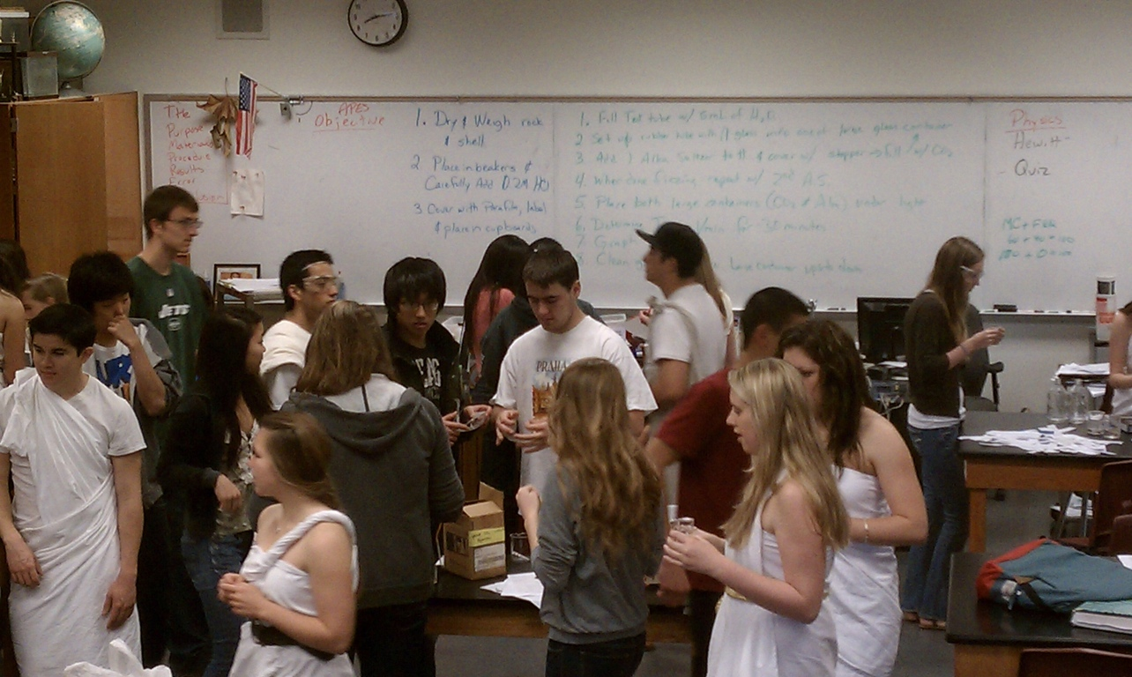
How do Students Feel About Labs Now?
“Why do we have to learn this material?”
“This is depressing...”
“What is the purpose of this lab?”
“How do I write the procedure?”
“Are my results correct?”
“Do I need to...”
2

Slide 5
Paradigm Shift for Students (and Teachers)
8

Slide 6
How “Scientific” are AP Sciences?
48

Slide 7
The Science Educational Reform Efforts & the “Science Practices”
Compare the Science Practices for AP Science to the following:
NRC’s (Common Core) Scientific and Engineering Practices
1. Asking questions (for science) and defining problems (for engineering)
2. Developing and using models
3. Planning and carrying out investigations
4. Analyzing and interpreting data
5. Using mathematics and computational thinking
6. Constructing explanations (for science) and designing solutions (for engineering)
7. Engaging in argument from evidence
8. Obtaining, evaluating, and communicating information
We are all speaking the same language!

Slide 8
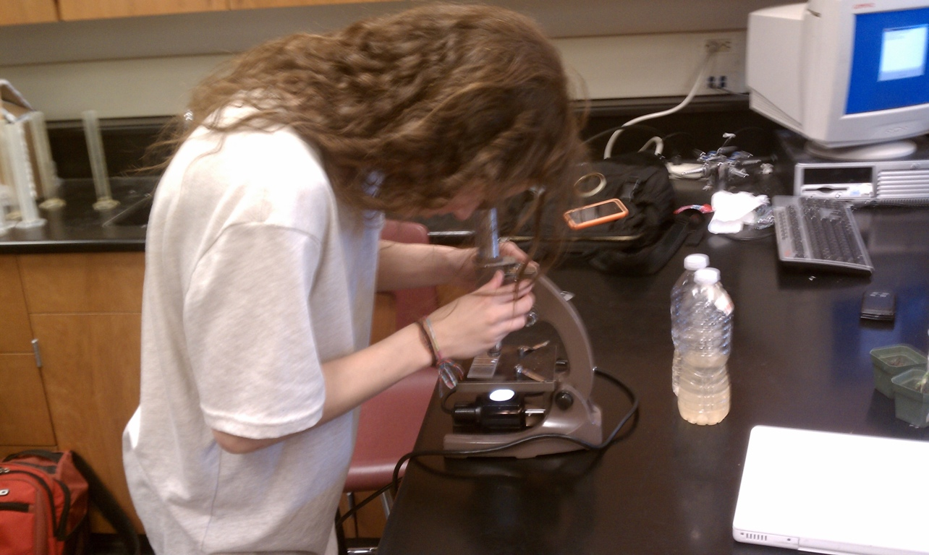
What is Scientific Method?
Ask a Question
Do Background Research
Construct a Hypothesis
Test Your Hypothesis by Doing an Experiment
Analyze Your Data and Draw a Conclusion
Communicate Your Results
AND What’s Next??????
36

Slide 9
Initial Experiment
Serial Dilutions - LD50 Salt on Mung Beans
39

Slide 10
Serial Dilutions

Slide 11
Get 2 x 3 inch jewelry bags
jewelry supply store. See product # 52-002 on second table @ http://www.aajewelry.com/templates/product_list_dropdown_pix.aspx?GroupGuid=5523
Staple across the bag such that there is space for roots to grow
Cut piece of paper towel and insert into bag
Add 10 to 15 seeds to each bag

Slide 12
Make a 0.2-g/mL NaCl STOCK solution
- Add 2 g of sodium chloride to beaker and add water to 10 mL
0.2 g/mL NaCl
Stock Solution

Slide 13
Get as many test tubes (minus two controls) as you have plastic jewelry bags for your experiment

Slide 14
Add 5 mL of water to each of you test tubes

Slide 15
Add 5 mL of Stock Solution to first test tube.

Slide 16
Mix the first Tube

Slide 17
Take 5 mL of first tube and add to second tube

Slide 18
Mix

Slide 19
Repeat and remove 5 ml from last tube and discard

Slide 20
Using a 5mL disposable pipette
Add 3 mL from stock to a bag
Add 3 mL of water to another bag
Add the 3 mL from each test tube to its respective bag

Slide 21
Stock Solution

Slide 23
Stock

Slide 24
Water

Slide 25
Water

Slide 26
0.1 g/mL Solution

Slide 28
0.1 g/mL

Slide 29
0.05 g/mL Solution

Slide 31
0.5 g/mL

Slide 32
Etc.

Slide 34
Conclusion/Errors
LD50 with NaCl in baggies is about 1.25 to 1.30 %
Some beans may have died at low concentrations due mold growing on seeds, bugs or just bad seeds

Slide 35
Serial Dilutions - LD50 Salt on Mung Beans
Ammonium Sulfate on Mung Beans
New Question
39

Slide 36
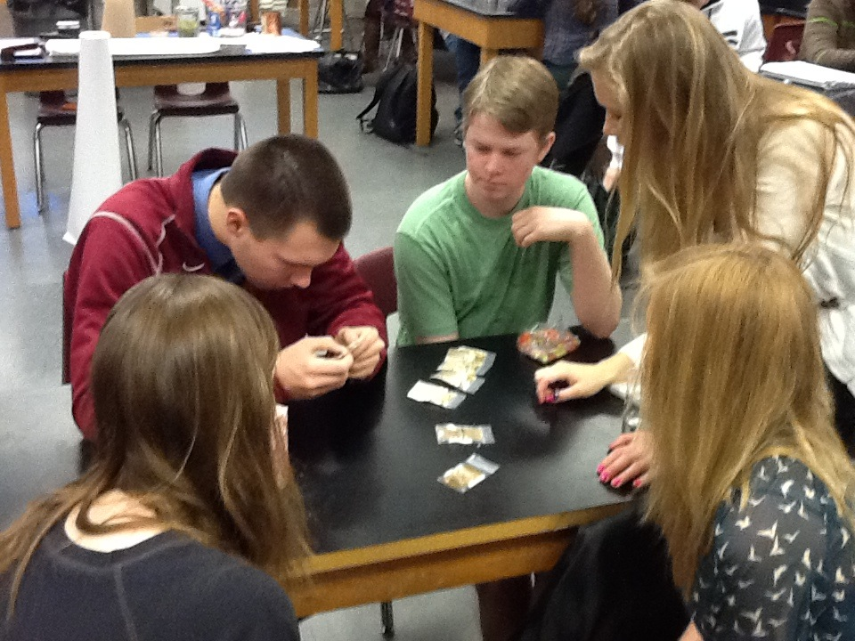
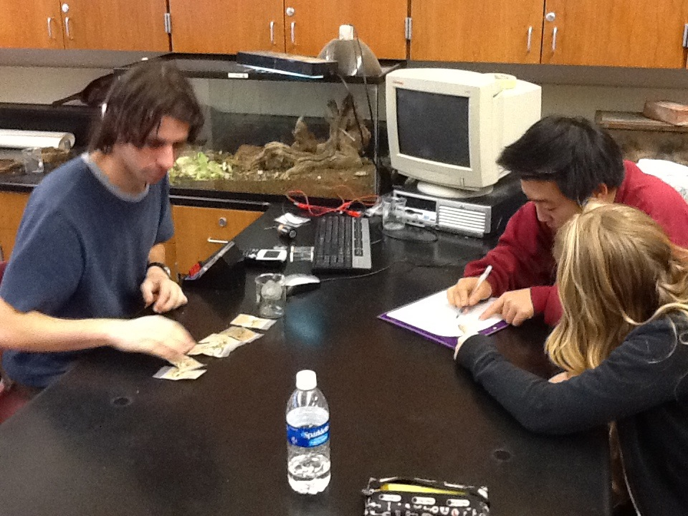
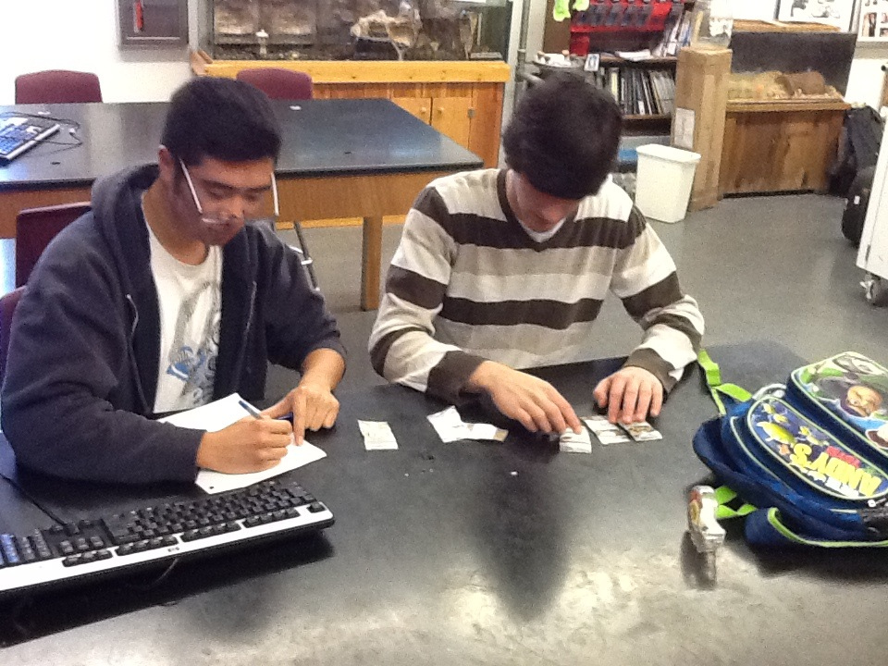
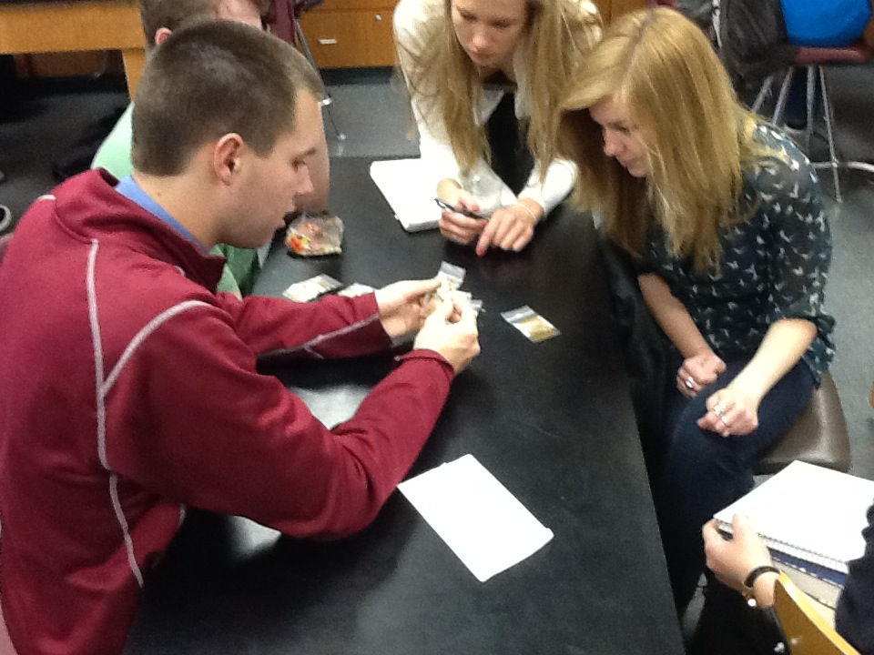
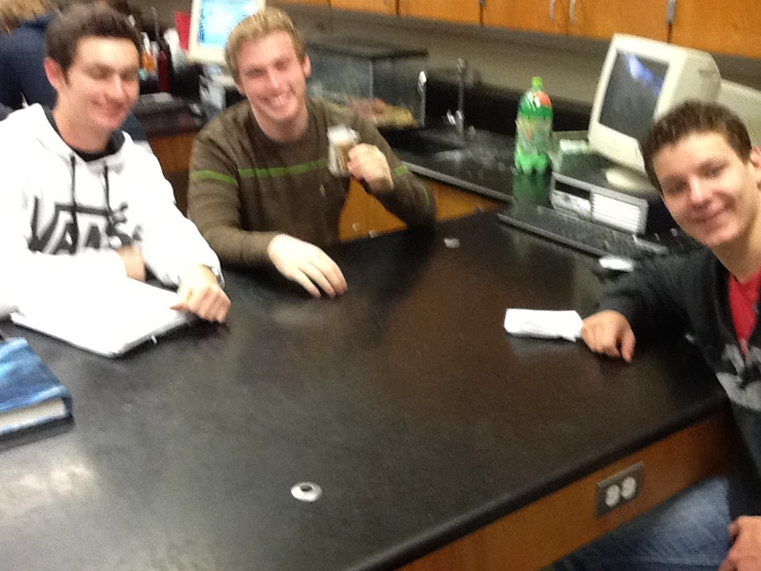
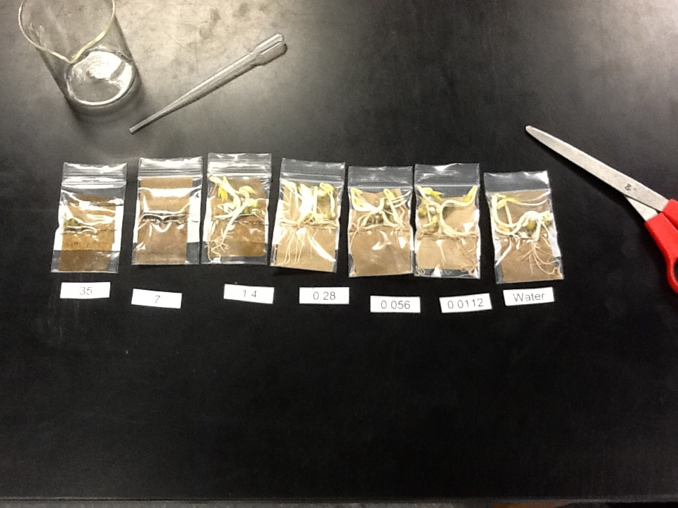

Slide 37
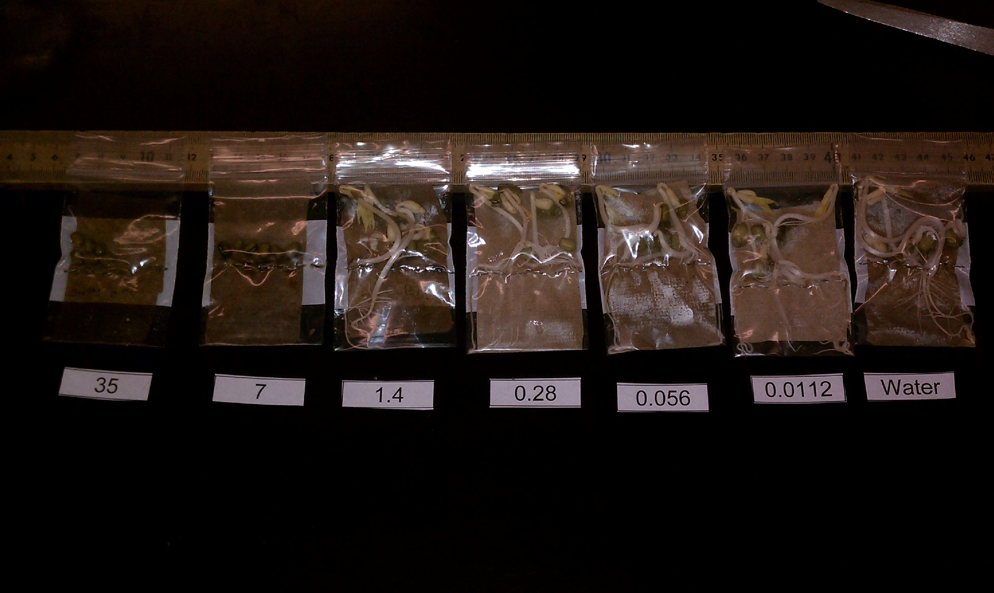

Slide 39
LD50 with Ammonium sulfate in baggies is estimated at 2 to 3%
Some beans may have died at low concentrations due mold growing on seeds, bugs or just bad seeds

Slide 40
Serial Dilutions - LD50 Salt on Mung Beans in bags
Ammonium Sulfate on Mung Beans in bags
Ammonium Sulfate on Mung Bean
plant growth in SOIL
New Question
39

Slide 41
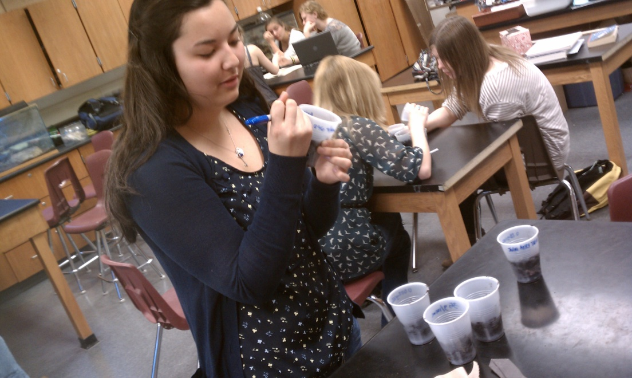
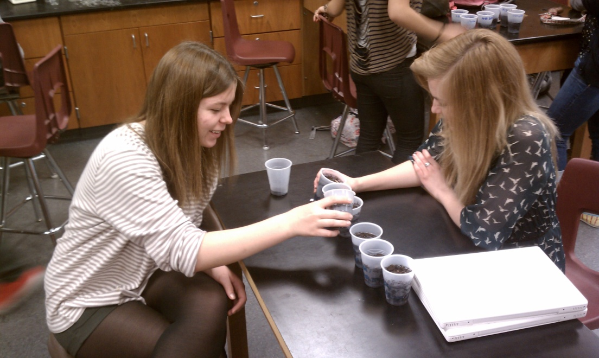
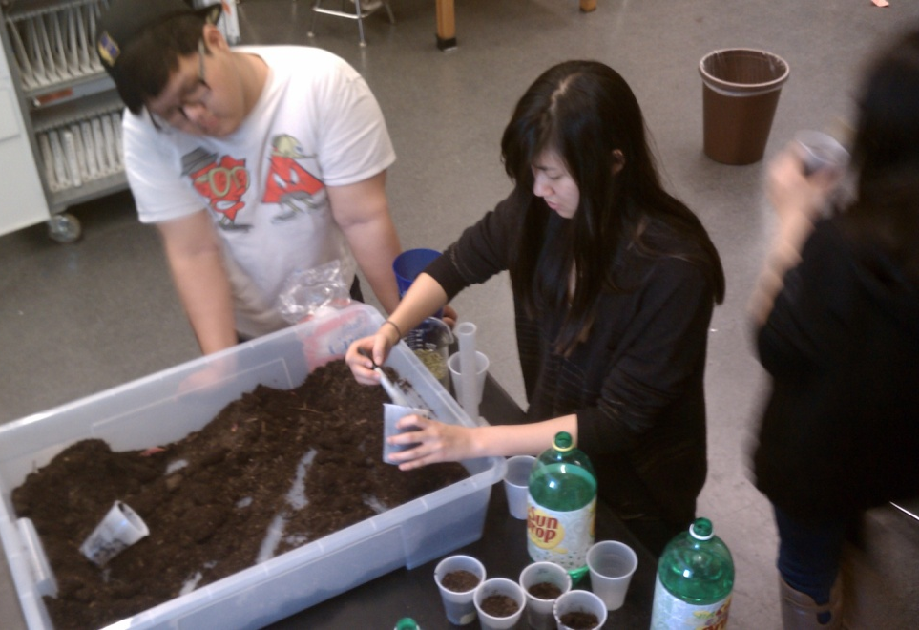
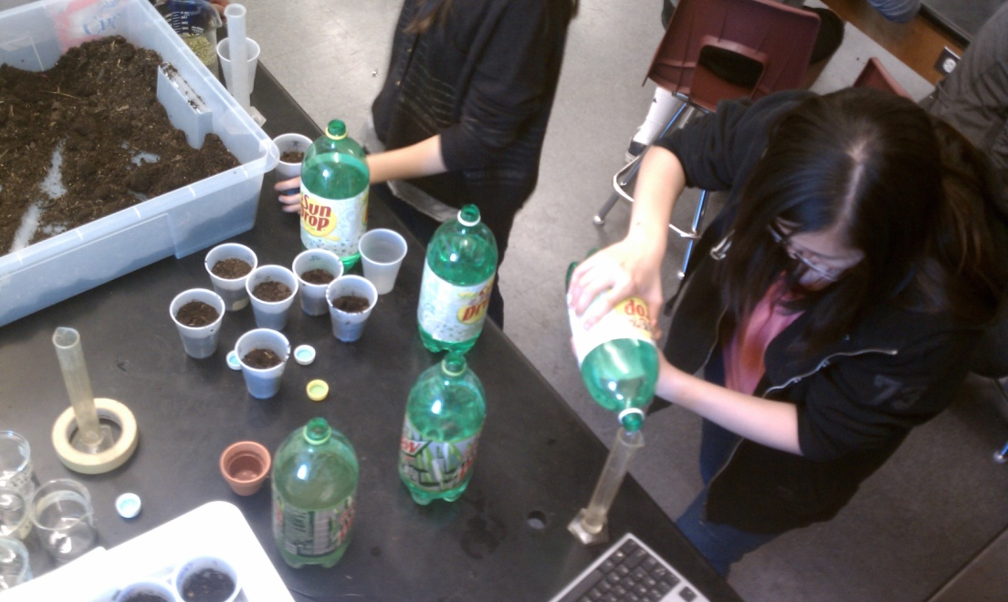
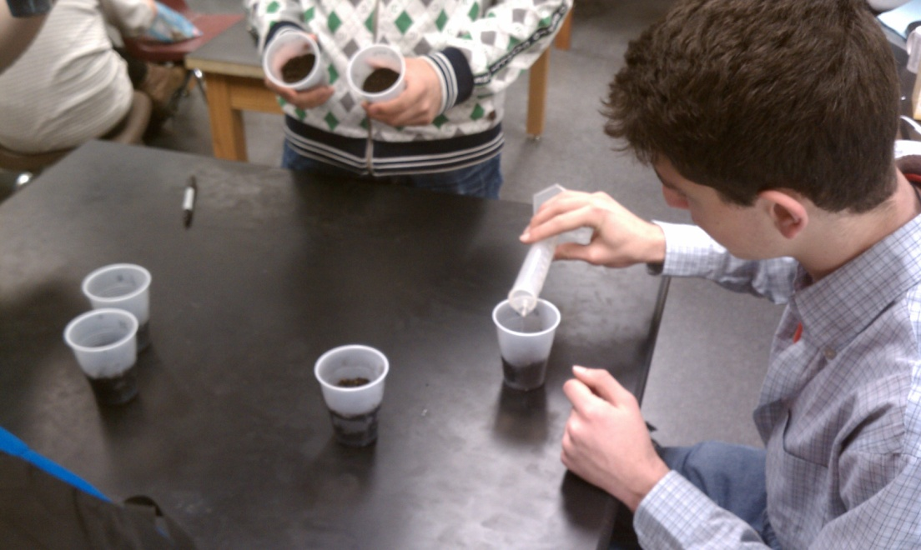
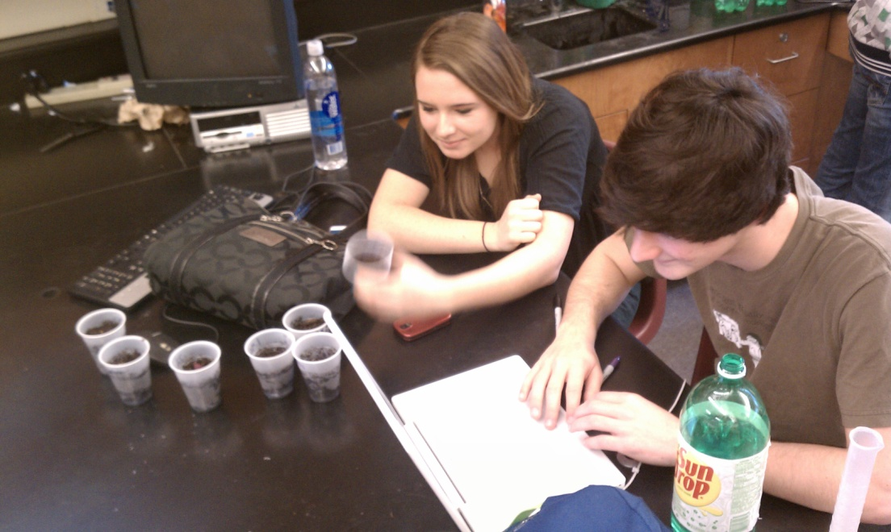
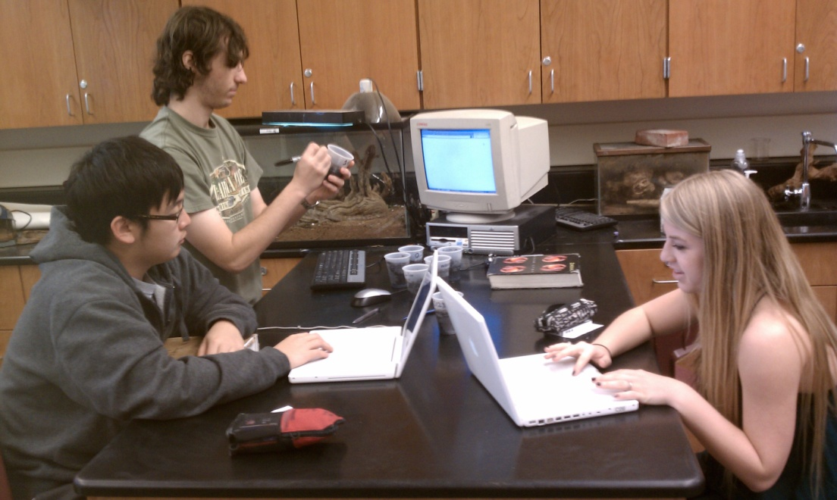

Slide 43
Conclusion/Errors
LD50 with A.S. in soil is about 1.4 to 5.0% - unsure because it starts at 20%
Some beans may have been planted to deep, too much compaction of soil, not enough water

Slide 44
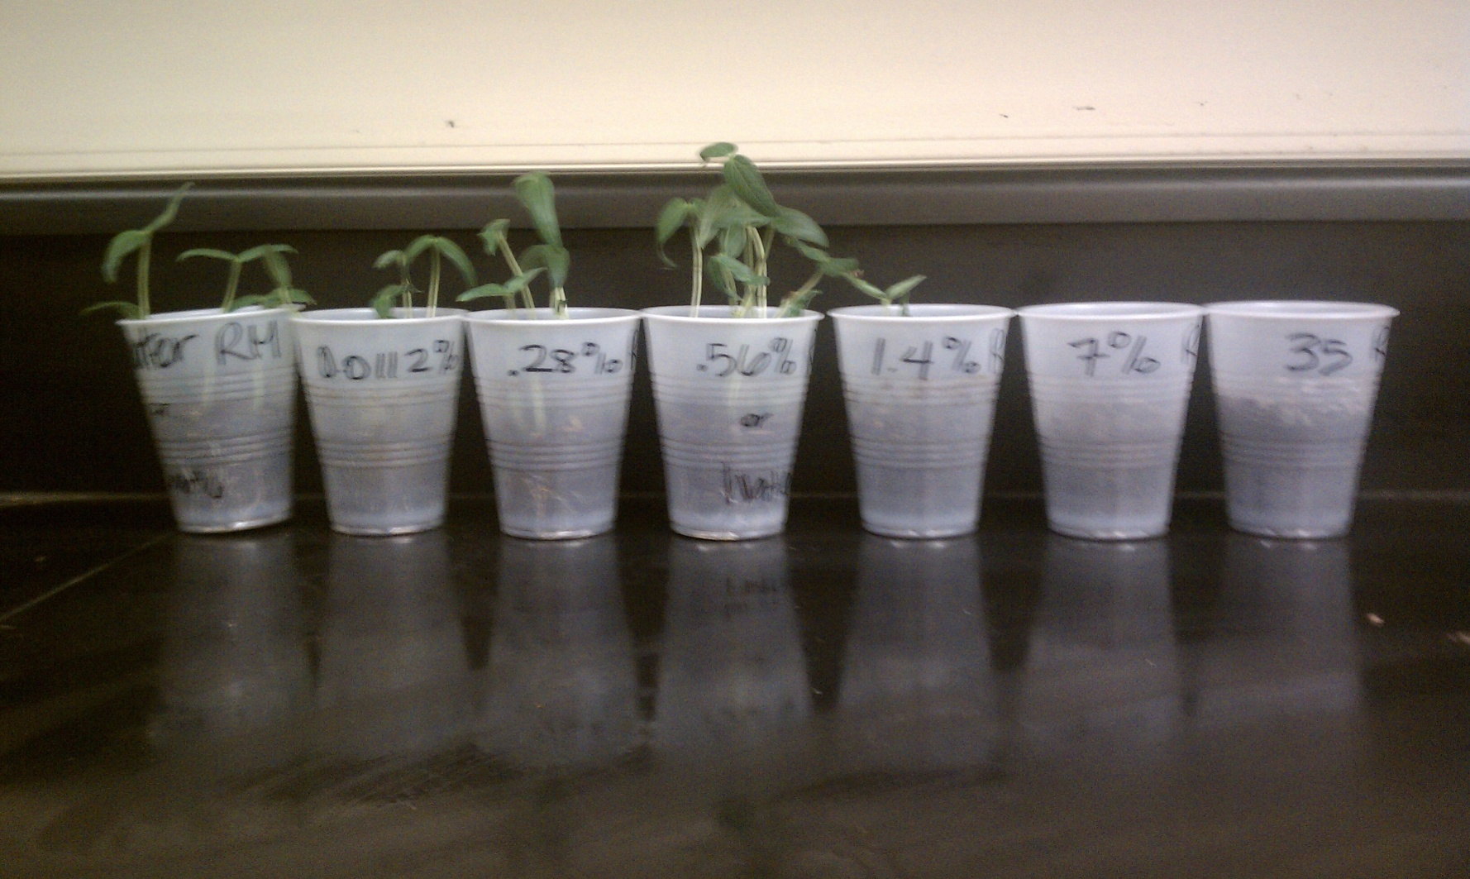
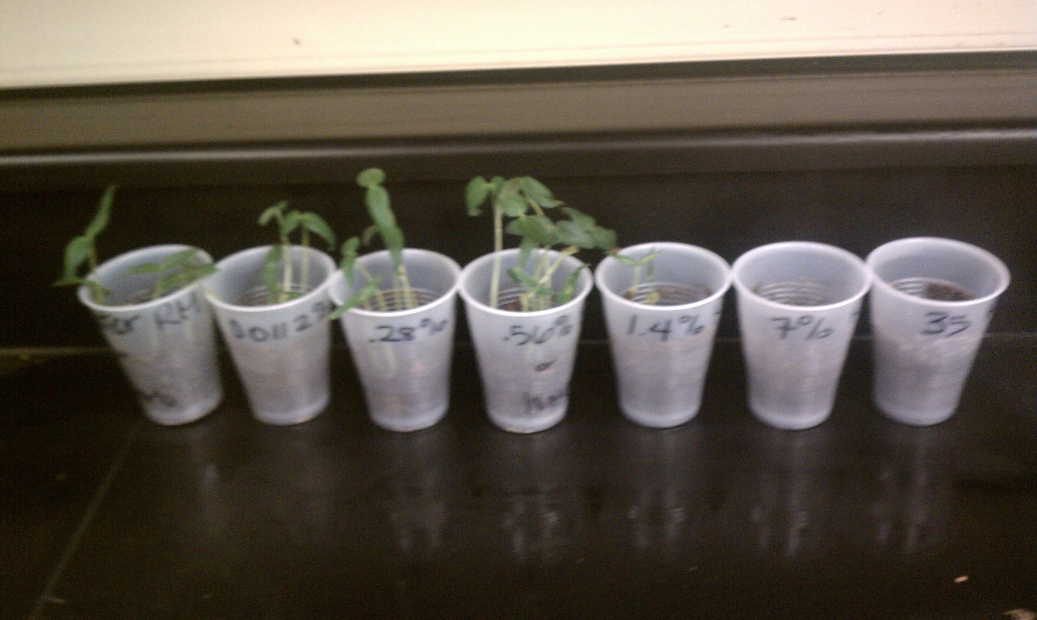

Slide 46
Conclusion/Errors
Ammonium sulfate helps the beans grow at a concentration of about 0.28%
Right above that concentration, the amount of A.S. keeps the seeds from germinating.
Important for farmers to know so do not add to much fertilizer
Next time try the test with poorer soil

Slide 48
Serial Dilutions - LD50 Salt on Mung Beans in bags
Ammonium Sulfate on Mung Beans in bags
Ammonium Sulfate on Mung Beans plant growth
Ammonium Sulfate with Algae
New Question
39

Slide 49
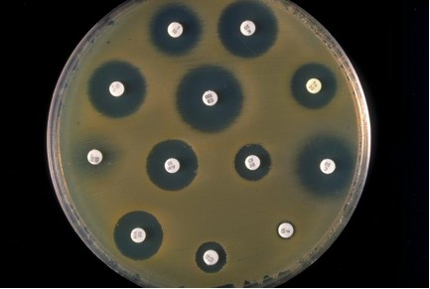
Taking Traditional Labs and Making them Inquiry-Based
Almost any “traditional” lab can be modified to focus on student-centered inquiry
There is a spectrum of guidance given to students depending on the lab structure – See MAPSI
See handout on revised lab for toxicology of “traditional” cleaners

Slide 50
The Investigation is Over…NOW WHAT?
The post-lab discourse is one of THE most important aspects of the investigation….and often the most disregarded component
Students should engage in rich, didactic critique of their experimental design and analysis
WHY is this important?
This allows students to engage in the practice of scientific argumentation/critique
Through this discourse, student beliefs become transparent and create authentic formative assessment opportunities for teachers

Slide 51
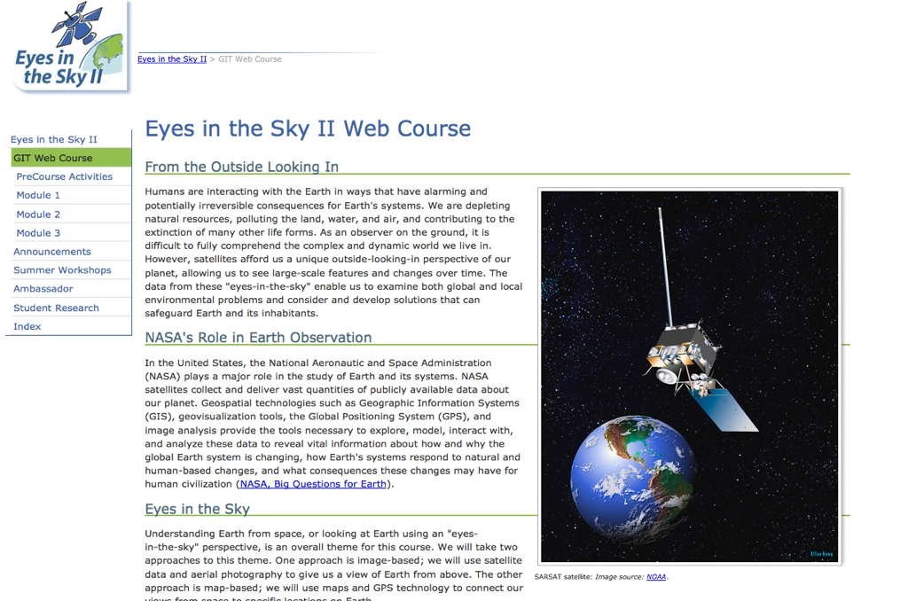
Resources for Student-Centered, Inquiry-Based Learning

Slide 52
Image-J Montage - Insolation
41

Slide 53
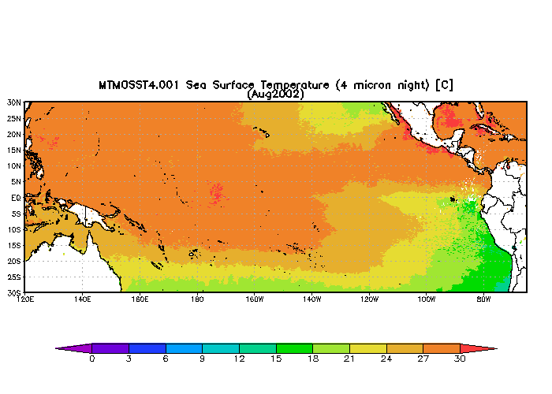
Image-J Animation - El Niño
42

Slide 54
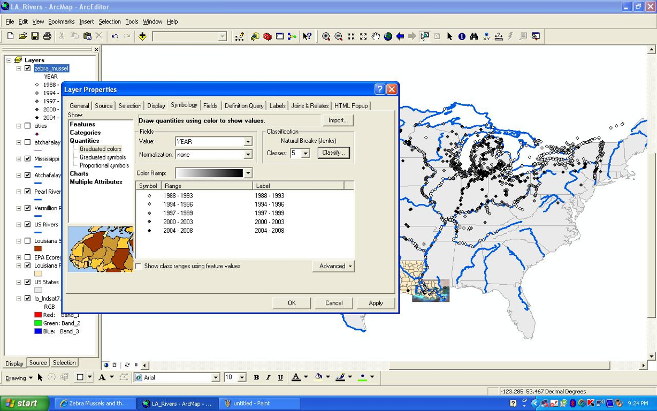
ArcMap - Zebra Mussels
43

Slide 55
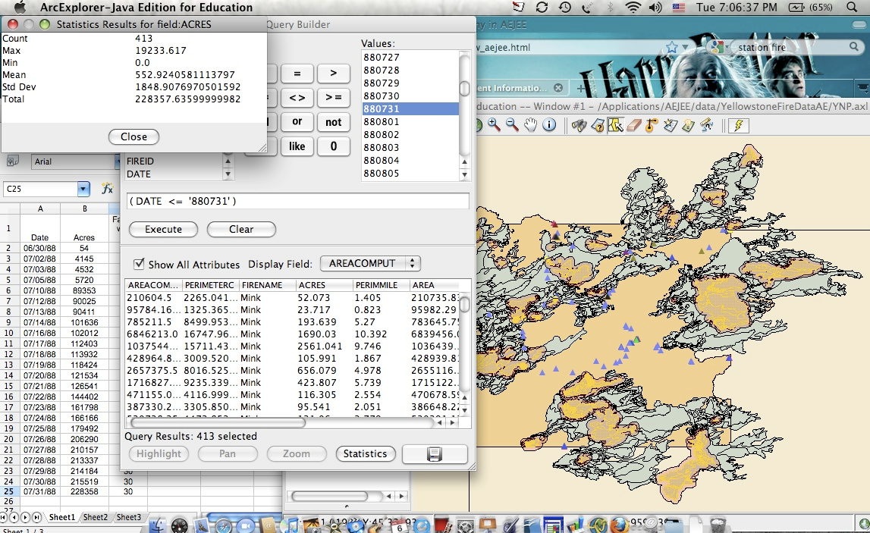
ArcMap Data Analysis Yellowstone Fires
45

Slide 56
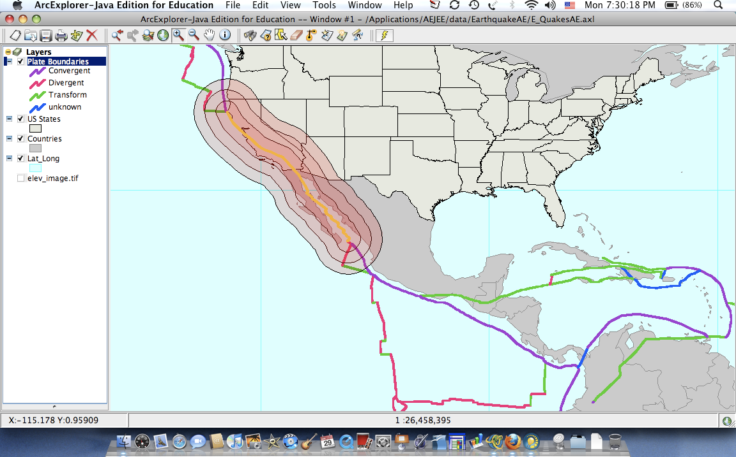
AEJEE Earthquakes
44

Slide 57
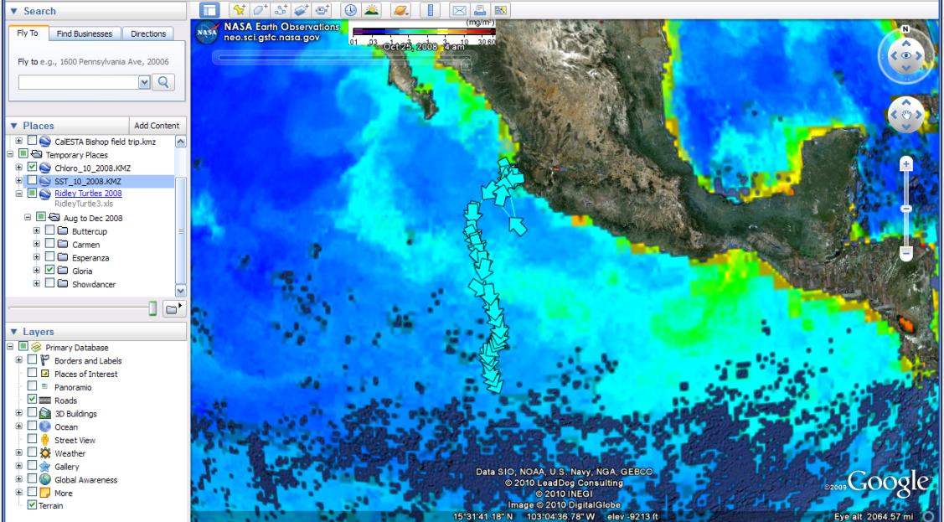
Google Earth - Turtle Travel
46

Slide 58
Resources for Inquiry-Based Learning: NASA Instructional Modules
Providing case-studies and project-based earning opportunities for students
Instructional modules are grounded in real-world data that teachers can use to support inquiry-based investigations
Allows students to engage in authentic problem-solving activities that incorporate both math and science principles/concepts

Slide 59
Some modules are Pre-AP level and lay the foundation for future work at the AP level by engaging students in critical thinking activities and the “science practices”

Slide 60
“Imagination is more important than knowledge.
For knowledge is limited to all we now know and understand,
while imagination embraces the entire world,
and all there ever will be to know and understand.”
– Albert Einstein
49

Slide 61
Where to find materials today…
Google “Dr. E’s Science Page”
Open Discussion…
Questions or Comments, Contact AP:
Dr. Mark Ewoldsen
College Board Advisor: AP Environmental Science
mewoldsen@lcusd.net
Questions or Comments, Contact AP:
Karen Lionberger
Director, AP Environmental Science,
klionberger@collegeboard.org

