Slide 1
Kicking the Cookbook
Out of
AP Environmental Science
Karen Lionberger, Director of Curriculum & Content Development
College Board – AP Program
Dr. Mark Ewoldsen, College Board Advisor on the
AP Environmental Science Test Development Committee
April 2013

Slide 2
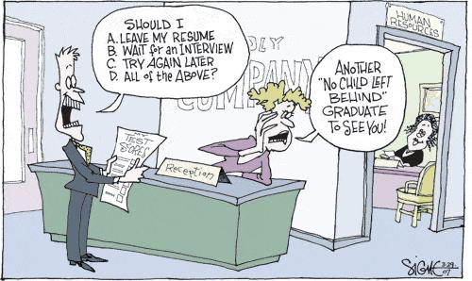

Slide 3


Sir Ken Robinson
RSA Animate - Changing Education Paradigms
Divergent Thinking Study
Process of having original ideas that have value
On their DT Test, if you scored above a certain level you'd be considered to be a genius of divergent thinking
1500 People were tested and asked the question:
How many uses can you think of for a paper clip?
4

Slide 4
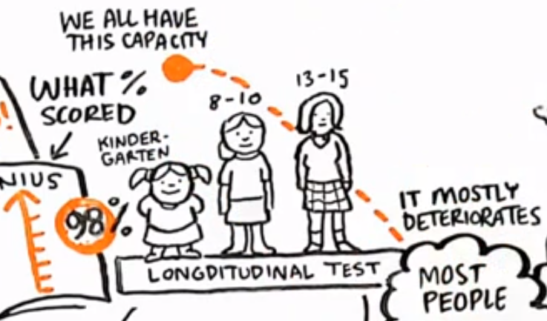
6

Slide 5


Paradigm Shift for Students
(and Teachers)
8

Slide 6
How “Scientific” are AP Sciences?
48

Slide 7
Goals of the AP® Science Revision
To produce a more inclusive and more engaging program of study for each AP science discipline by identifying:
The concepts to be studied in depth and measured on the exams
The need for a reduction in breadth of course content and an increase in depth of understanding
The essential reasoning and inquiry skills that are to be supported with instruction and measured on the exams – science practices
Emerging areas of research that capture essential concepts within the discipline and engage diverse student populations

Slide 8
Science Educational Reform Efforts & “Science Practices”
Compare the Science Practices for AP Science to the following:
NRC’s (Common Core) Scientific &Engineering Practices
1. Asking questions (for science) and defining problems (for engineering)
2. Developing and using models
3. Planning and carrying out investigations
4. Analyzing and interpreting data
5. Using mathematics and computational thinking
6. Constructing explanations (for science) and designing solutions (for engineering)
7. Engaging in argument from evidence
8. Obtaining, evaluating, and communicating information
We are all speaking the same language!
Notes:
Karen: Discuss how the Science Practices in AP are aligned to the Next Generation Science Standards

Slide 9
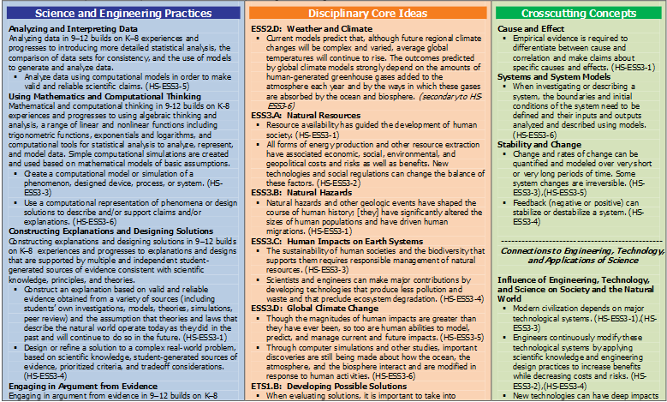

Slide 10
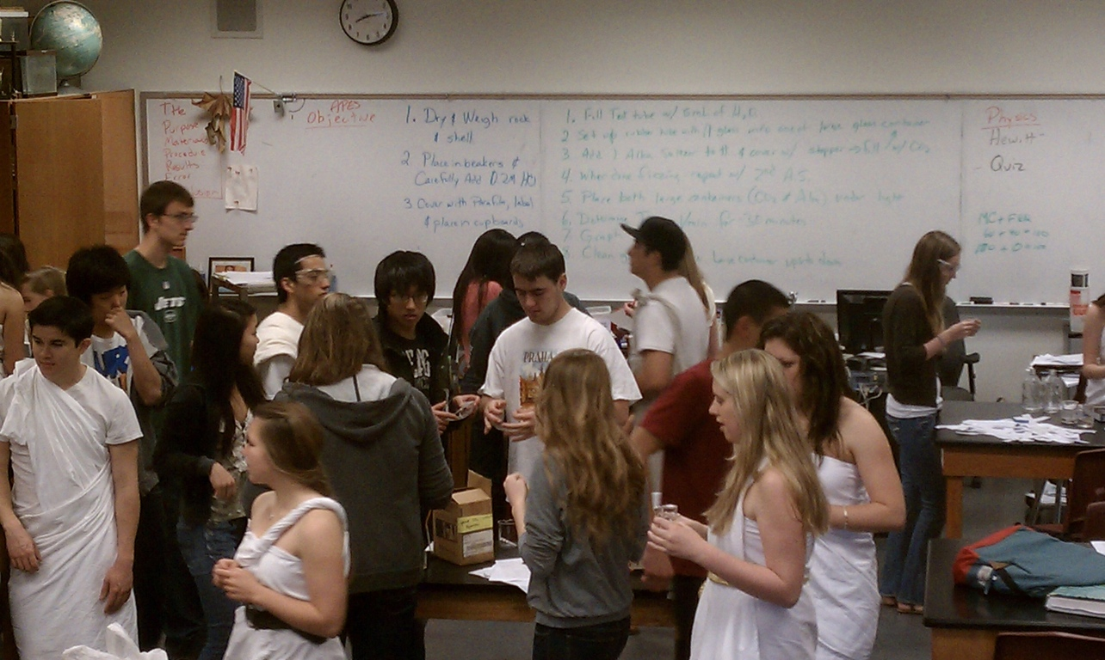
Student Questions that I Hate
“Why do we have to learn this material?”
“Will this be on the test?”
“What is the purpose of this lab?”
“How do I write the procedure?”
“Are my results correct?”
“Do I need to...”
2

Slide 11


Slide 12
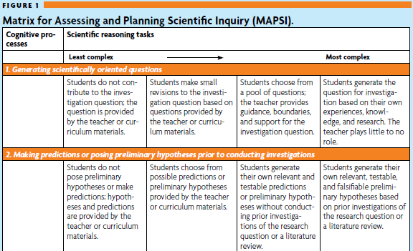
“Cookbook” Labs Inquiry-Based Investigations
Almost any “traditional” lab can be modified to focus on student-centered inquiry
A spectrum of guidance can be given to students depending on the lab structure

Slide 13
Seven Days of Observing Germinating and Growing Mung Beans

Slide 14
Staple across the bag such that there is space for roots to grow
Cut piece of paper towel and insert into bag
Get 2 x 3 inch jewelry bags
Add 10 to 15 seeds to each bag

Slide 15
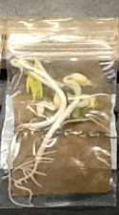

Slide 16
The Investigation is Over…NOW WHAT?
The post-lab discourse is one of THE most important aspects of the investigation….and often the most disregarded component
Students should engage in rich, didactic critique of their experimental design and analysis
WHY is this important?
This allows students to engage in the practice of scientific argumentation/critique
Through this discourse, student beliefs become transparent and create authentic formative assessment opportunities for teachers
But to be scientific, WHAT IS THE NEXT STEP???

Slide 17
Risk Analysis – Toxicology Unit
LD50 Salt on Mung Beans
Serial Dilutions
New Step
39

Slide 18

0.1 g/mL

Slide 20
Conclusion/Errors
LD50 with NaCl in baggies is about 1.25 to 1.30 %
Some beans may have died at low concentrations due mold growing on seeds, bugs or just bad seeds

Slide 21
Agriculture Unit
  Ammonium Sulfate
  Mung Beans
New Step
39

Slide 22
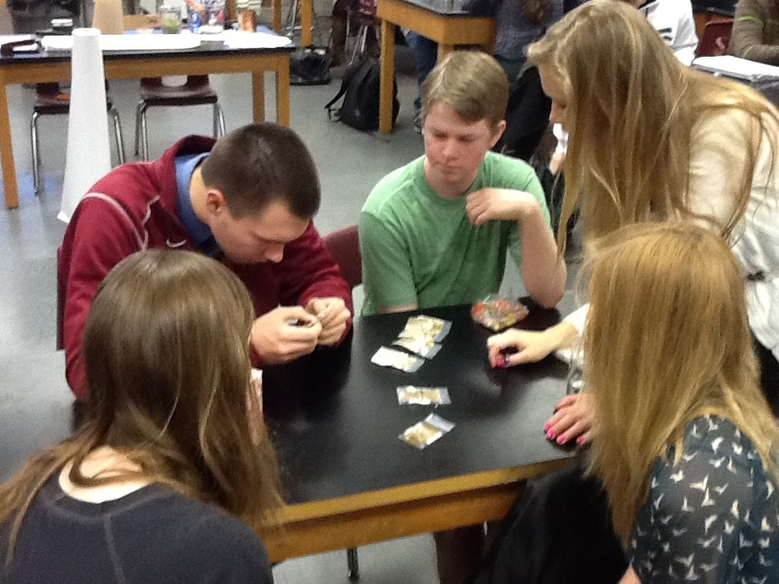
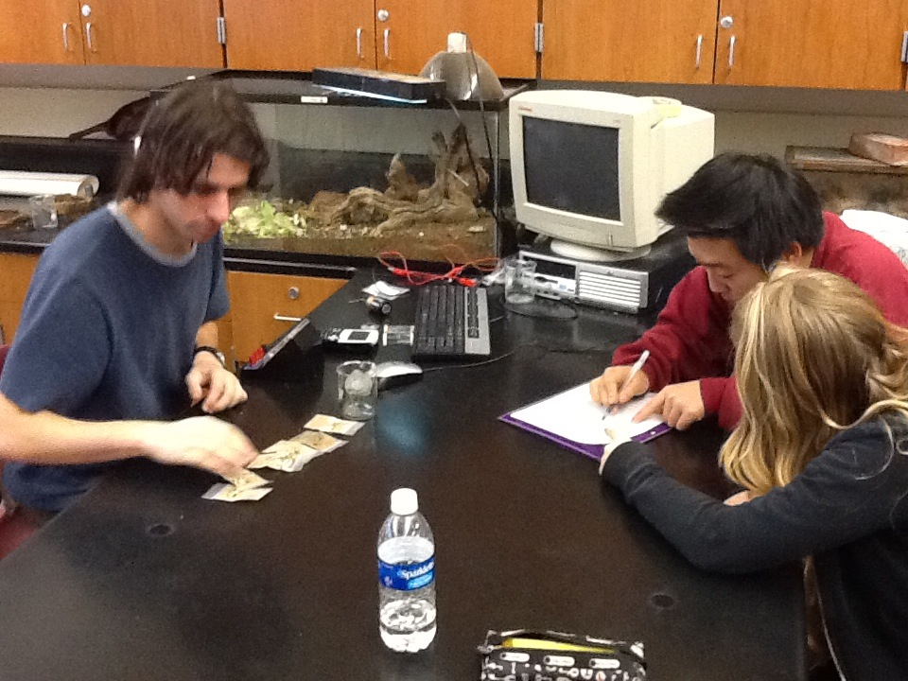
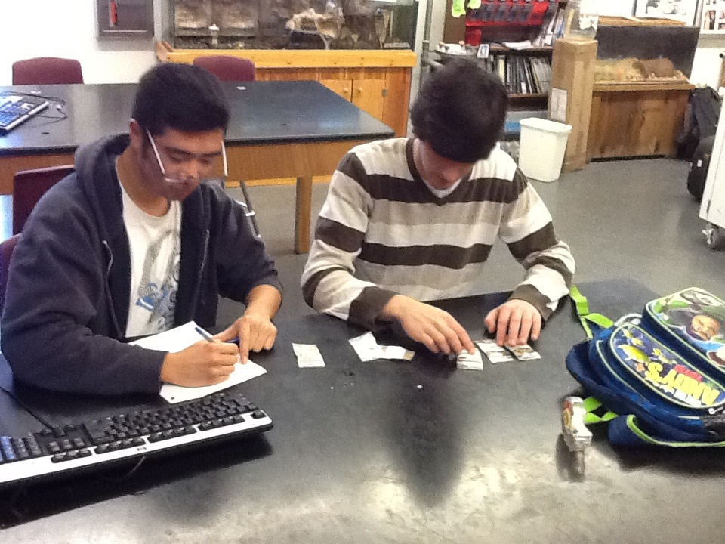
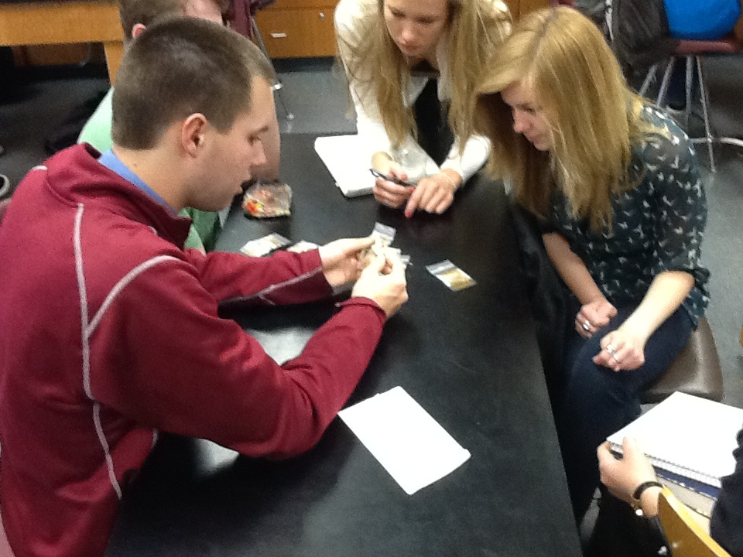
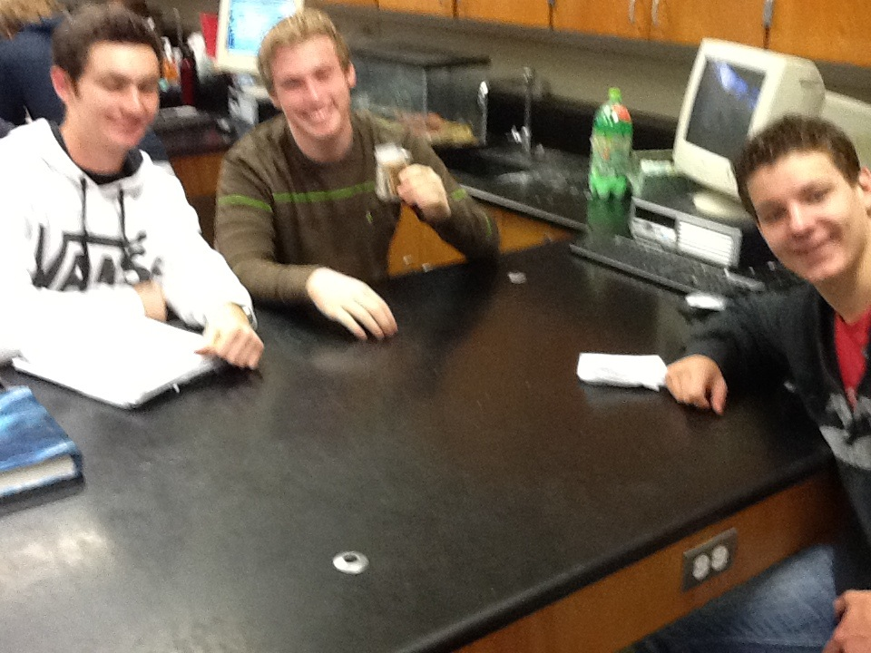
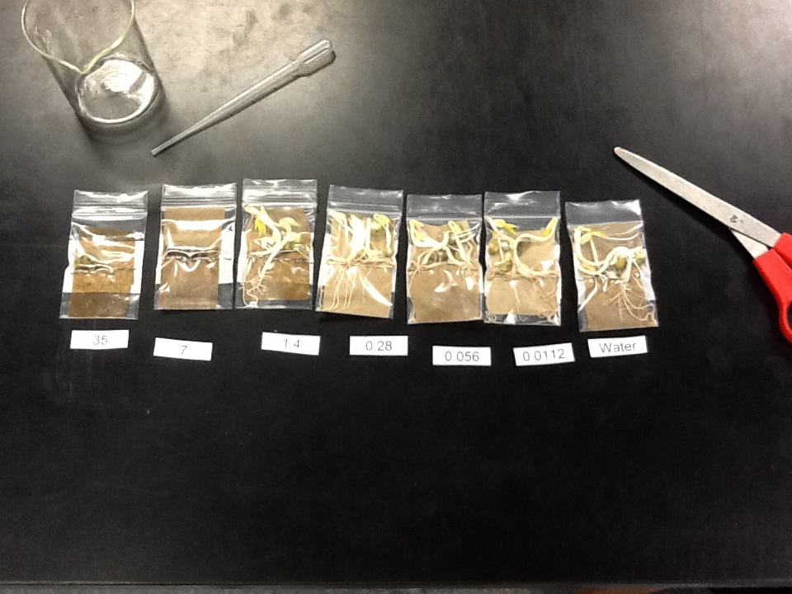

Slide 23
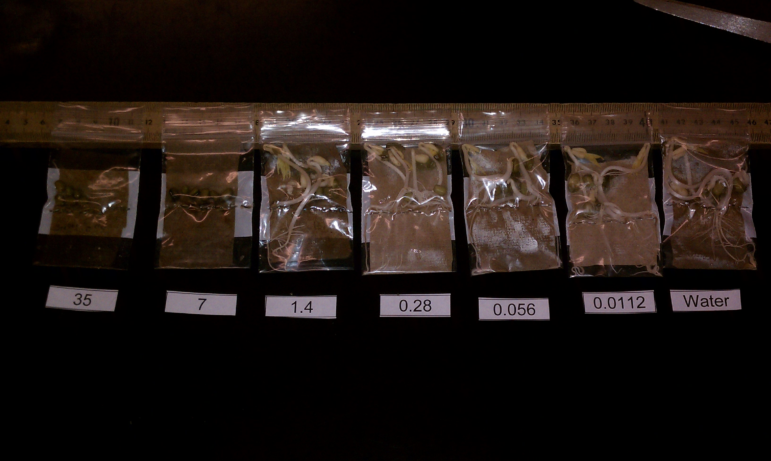

Slide 25
Conclusion/Errors
LD50 with Ammonium sulfate in baggies is estimated at 2 to 3%
Some beans may have died at low concentrations due mold growing on seeds, bugs or just bad seeds

Slide 26
Serial Dilutions - LD50 Salt on Mung Beans in bags
Ammonium Sulfate on Mung Beans in bags
Ammonium Sulfate on Mung Bean
Plant Growth in SOIL
New STEP
39

Slide 27
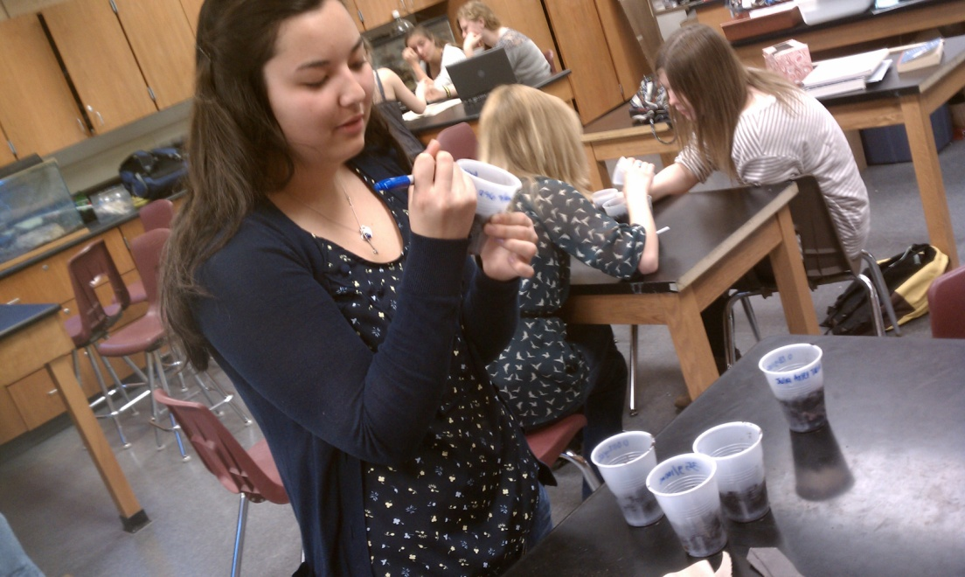
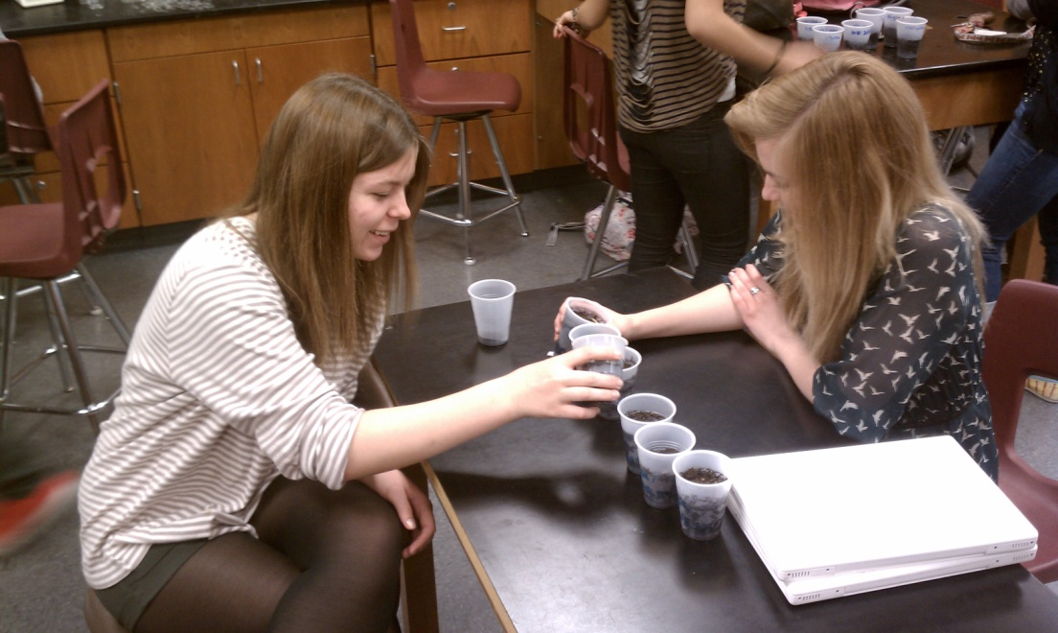
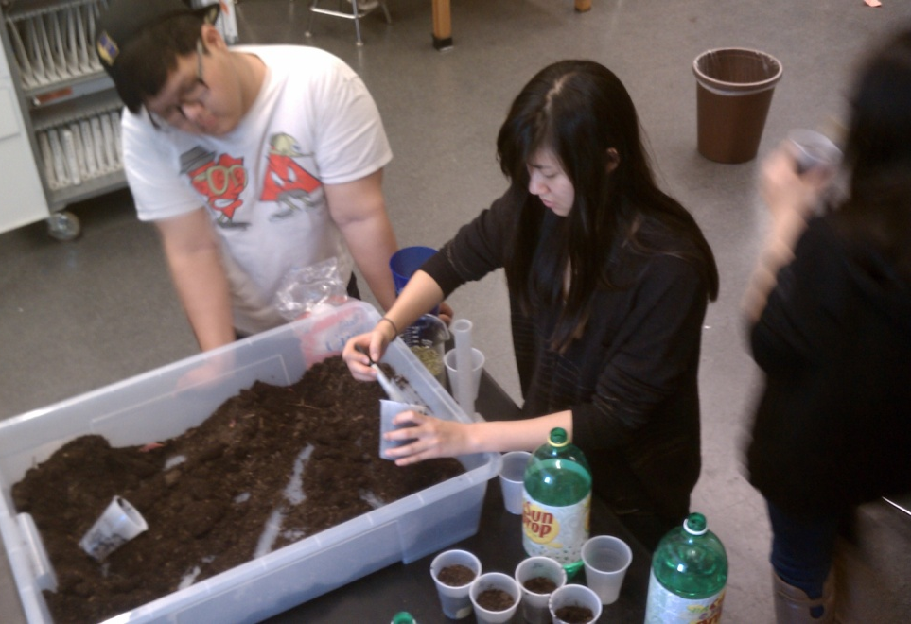
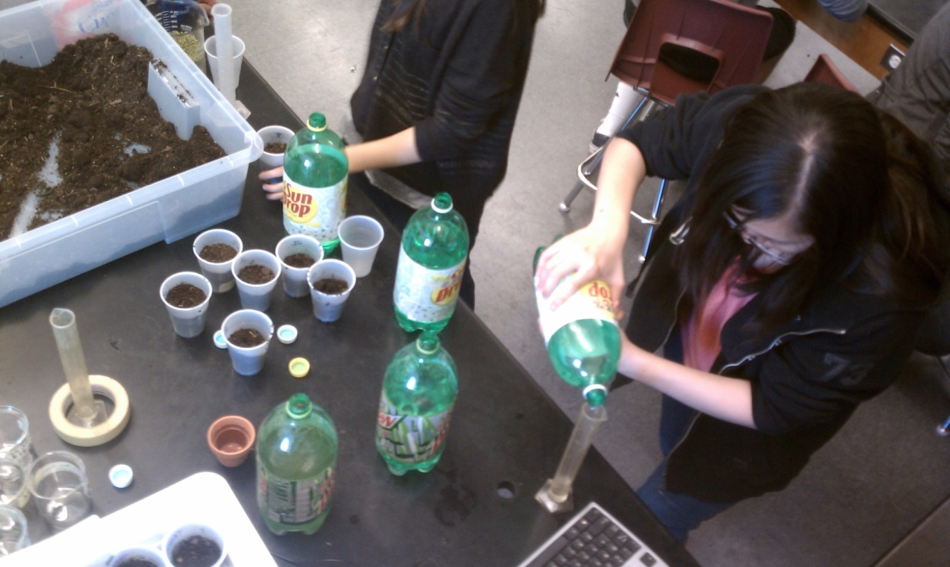
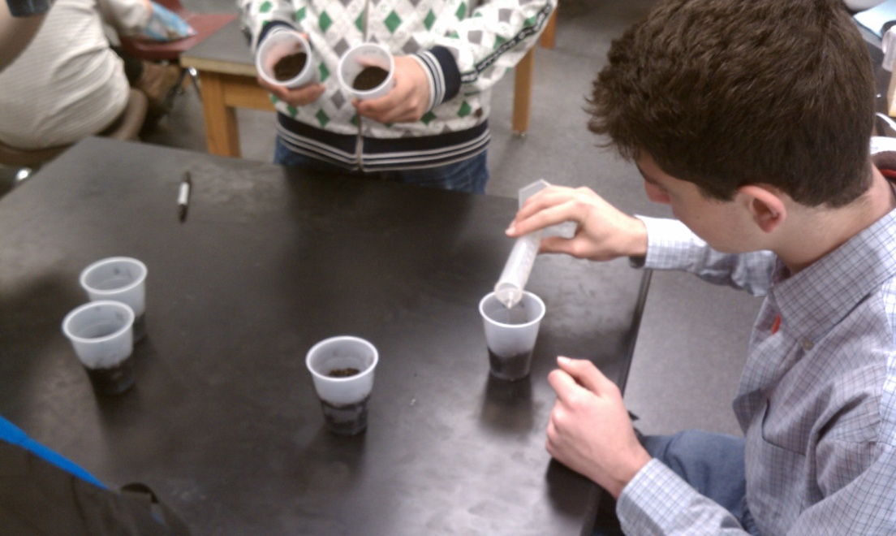
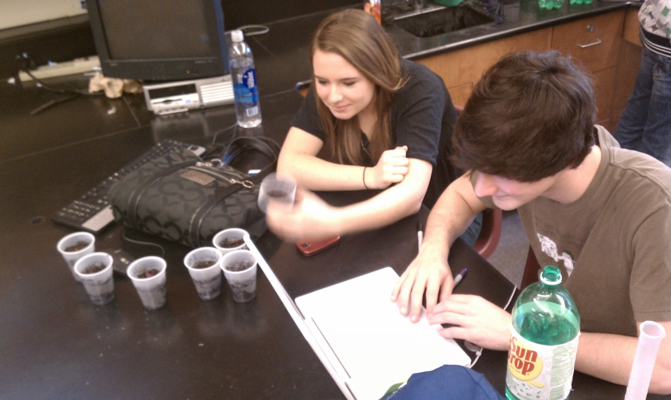
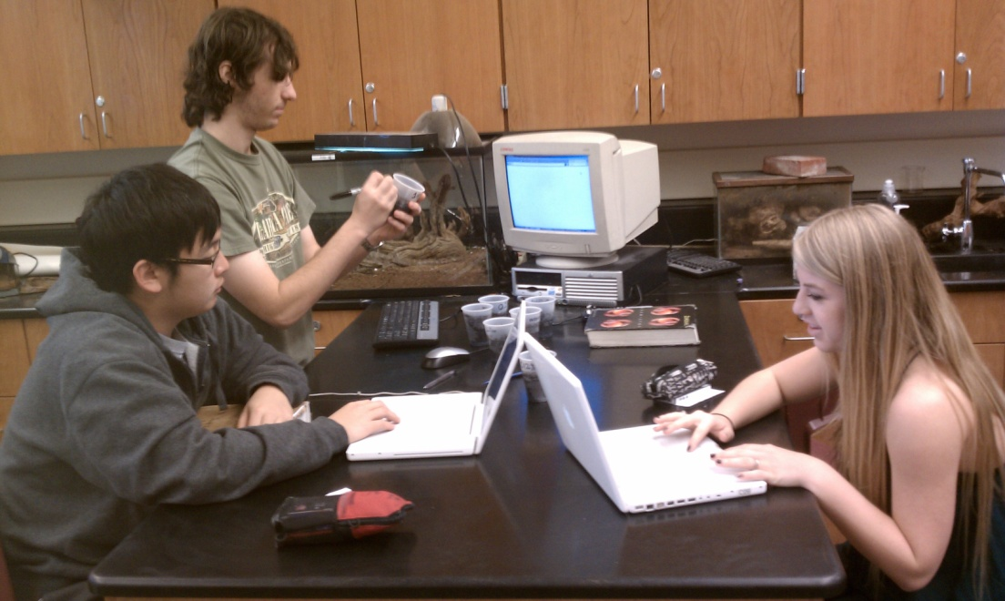

Slide 29
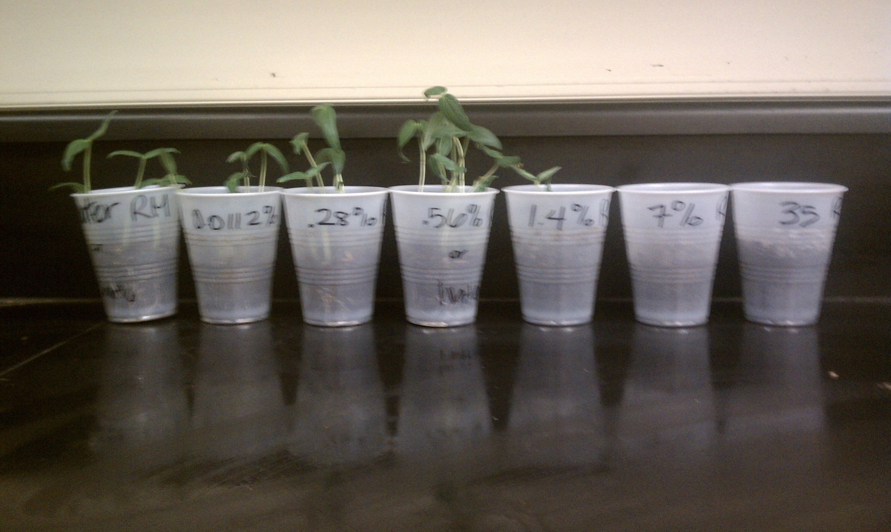
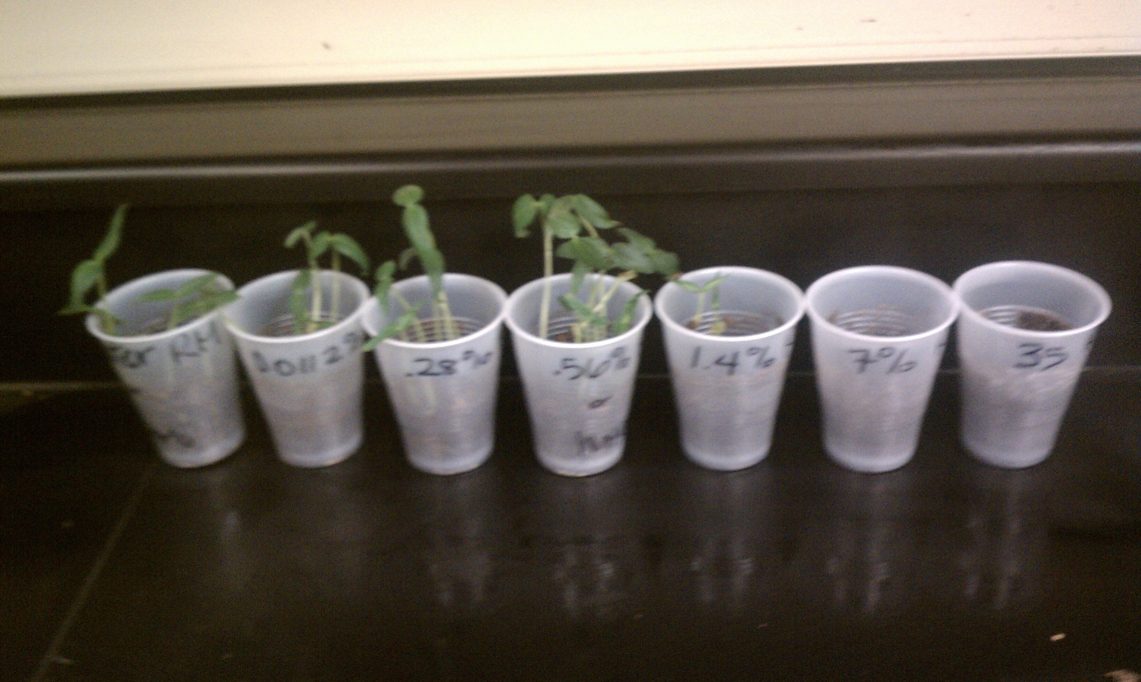

Slide 31
Conclusion/Errors
LD50 with A.S. in soil is about 1.4 to 5.0% - unsure because it starts at 20%
Some beans may have been planted to deep, too much compaction of soil, not enough water

Slide 33
Conclusion/Errors
Ammonium sulfate helps the beans grow at a concentration of about 0.28%
Right above that concentration, the amount of A.S. keeps the seeds from germinating.
Important for farmers to know so do not add to much fertilizer
Next time try the test with poorer soil

Slide 34
Serial Dilutions - LD50 Salt on Mung Beans in bags
Ammonium Sulfate on Mung Beans in bags
Ammonium Sulfate on Mung Beans plant growth
Ammonium Sulfate on Eutrophication?
New STEP
39

Slide 35
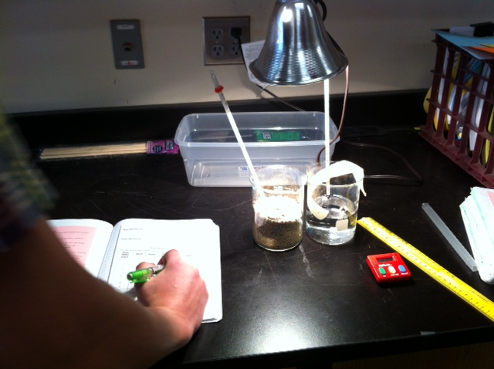
Specific Heat and Albedo

Slide 36
Specific Heat of Water and White Sand
39

Slide 37
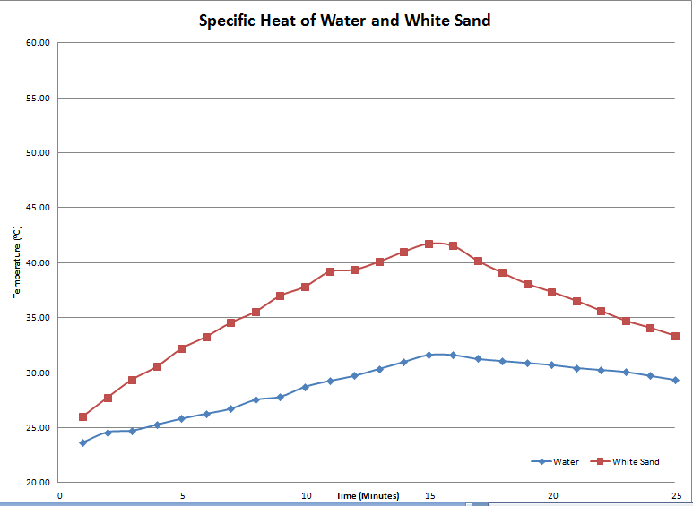

Slide 38
Specific Heat of Water and White Sand
Specific Heat and Albedo of White and Black Sand
New Step
39

Slide 39
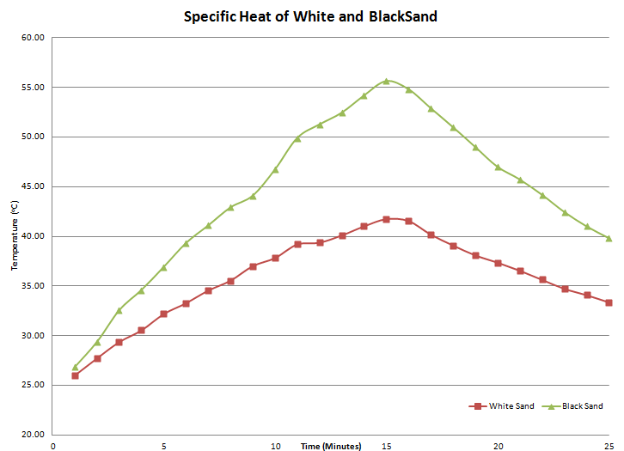

Slide 40
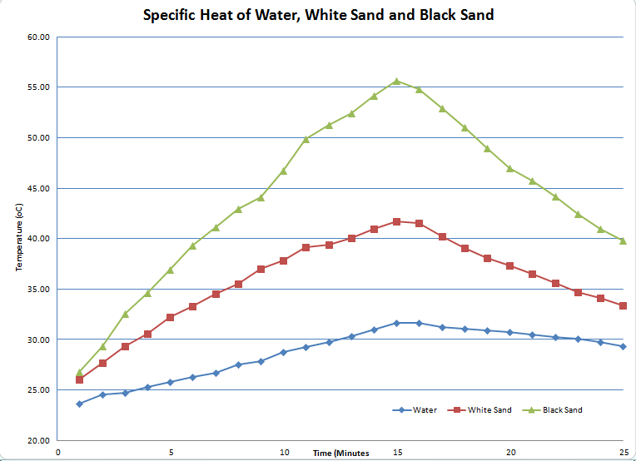

Slide 41
Specific Heat of Water and White Sand
Specific Heat and Albedo of White and Black Sand
?
New Step
39

Slide 42
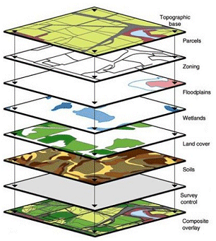
GIS
College
And
Employability

Slide 43
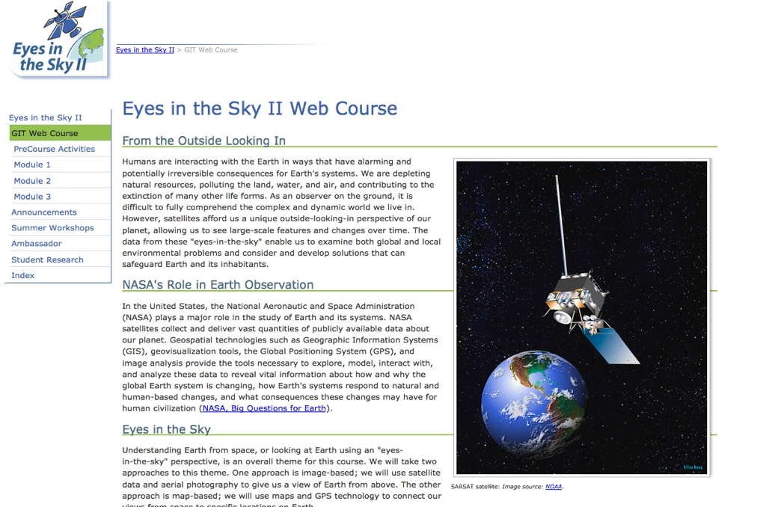
Resources for Student-Centered, Inquiry-Based Learning

Slide 44

Image-J Montage - Insolation
41

Slide 45
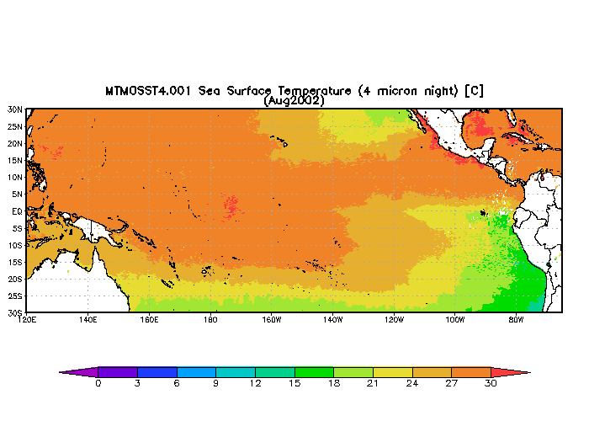
Image-J Animation - El Niño
42

Slide 46
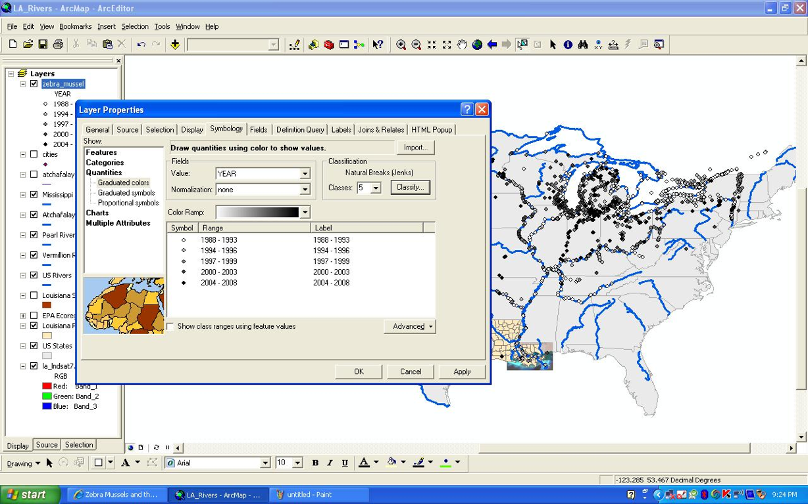
ArcMap - Zebra Mussels
43

Slide 47
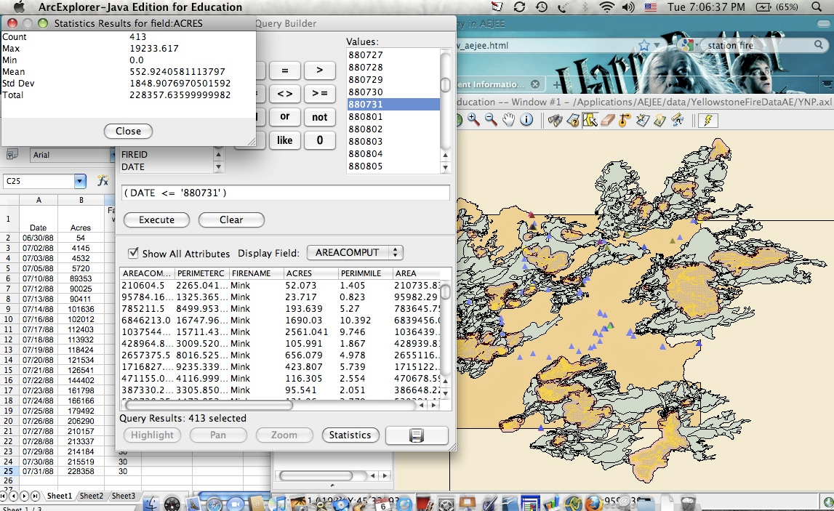
ArcMap Data Analysis Yellowstone Fires
45

Slide 48
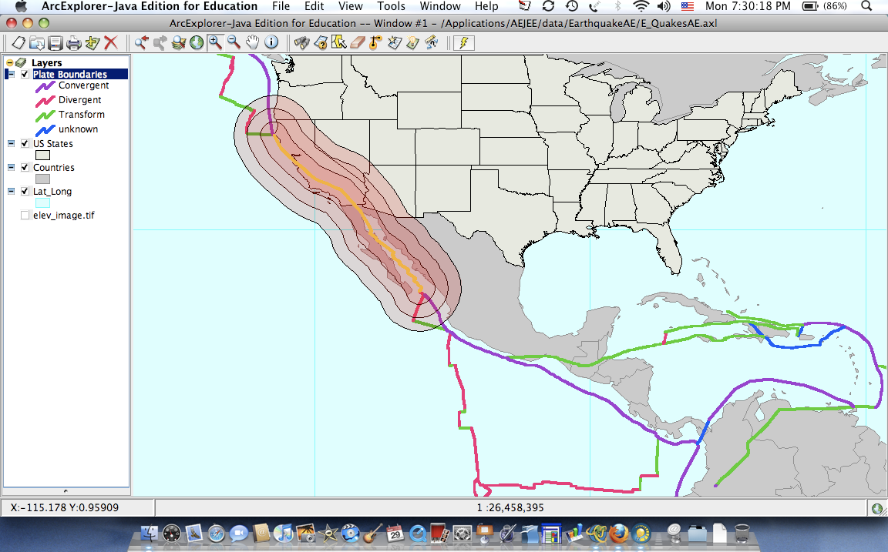
AEJEE Earthquakes
44

Slide 49
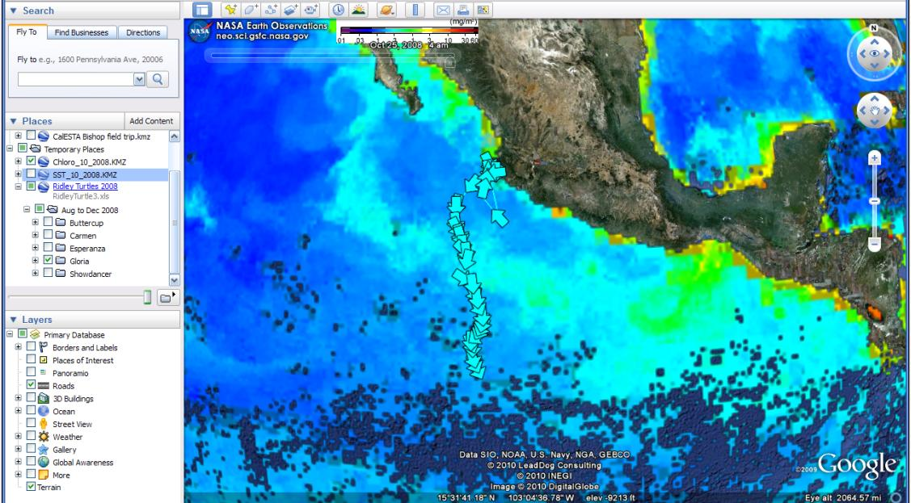
Google Earth - Turtle Travel
46

Slide 50
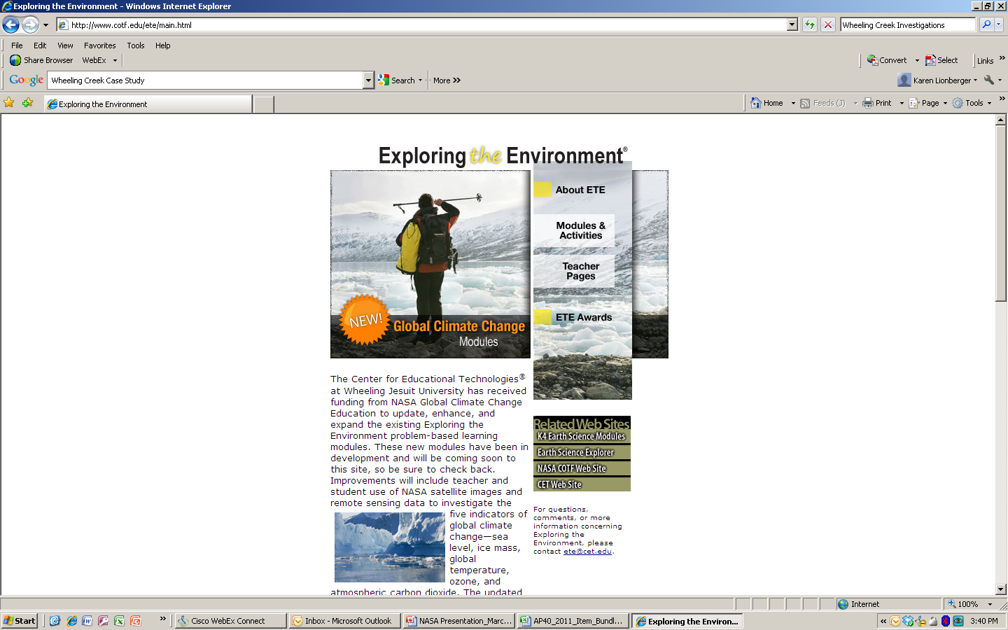
Resources for Inquiry-Based Learning: NASA Instructional Modules
Providing case-studies and project-based earning opportunities for students
Instructional modules are grounded in real-world data that teachers can use to support inquiry-based investigations
Allows students to engage in authentic problem-solving activities that incorporate both math and science principles/concepts

Slide 51
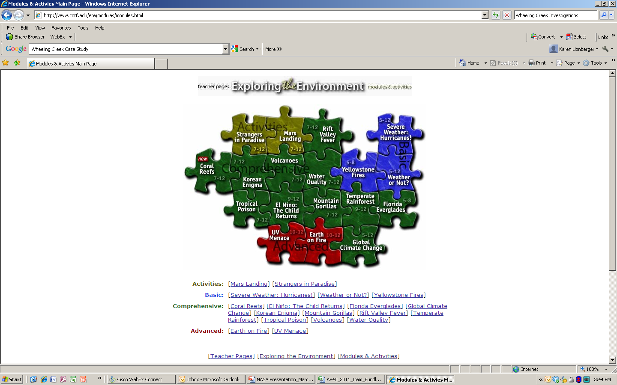
Some modules are Pre-AP level and lay the foundation for future work at the AP level by engaging students in critical thinking activities and the “science practices”

Slide 52
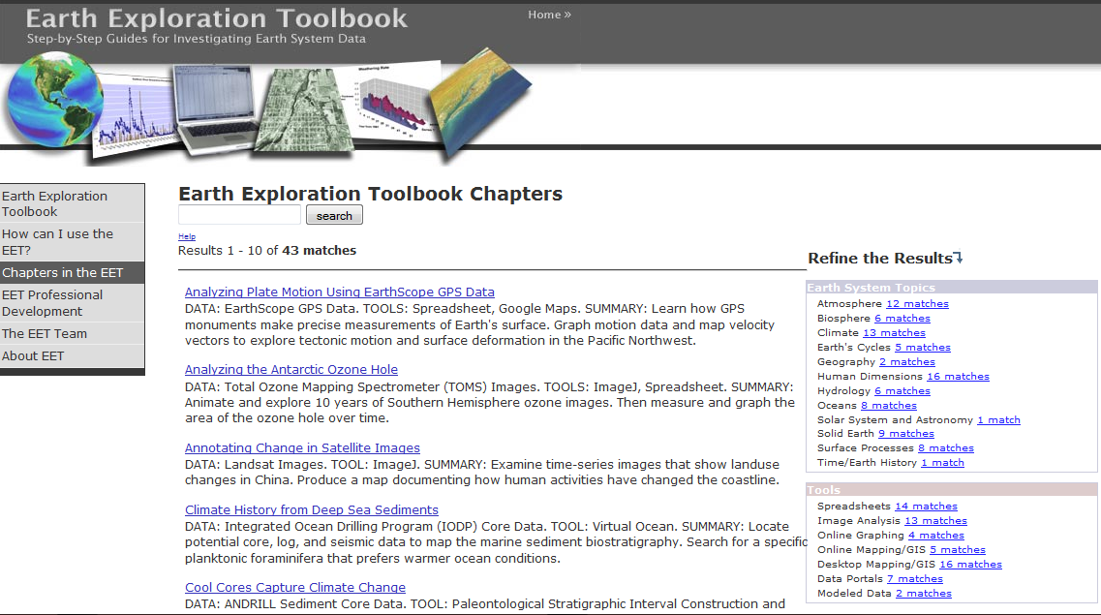

Slide 53


Slide 54
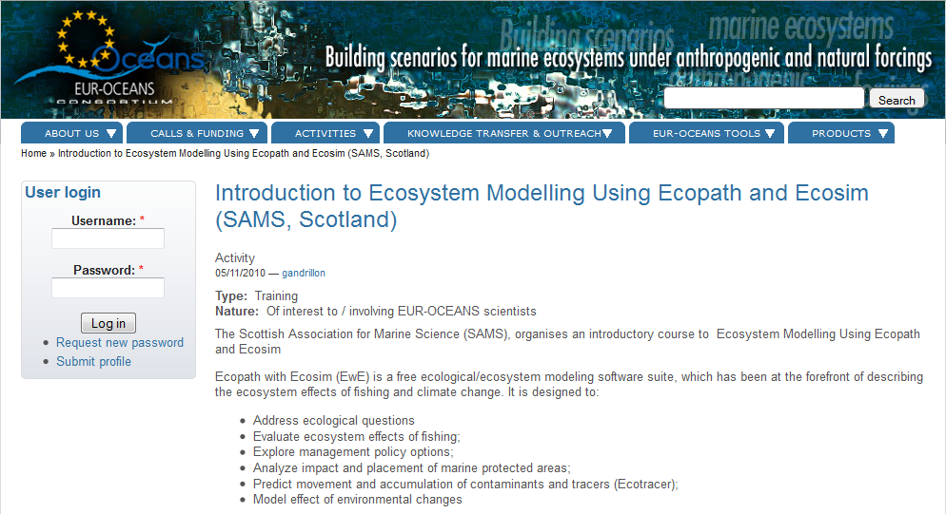

Slide 55

“Imagination is more important than knowledge.
For knowledge is limited to all we now know and understand,
while imagination embraces the entire world,
and all there ever will be to know and understand.”
– Albert Einstein
49

Slide 56
Paradigm Shift for Students
(and Teachers)
8

Slide 57
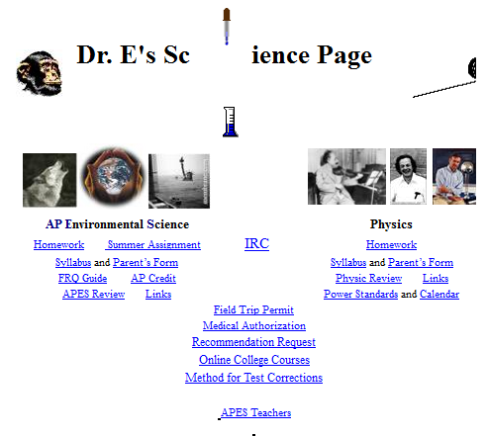
Where to find materials from today…
Google “Dr. E’s Science Page”
Questions or Comments, Contact AP:
Dr. Mark Ewoldsen
College Board Advisor: AP Environmental Science
mewoldsen@gmail.com
Questions or Comments, Contact AP:
Karen Lionberger
Director, AP Environmental Science,
klionberger@collegeboard.org
Discussion…

Slide 58
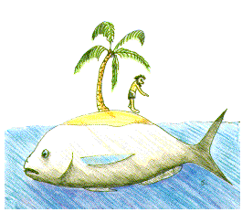
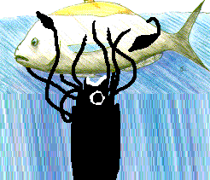
Ecosim* overview for NEMoW
*and spawn of Ecosim: related dynamic models including Ecospace
Sarah Gaichas aNWFSC
John Field, SWFSC
Frank Parrish, PIFSC
Clay Porch, SEFSC
Howard Townsend, NCBO
nd Kerim Aydin, AFSC
Chris Harvey,

Slide 59
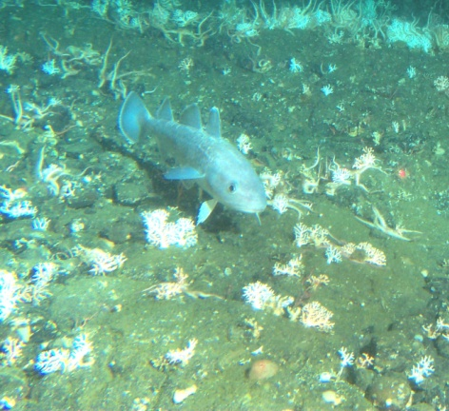
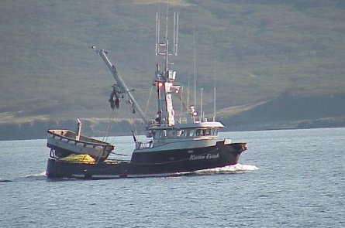
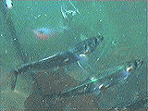
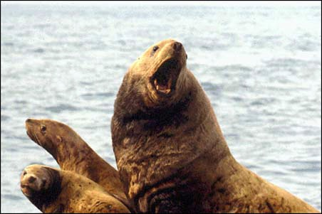

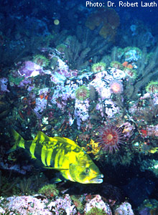
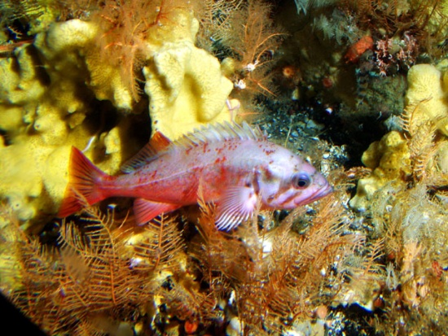
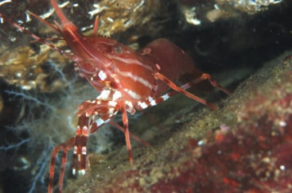
What is/has/will the model be used for?
Describing ecosystems and improving understanding of how simultaneous physical, ecological, and fisheries interactions affect commercial and bycatch species
Examining apex predator (and or protected species) carrying capacity and predicting responses to changing fishing and primary production
Examining ecosystem effects of
  changing water quality
  changing fishing gear
  different MPA scenarios
Evaluating tradeoffs between management strategies
Providing foundation for developing proposals to integrate ecosystem-based management approaches into current management regimes

Slide 60
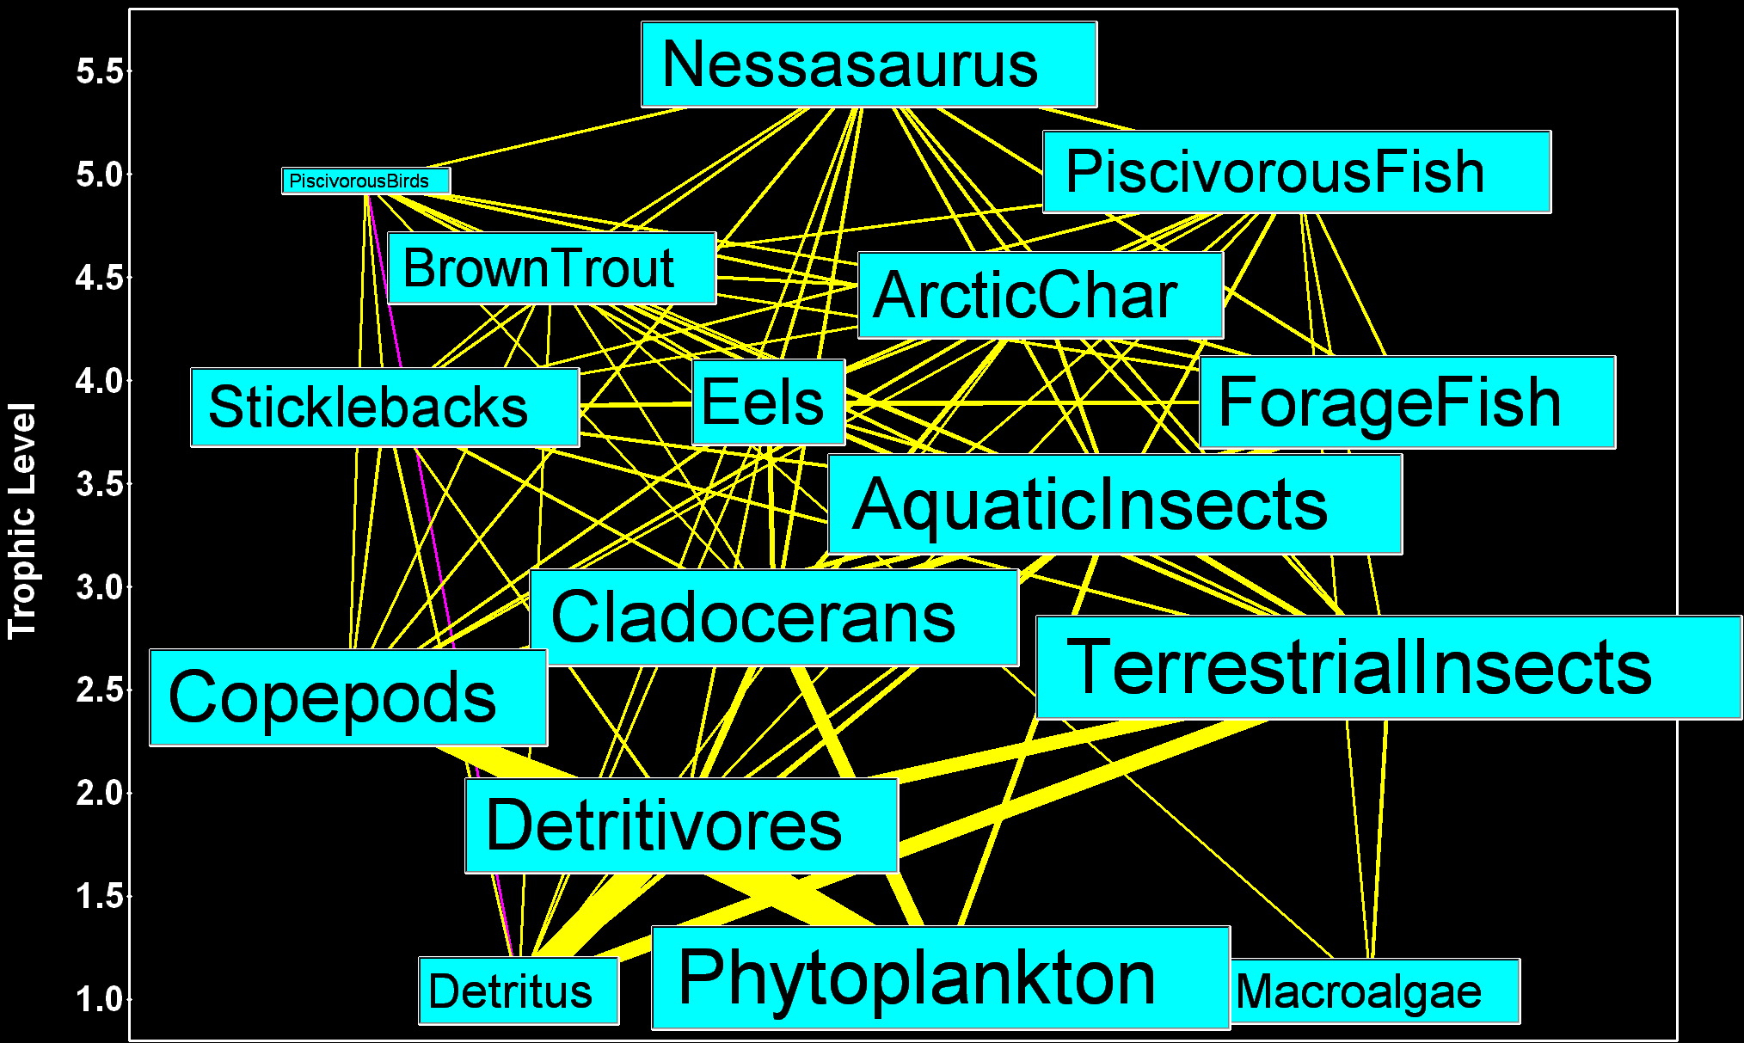
Static food web to dynamic simulation requires functional response
+ age structured population dynamics
?

Slide 61
Gulf of Alaska (GOA) simulation
Low vulnerability versus
High vulnerability
Biomass (t/km²)
Simulation year

Slide 62
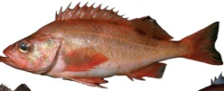
Experience: equilibrium + uninformative data + vulnerability estimation in the GOA*
Today’s rules (path equilibruim) can’t recreate yesterday’s GOA. Species and or ecosystem production was different historically.
Supports both climate and fishing-related hypotheses for change, but with different predator prey relationships implied by estimated vulnerability parameters
*Analyses in Sim alternative

Slide 63
Different drivers for different species*
*
*
*
*
Key: Lower AIC is better overall fit;
Each species fit varies by model
Extinct
OK fit
Best fit
Notes:
Fishing alone does not explain system dynamics
Closest for halibut (F >> predation)
Many other ecosystems appear fishing-driven
Best explanations require
Estimating vulnerability parameters by species AND
Variable productivity over time
High historical recruitment for three key species or
Changing primary production (Pacific Decadal Oscillation)
Vulnerability parameters
differed under each production assumption, but
had similar explanatory power
No single driver of the GOA. Maybe that’s good.

Slide 64
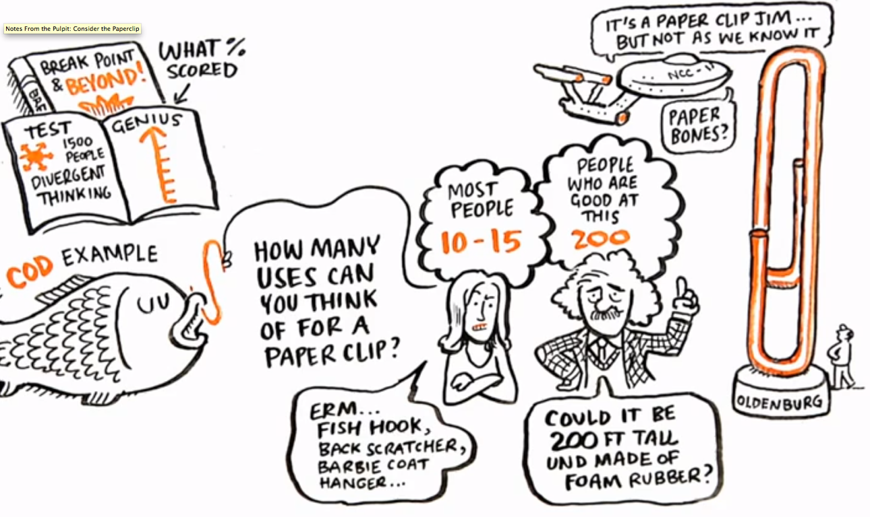
5

Slide 65

What is Scientific Method?
Ask a Question
Do Background Research
Construct a Hypothesis
Test Your Hypothesis by Doing an Experiment
Analyze Your Data and Draw a Conclusion
Communicate Your Results
AND What’s Next??????
36

Slide 66

Taking Traditional Labs and Making them Inquiry-Based
Almost any “traditional” lab can be modified to focus on student-centered inquiry
There is a spectrum of guidance given to students depending on the lab structure – See MAPSI
See handout on revised lab for toxicology of “traditional” cleaners

