Slide 1
Population Review

Slide 2
When natural selection occurs, what is the key factor that will determine which individuals will survive and pass on the beneficial traits?
A. The traits that are more useful to humans will be passed on
B. Size; the larger the animal or plant, the more likely it will survive
C. How large the initial population is
D. The environment will determine which traits are most beneficial
E. Natural selection is random and occurs by chance
Notes:
D

Slide 3
If a population of 100 birds increases to 120 birds the following year, r = _____.
A. 0. 16
B. 0. 20
C. 1. 2
D. 2
E. 20
Notes:
B

Slide 4
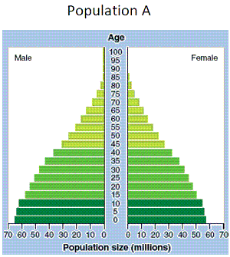
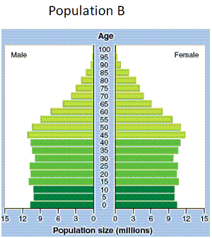
Population A
I. Is likely to have a higher level of education than population B
II. Is likely to have had a recent decline in infant mortality
III. Is likely to be poorer than population B
A. I
B. III
C. I and II
D. II and III
E. I, II, and III
Notes:
D

Slide 5
A population of rabbits, introduced to an island, has rapid growth for a few years; then its growth slows. The population becomes stable because
A. the carrying capacity has been reached.
B. environmental resistance declines.
C. immigration is reduced.
D. r declines.
E. Bergman’s Principle takes effect.
Notes:
A

Slide 6
Countries undergoing rapid population decline may experience a rise in the proportion of the population
A. on “social security”.
B. consuming a large fraction of medical services.
C. who are older people.
D. can face labor shortages.
E. who fit all of these answers.
Notes:
E

Slide 7
Rapidly growing countries have an age structure that
A. forms an inverted pyramid.
B. has a broad-based pyramid.
C. shows little variation in population by age.
D. has a large postreproductive population.
Notes:
B

Slide 8
Countries that have achieved ZPG have an age structure that
A. forms an inverted pyramid.
B. has a broad-based pyramid.
C. shows little variation in population by age.
D. has a large prereproductive population.
E. has a large reproductive population.
Notes:
C

Slide 9
An exponential growth curve depicting an ever-growing population is shaped like the letter ____.
A. J
B. L
C. M
D. S
E. N
Notes:
A

Slide 10
The age structure of a population is the number or percentage of
A. females age 14 years or under.
B. females age 15 to 44.
C. males age 15 to 44.
D. persons of each sex at each age level.
E. persons of each sex age 15 to 44
Notes:
D

Slide 11
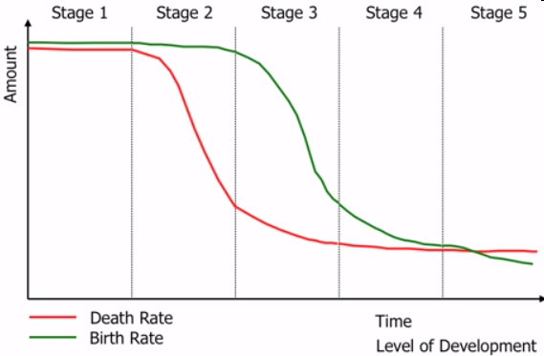
According to the theory of demographic transition, rapid growth occurs during phase
A. 1.
B. 2.
C. 3.
D. 4.
E. 5.
Notes:
B

Slide 12
Two useful indicators of overall health in a country or region are
A. birth rate and death rate.
B. replacement-level fertility rate and total fertility rate.
C. life expectancy and infant mortality rate.
D. life expectancy and death rate.
E. population growth rate.
Notes:
C

Slide 13
Two useful indicators of overall health in a country or region are
A. birth rate and death rate.
B. replacement-level fertility rate and total fertility rate.
C. life expectancy and infant mortality rate.
D. life expectancy and death rate.
E. population growth rate.
Notes:
C

Slide 14
The most useful measure of fertility for projecting future population change is the
A. replacement-level fertility.
B. one-year future fertility level.
C. total fertility rate.
D. birth rate.
E. abortion rate.
Notes:
C

Slide 15
Which of the following would contribute the greatest number to total population size in one year?
A. a country of 1. 5 million people with a growth rate of 3%
B. a country of 5 million people with a growth rate of 2. 5%
C. a country of 100 million people with a growth rate of 2%
D. a country of 500 million people with a growth rate of 1. 5%
E. a country of 10 million people with a growth rate of 2. 5%
Notes:
D

Slide 16
When mosquitoes are very abundant, purple martins flock to the area and specialize on them. When mosquito populations are not large, purple martins are similarly scarce and feed on other insects. This is an example of
A. density-independent regulation.
B. density-dependent regulation
C. ecosystem carrying capacity.
D. community carrying capacity.
E. exotic regulation.
Notes:
B

Slide 17
Approximately how many females are between the ages of 50 and 59?
A. 500,000
B. 5,000,000
C. 20,000,000
D. 30,000,000
E. 50,000,000
Notes:
C

Slide 18
The crude birth rate is the number of live births per ____ persons in a given year.
A. 50
B. 100
C. 500
D. 1,000
E. 10,000
Notes:
D

Slide 19
Which of the following best describes the survivorship curve you would expect to find for a Kangaroo?
A. late loss
B. constant loss
C. early loss
D. no loss
Notes:
A

Slide 20
Which of the following factors leads to an increase in biotic potential?
A. too much or too little light
B. low reproductive rate
C. too many competitors
D. optimal level of critical nutrients
E. specialized niche
Notes:
D

Slide 21
The most common pattern of population dispersion found in nature is
A. random.
B. clumped.
C. uniform.
D. dispersed.
Notes:
B

Slide 22
Worldwide, the largest density-dependent cause of death is
A. natural disaster.
B. malnutrition.
C. heart disease.
D. infectious disease.
E. car accidents.
Notes:
D

Slide 23
A country has a growth rate of 0. 2%, a TFR of 2. 6, and a net migration rate of -8. What is most likely true of this country?
A. The population will likely decrease over time.
B. The population will likely grow for a few generations before stabilizing.
C. The population will likely grow for a few generations before shrinking.
D. The population will likely increase at a steady rate.
E. There is not enough information to tell.
Notes:
A

Slide 24
Using the rule of 70, a population growing at 3.5% would double in
A. 7 years
B. 10 years
C. 15 years
D. 17 years
E. 20 years

Slide 25
According to the theory of demographic transition, birth rates make the most significant decline during phase
A. 1.
B. 2.
C. 3.
D. 4.
E. 5.
Notes:
C

Slide 26
Developing countries tend to have a(n) ____ age structure diagram.
A. rectangular-shaped
B. inverted triangle
C. pyramid-shaped
D. square
E. round
Notes:
C

Slide 27
To determine the number of individuals that will be added to a population in a specified time we multiply the growth rate (r) by the
A. biotic potential.
B. original population size.
C. environmental resistance.
D. final population size.
E. number of immigrants.
Notes:
B

Slide 28
The total fertility rate (TFR) is an estimate of
A. the number of children that will survive to adulthood.
B. the number of years a typical infant will live.
C. the percentage of women in a population that are able to have children.
D. the number of births per 1000 people per year.
E. the number of children each woman in a population will have.
Notes:
E

Slide 29
If the growth rate r of a population is positive and remains constant, the number of people added to the population
A. remains constant.
B. fluctuates randomly.
C. decreases each year.
D. reaches carrying capacity.
E. increases each year.
Notes:
E

Slide 30
The biologist who studies interactions at the “community” level investigates interactions between
A. organisms of one species
B. populations of more than one species.
C. animals of one species.
D. social animals (like insects).
E. ecosystems.
Notes:
B

Slide 31
The intrinsic growth rate of a population
A. directly affects environmental resistance.
B. causes changes in birth rates without affecting death rates.
C. causes changes in death rates without affecting birth rates.
D. is the maximum rate at which a population may increase.
Notes:
D

Slide 32
According to the theory of demographic transition, the highest birth rates and death rates are likely to occur during phase
A. 1.
B. 2.
C. 3.
D. 4.
E. 5.
Notes:
A

Slide 33
Approximately how many males are under the age of 10?
A. 130,000,000
B. 110,000,000
C. 20,000,000
D. 15,000,000
E. 450,000
Notes:
A

Slide 34
You observe uniform dispersion in a species you are studying intensely. You predict that as you extend your work, you will find
A. intraspecific competition and evenly spread, scarce resources.
B. interspecific predation and evenly spread, scarce resources.
C. intraspecific competition and evenly spread, abundant resources.
D. commensalism and clumped resources.
E. interspecific competition and evenly spread, abundant resources.
Notes:
A

Slide 35
Two species of aster can be found in a field in New York, and they tend to flower at the same approximate time in early spring. When some ecology students decide to conduct an experiment in community dynamics, they selectively remove one species from the field by handpicking all plants of that species. When the one species is removed, the other species shows a significant increase in its population the next season. This study demonstrates
A. competitive exclusion.
B. niche fragmentation.
C. niche realignment.
D. resource partitioning.
E. interspecific competition
Notes:
D

