Slide 1
Geology and Energy Review

Slide 2
Which is our best immediate energy option?
A. Find and burn more forms of oil, natural gas, and coal.
B. Cut out unnecessary energy waste by improving energy efficiency.
C. Build more and better conventional nuclear power plants.
D. Increase efforts to develop breeder nuclear fission and nuclear fusion.
E. Discover a new form of energy.
Notes:
B

Slide 3
Reasons for which petroleum is the chosen fuel for transportation in the U.S. include
I. Its energy value per unit volume
II. Its ability to quickly start or stop providing energy
III. Its low amount of pollution produced per Joule
A. I only
B. II only D. I and II only
C. III only E. I, II, and III
Notes:
D

Slide 4
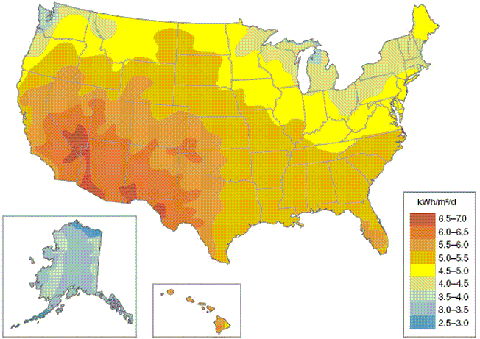
The region of the
US that has the
highest solar
radiation per
day is
A. the upper Midwest
B. the desert southwest
C. the temperate grasslands
D. the coastal plains
E. the deciduous forest region
Notes:
B

Slide 5
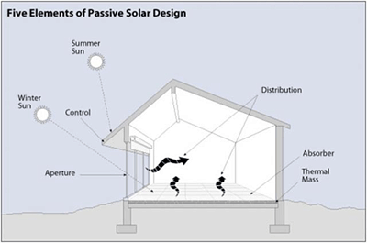
Windows designed to capture solar energy in the United States face
A. north.
B. east.
C. south.
D. west.
E. north-east.
Notes:
C

Slide 6
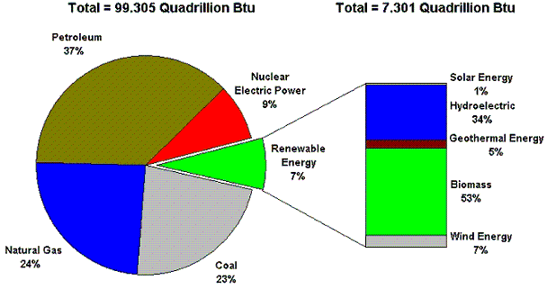
What percent of the US energy needs are served by nonrenewable energy sources?
A. 7% B. 60% C. 84% D. 93% E. 99%
Notes:
D

Slide 7
When supplies of a particular energy type are finite, it is known as a
A. renewable resource
B. potentially renewable resource
C. nonrenewable resource
D. nondepletable resource
E. perpetual resource
Notes:
C

Slide 8
Which of the following is considered to be a subsistence energy source?
I. coal
II. charcoal
III. wood
A. I only
B. III only D. II and III only
C. I and III only E. I, II, and III
Notes:
D

Slide 9
Which of the following represents the correct sequence of energy resource use as the United States progressed from the late 1800s to the 1950s?
A. wood, coal, oil, natural gas, hydroelectric
B. coal, hydroelectric, natural gas, oil, wood
C. wood, oil, natural gas, hydroelectric, coal
D. coal, oil, wood, natural gas, hydroelectric
E. coal, wood, hydroelectric, natural gas, oil
Notes:
A

Slide 10
On the east coast,
which state has
the greatest
potential for
solar power
generation?
A. Maine
B. New York D. Virginia
C. Massachusetts E. Florida
Notes:
E

Slide 11
The energy expenditure value of traveling by car is 3.6 MJ/passenger-kilometer. The value for traveling by train is 1.1 MJ/passenger-kilometer. For one person making a trip of 1000 km, the train is
A. approximately 1/3 more efficient
B. not at all more efficient
C. approximately 3 times more efficient
D. approximately 30 times more efficient
E. approximately 300 times more efficient
Notes:
C

Slide 12
The energy expenditure value of traveling by car is 3.6 MJ/passenger-kilometer. The value for traveling by train is 1.1 MJ/passenger-kilometer. What would be the best way to increase the efficiency of traveling by car?
A. increase the gas mileage
B. increase the number of passengers
C. reduce the number of miles traveled
D. purchase a less expensive vehicle
E. use a different energy source
Notes:
B

Slide 13
The least utilized renewable energy source of the U.S. is
A. wind energy D. solar energy
B. geothermal energy E. hydroelectric energy
C. nuclear energy
Notes:
D

Slide 14
The energy expenditure value of traveling by car is 3.6 MJ/passenger-kilometer. For one person making a trip of 1000 km, if a gallon of gasoline contains 120 MJ, approximately how many gallons of gasoline would be required?
A. 3
B. 9 D. 60
C. 30 E. 90
Notes:
C

Slide 15
Why is a gas water heater more energy efficient OVERALL than an electric water heater when the electricity comes from a coal-fired power plant?
I. the electric water heater has a lower direct efficiency
II. the energy efficiency of the coal-fired power plant is low
III. natural gas does not need to be transported
A. I only
B. II only D. II and III only
C. I and II only E. I, II, and III
Notes:
C

Slide 16
The order of grades of coal from lowest energy content to highest energy content is
A. anthracite, lignite, sub-bituminous, bituminous
B. anthracite, sub-bituminous, bituminous, lignite
C. sub-bituminous, bituminous, lignite, anthracite
D. bituminous, sub-bituminous, lignite, anthracite
E. lignite, sub-bituminous, bituminous anthracite
Notes:
E

Slide 17
One of the biggest limitations to the wide scale use of geothermal energy is the need for
A. large amounts of water
B. a suitable site
C. an area with warm water temperatures
D. a cooling system
E. a large amount of land
Notes:
B

Slide 18
If an average refrigerator uses 500 watts of energy per hour on a daily basis, and your energy cost is $0.11 per kwh, approximately how much does the energy used by the refrigerator cost per month?
A. $1.30
B. $13 D. $55
C. $40 E. $132
Notes:
C

Slide 19
The fossil fuel(s) that pose risks to the environment include
I. coal
II. natural gas
III. petroleum
A. I only
B. II and III only D. I and II only
C. I and III only E. I, II, and III
Notes:
E

Slide 20
An automobile that gets 40 mpg on a 200-mile trip uses what fraction of gasoline compared to an automobile that gets 20 mpg for the same trip?
A. 1/4 the amount
B. 1/2 the amount
C. 1 1/4 the amount
D. 1 1/2 the amount
E. 2 times the amount
Notes:
B

Slide 21
If ANWR (the Arctic National Wildlife Refuge) yields a projected peak amount of approximately 330 million gallons of oil a year and the United States uses roughly 110 billion gallons of oil in one year, what percent of the oil used per year would be provided for by ANWR?
A. 0.003%
B. 0.03%
C. 0.3%
D. 3.0%
E. 30%
Notes:
C

Slide 22
Stronitum-90 has a half-life of 29 years. If a site held 2000 kg of this isotope, approximately what mass of Strontium-90 would be left after 116 years?
A. 250 kg
B. 1000 kg
C. 300 kg
D. 125 kg
E. 500 kg
Notes:
D

Slide 23
More than 80% of U.S. renewable energy is provided by
A. biomass and wind energy
B. wind energy and geothermal energy
C. biomass and hydroelectric energy
D. hydroelectric energy and geothermal energy
E. solar energy and hydroelectric energy
Notes:
C

Slide 24
Which of the following resources consists mostly of CH₄?
A. Coal
B. Natural Gas
C. Oil
D. Uranium
E. Solar Cells
Notes:
B

Slide 25
An important aspect of utility companies is reducing peak demand events. This is best accomplished by
A. building power plants with larger generating capacity.
B. implementing rolling black outs.
C. keeping an ample supply of coal on hand.
D. allowing customers to pay lower prices for energy when peak demand is low
E. using renewable sources to generate peak electricity needs
Notes:
D

Slide 26
Which of the following are Sun-driven energy types?
I. Wind power
II. Biodiesel
III. Geothermal
A. I only
B. II only D. I and II only
C. III only E. I, II, and III
Notes:
D

Slide 27
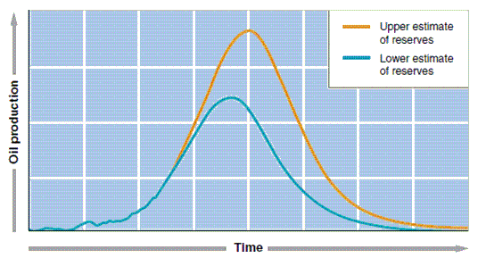
The curves show that oil production
A. will increase exponentially for the foreseeable future
B. will increase, decrease, then increase again
C. will reach a peak, then steadily decrease
D. will remain constant
E. is not affected at all by the amount of oil reserves
Notes:
C

Slide 28
The most utilized nondepletable resource of the U.S. is
A. natural gas
B. hydroelectric D. solar
C. wind E. geothermal
Notes:
B

Slide 29
Which of the following tends to be problematic for run-of-the-river generation stations?
A. intermittent electricity generation
B. seasonal changes in river flow
C. high environmental costs
D. silting of the reservoirs
E. high flow rates
Notes:
A

Slide 30
The largest dam in the world, ____ , can generate almost 85,000,000,000 kWh of electricity per year.
A. The U.S.’s Hoover Dam
B. China’s Three Gorges Dam
C. Brazil's and Paraguay's Itaipu Dam
D. England’s Cragside Dam
E. Venezuela’s Guri Dam
Notes:
B

Slide 31
Fish ladders help to mitigate the environmental problems caused by
A. tidal power
B. water impoundment systems
C. run-of-the-river systems
D. photovoltaic solar cells
E. hydrogen fuel cells
Notes:
B

Slide 32
On a worldwide basis the fastest growing renewable source for generating electricity is
A. geothermal
B. hydroelectric
C. solar
D. biomass
E. wind
Notes:
E

Slide 33
Which country's percentage of electricity from wind power is the highest?
A. Brazil
B. Russia
C. United States
D. Denmark
E. India
Notes:
D

Slide 34
The bell-shaped curve, as originally drawn by a Shell Oil Company geophysicist, representing global oil production is known as the _____ Curve.
A. Hubbert
B. Peak Oil
C. Shell
D. Production
E. Allen
Notes:
A

