Slide 1
Circular Motion Review
Notes:
1

Slide 2
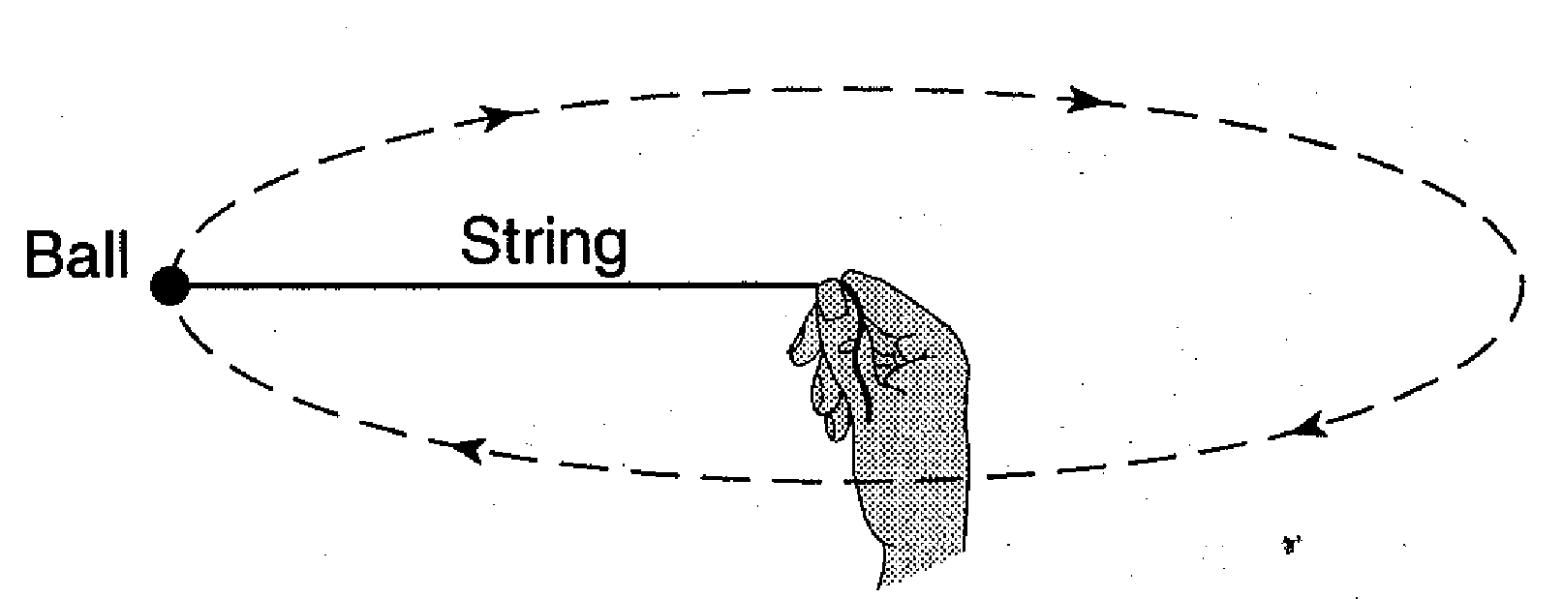
A student spinning a 0.10-kilogram ball at the end of a 0.50-meter string in a horizontal circle at a constant speed of 10. meters per second. If the magnitude of the force applied to the string by the student's hand is increased, the magnitude of the acceleration of the ball in its circular path will
A. decrease
B. increase
C. remain the same
Notes:
B
2

Slide 3
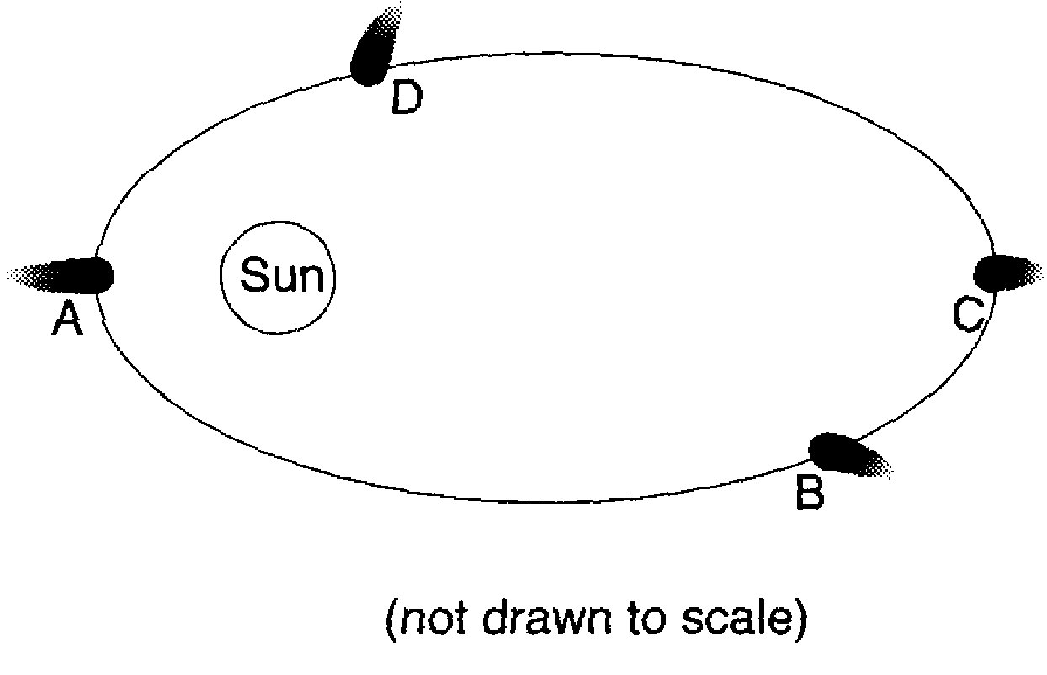
The diagram below shows the elliptical orbit of a comet around the Sun. The magnitude of the centripetal acceleration of the comet is greatest at point
Notes:
A

Slide 4
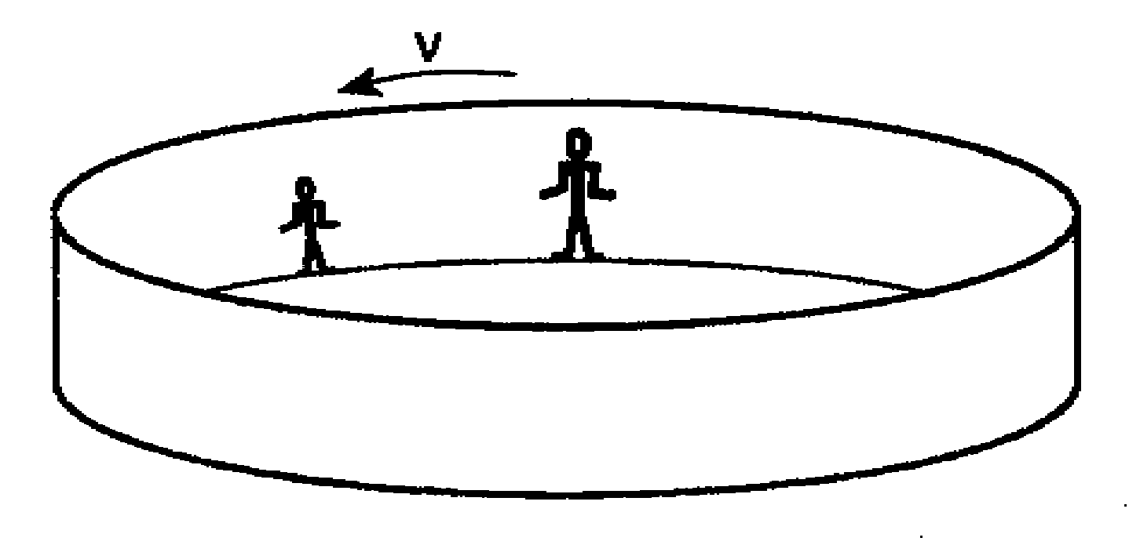
A 60.-kilogram adult and a 30.-kilogram child are passengers on a rotor ride at an amusement park. When the rotating hollow cylinder reaches a certain constant speed, v, the floor moves downward. Both passengers stay "pinned“ against the wall of the rotor. Compared to the magnitude of the acceleration of the adult, the magnitude of the acceleration of the child is
A. less
B. greater
C. the same
Notes:
C
4

Slide 5
A 60.-kilogram adult and a 30.-kilogram child are passengers on a rotor ride at an amusement park. When the rotating hollow cylinder reaches a certain constant speed, v, the floor moves downward. Both passengers stay "pinned“ against the wall of the rotor. Compared to the magnitude of the centripetal force of the adult, the magnitude of the centripetal force of the child is
A. less
B. greater
C. the same
Notes:
A
5

Slide 6
As a car goes around the curve, the centripetal force is directed
A. toward the center of the circular curve
B. away from the center of the circular curve
C. tangent to the curve in the direction of motion
D. tangent to the curve opposite the direction of motion
Notes:
A
6

Slide 7
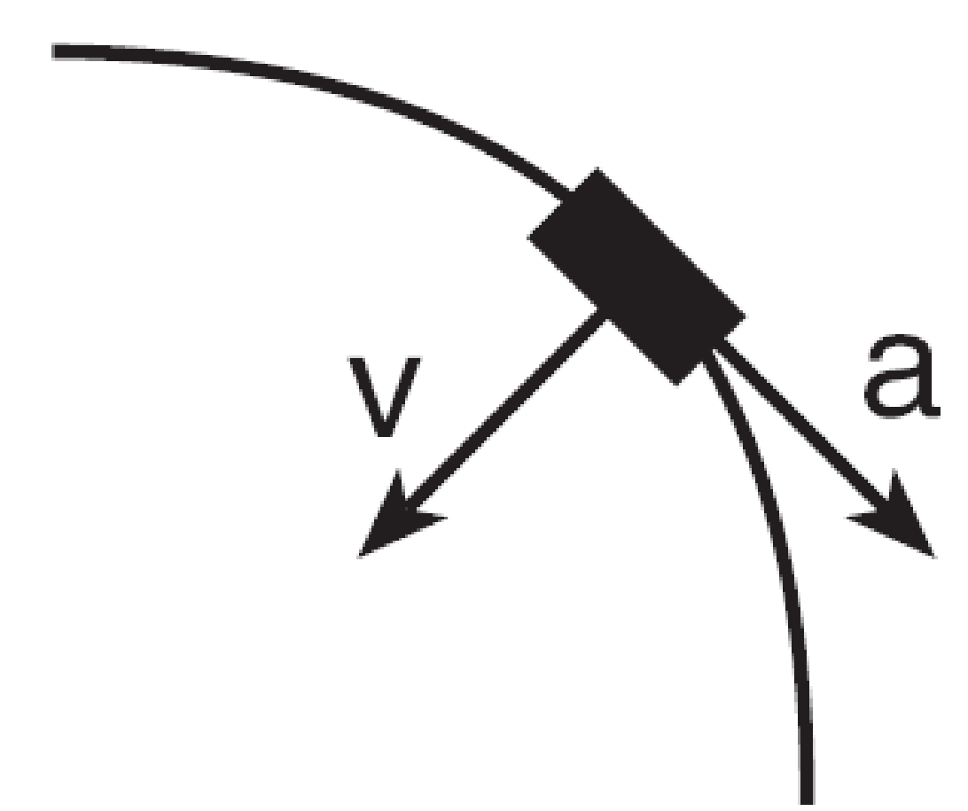
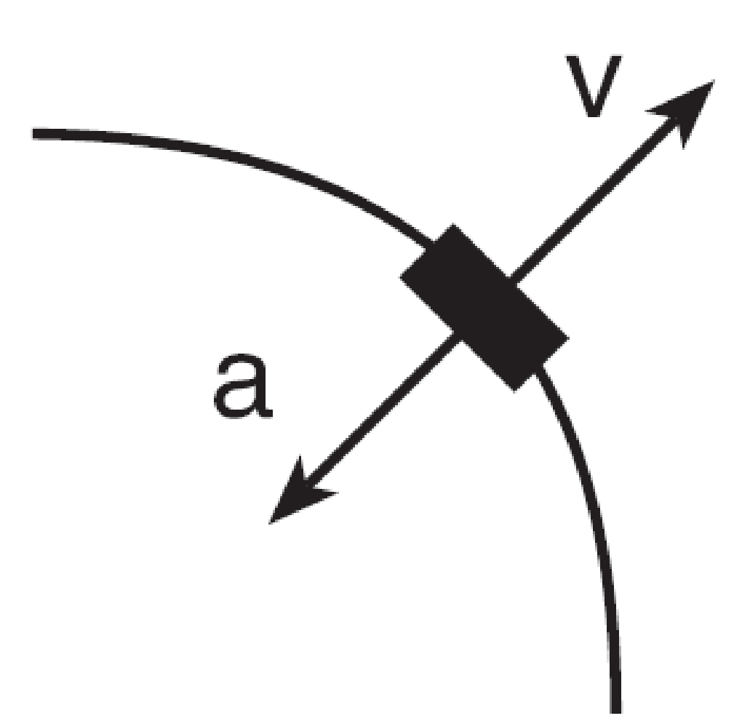
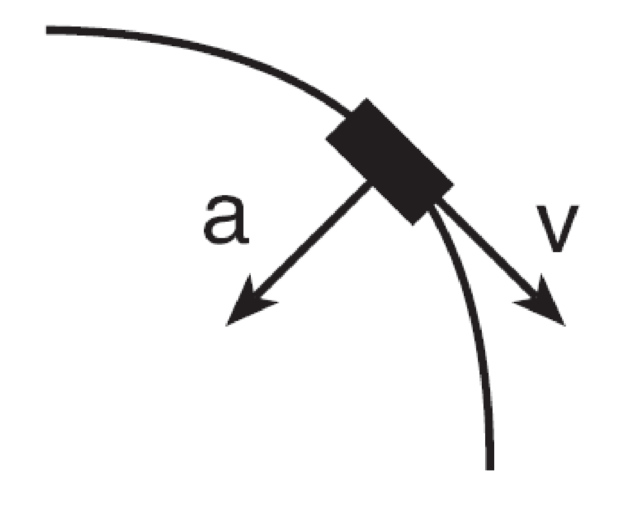
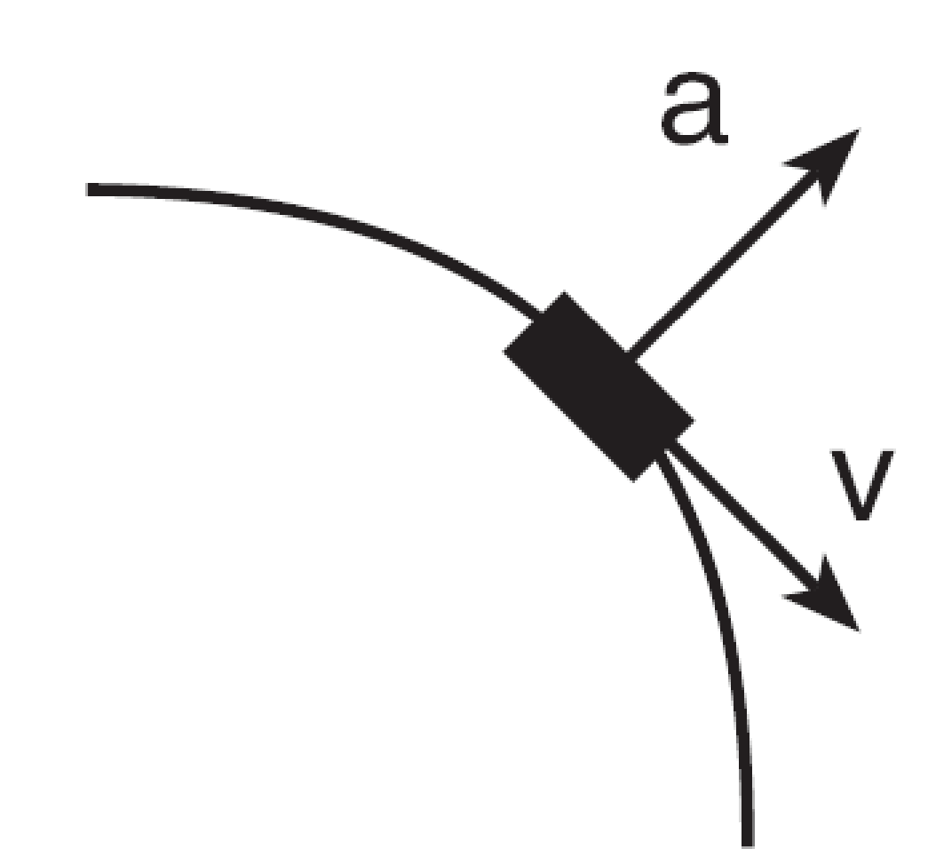
A car rounds a horizontal curve of constant radius at a constant speed. Which diagram best represents the directions of both the car’s velocity, v, and acceleration, a?
A. B. C. D.
Notes:
C
7

Slide 8
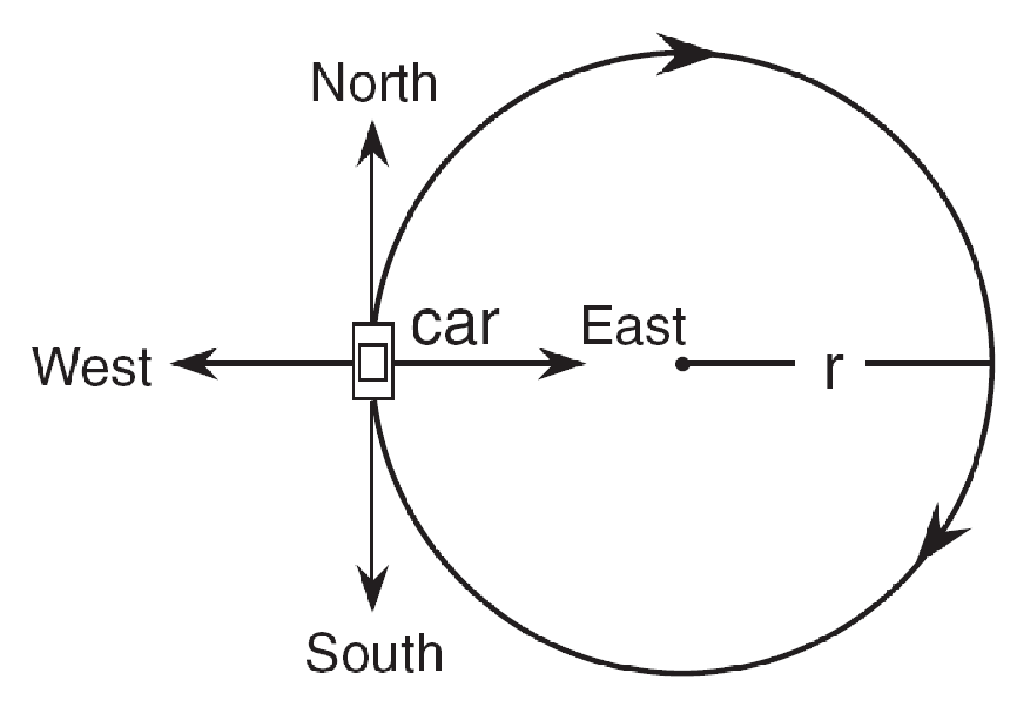
A car moves with a constant speed in a clockwise direction around a circular
path of radius r. When the car is in the position shown, its acceleration is directed toward the
A. north
B. west
C. south
D. east
Notes:
D
8

Slide 9
A coin and a ring with the same mass start rolling down a slope at the same time. Which one will reach the bottom first?
A. Ring
B. Coin
C. Both will reach the bottom at the same time
Notes:
B
9

Slide 10
The magnitude of the centripetal acceleration of an object traveling in a horizontal, circular path will decrease if the
A. radius of the path is increased
B. mass of the object is increased
C. direction of motion of the object is reversed
D. speed of the object is increased
Notes:
A
10

Slide 11
The magnitude of the centripetal force acting on an object traveling in a horizontal, circular path will decrease if the
A. radius of the path is increased
B. mass of the object is increased
C. direction of motion of the object is reversed
D. speed of the object is increased
Notes:
A

Slide 12
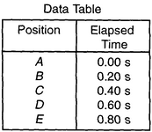
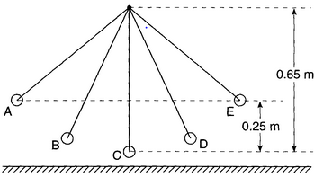
The pendulum is timed at five positions, A through E. Based on the information in the diagram and the data table, determine the period of the pendulum.
Notes:
T = 1.6 s
12

Slide 13
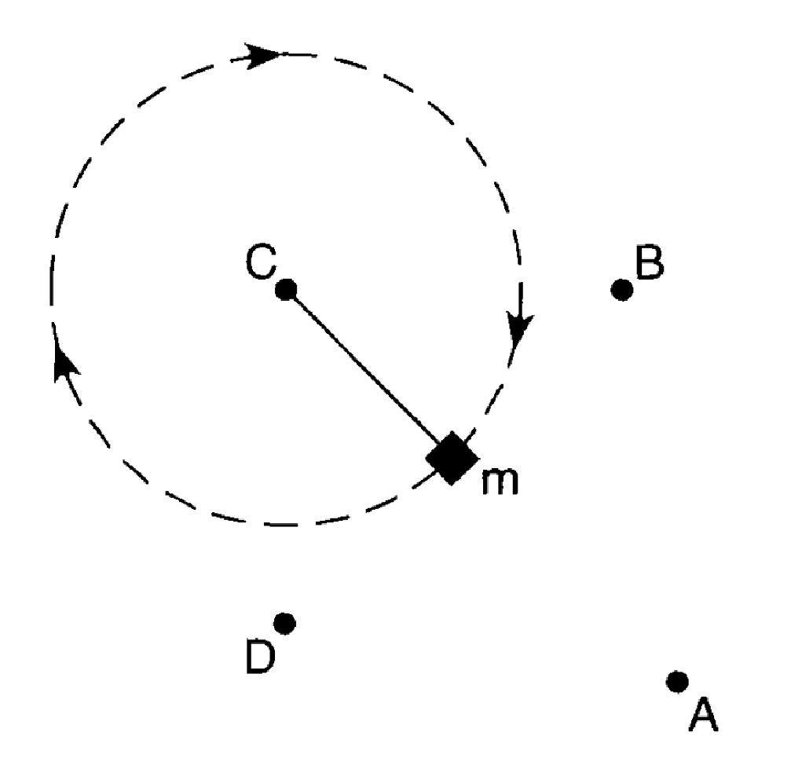
A mass, m, is being swung clockwise at constant speed in a horizontal circle. If the rope holding the mass is released at the instant shown, the mass will hit point
A. A
B. B
C. C
D. D
Notes:
D
13

Slide 14
A mass, m, is being swung clockwise at constant speed in a horizontal circle. At the instant shown, the centripetal force acting on mass m is directed toward point
A. A
B. B
C. C
D. D
Notes:
C
14

Slide 15
A bicyclist travels 200. meters in 10 seconds. If the radius of the tire is 0.398 meters, how many times does it rotate in that distance?
Notes:
80 cycles

Slide 16
A bicyclist travels 200. meters in 10 seconds. If the radius of the tire is 0.398 meters, how many times does the tire rotate per second?
Notes:
8 cycles/second = 8 Hz

Slide 17
A bicyclist travels 200. meters in 10 seconds. If the radius of the tire is 0.398 meters, what is the tangential speed in m/s?
Notes:
V_{tan} = 20 m/s

Slide 18
A bicyclist travels 200. meters in 10 seconds. If the radius of the tire is 0.398 meters, what is the centripetal acceleration?
Notes:
A_{c} = 1005 m/s²

Slide 19
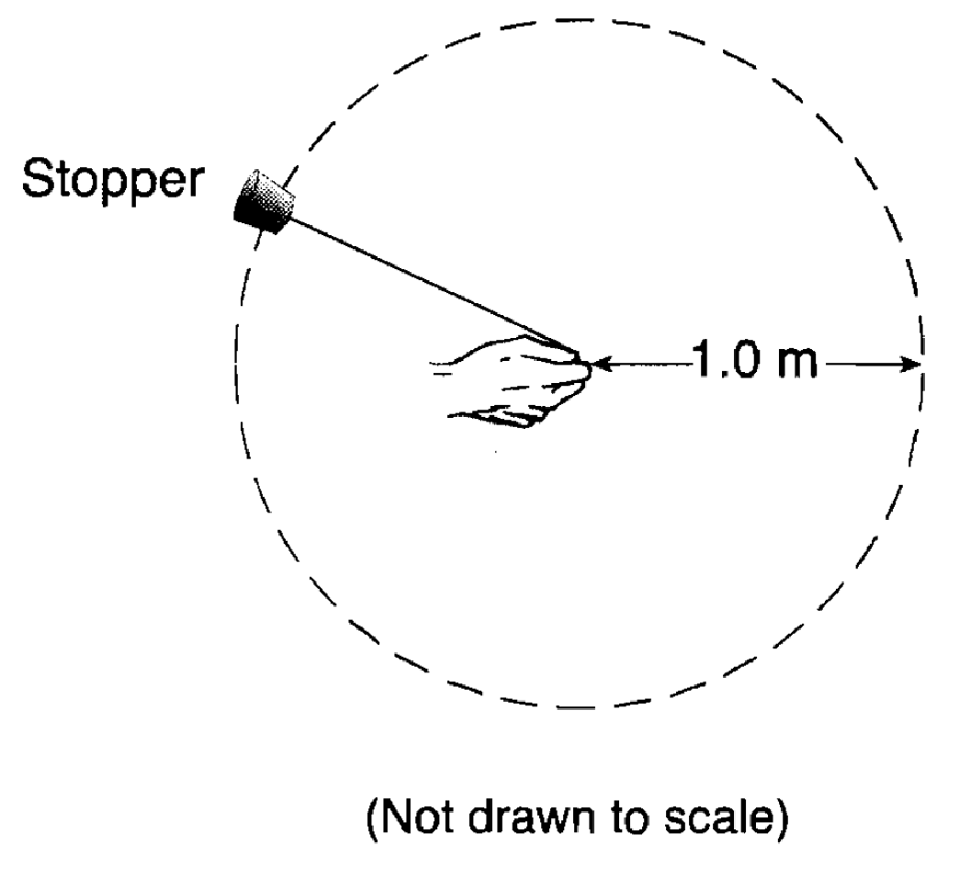
In an experiment, a 0.028-kilogram rubber stopper is attached to one end of a string. A student whirls the stopper overhead in a horizontal circle with a radius of 1.0 meter. The stopper completes 15 revolutions in 10. seconds.
Find the frequency in revolution/second.
Notes:
f = 1.5 cycles/second = 1.5 Hz

Slide 20
In an experiment, a 0.028-kilogram rubber stopper is attached to one end of a string. A student whirls the stopper overhead in a horizontal circle with a radius of 1.0 meter. The stopper completes 15 revolutions in 10. seconds.
Find the Period (s).
Notes:
T = 0.67 sec.

Slide 21
In an experiment, a 0.028-kilogram rubber stopper is attached to one end of a string. A student whirls the stopper overhead in a horizontal circle with a radius of 1.0 meter. The stopper completes 15 revolutions in 10. seconds.
Find the tangential velocity in m/s.
Notes:
v_{tan} = 9.4 m/s

Slide 22
In an experiment, a 0.028-kilogram rubber stopper is attached to one end of a string. A student whirls the stopper overhead in a horizontal circle with a radius of 1.0 meter. The stopper completes 15 revolutions in 10. seconds.
Find the centripetal acceleration in m/s².
Notes:
a_{c} = 88.4 m/s²

Slide 23
In an experiment, a 0.028-kilogram rubber stopper is attached to one end of a string. A student whirls the stopper overhead in a horizontal circle with a radius of 1.0 meter. The stopper completes 15 revolutions in 10. seconds.
Find the centripetal force in N.
Notes:
F = 2.5 N

Slide 24
A 0.50-kilogram object moves in a horizontal circular path with a radius of 0.25 meter at a constant speed of 4.0 meters per second. What is the magnitude of the object’s acceleration?
Notes:
a_{c} = 64 m/s²

Slide 25
A 0.50-kilogram object moves in a horizontal circular path with a radius of 0.25 meter at a constant speed of 4.0 meters per second. What is the magnitude of the object’s centripetal force?
Notes:
F = 32 N

Slide 26
A 0.50-kilogram object moves in a horizontal circular path with a radius of 0.25 meter at a constant speed of 4.0 meters per second. What is the magnitude of the object’s frequency or angular speed in rps?
Notes:
f = 2.5 cycles/second or 2.5 Hz

Slide 27
A 0.50-kilogram object moves in a horizontal circular path with a radius of 0.25 meter at a constant speed of 4.0 meters per second. What is the magnitude of the object’s period?
Notes:
T = 0.39 sec.

Slide 28
An unbalanced force of 40. Newtons keeps a 5.0-kilogram object traveling in a circle of radius 2.0 meters. What is the acceleration of the object?
Notes:
a_{c} = 8 m/s²

Slide 29
An unbalanced force of 40. Newtons keeps a 5.0-kilogram object traveling in a circle of radius 2.0 meters. What is the
speed of the object?
Notes:
v_{tan} = 4 m/s

Slide 30
An unbalanced force of 40. Newtons keeps a 5.0-kilogram object traveling in a circle of radius 2.0 meters. How long (s) does it take to go around one time?
Notes:
T = 3.14 sec.
30

Slide 31
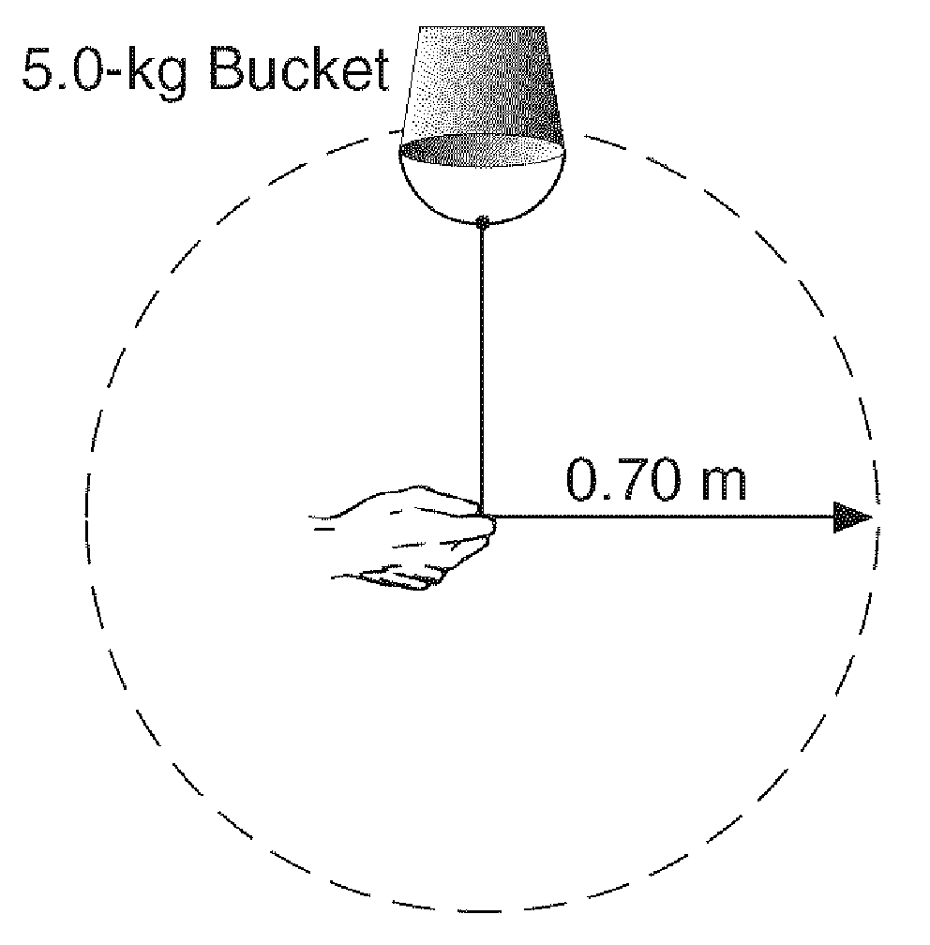
A 5.0-kg bucket of water is swung in a horizontal circle of 0.70-m radius at a constant speed of 2.0 m/s. How many rounds per second (frequency) does it go?
Notes:
f = 0.45 cycles/second = 0.45 Hz
31

Slide 32
A 5.0-kg bucket of water is swung in a horizontal circle of 0.70-m radius at a constant speed of 2.0 m/s. The magnitude of the centripetal acceleration (m/s²) on the bucket of water is approximately
Notes:
a_{c} = 5.7 m/s²
32

Slide 33
A 5.0-kg bucket of water is swung in a horizontal circle of 0.70-m radius at a constant speed of 2.0 m/s. The magnitude of the centripetal force (N) on the bucket of water is approximately
Notes:
F = 28.6 N
33

Slide 34
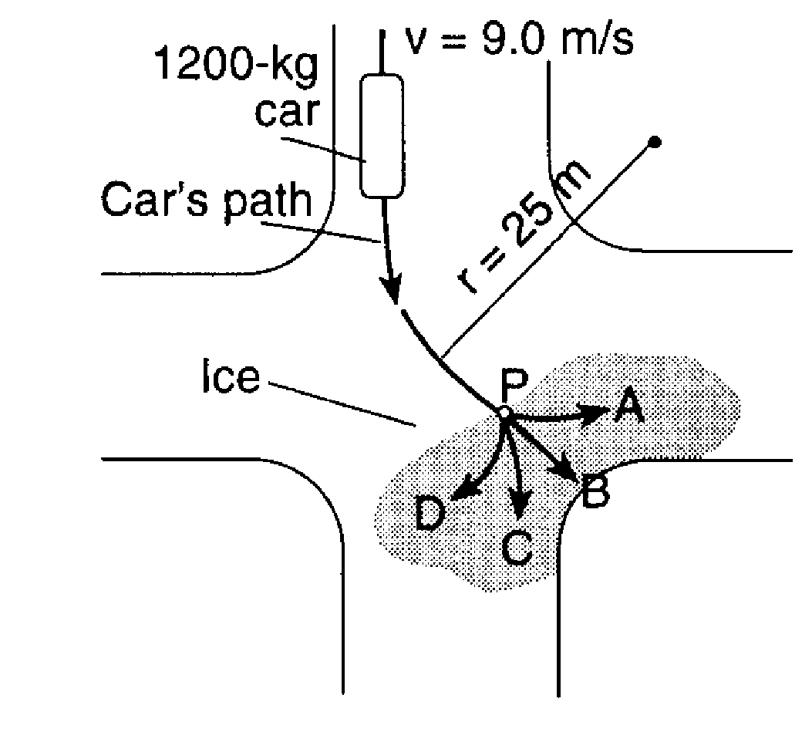
A 1200-kg car traveling at a constant speed of 9.0 m/s turns at an intersection. The car follows a horizontal circular path with a radius of 25 meters to point P. At point P, the car hits
an area of ice and
loses all frictional
force on its tires.
Which path does the
car follow on the ice?
Notes:
B

Slide 35
A 1200-kg car traveling at a constant speed of 9.0 m/s turns at an intersection. The car follows a horizontal circular path with a radius of 25 meters to point P. Before the car hit the
ice, what was its
centripetal
acceleration (m/s²)?
Notes:
a = 3.2 m/s²
35

Slide 36
A 1200-kg car traveling at a constant speed of 9.0 m/s turns at an intersection. The car follows a horizontal circular path with a radius of 25 meters to point P. Before the car hit the
ice, what was its
centripetal force (N)?
Notes:
F = 3888 N
36

Slide 37
A student spinning a 0.10-kilogram ball at the end of a 0.50-meter string in a horizontal circle at a constant speed of 10. meters per second. How many times does the ball go around per second (frequency)?
Notes:
f = 3.2 cycles/second = 3.2 Hz
37

Slide 38
A student spinning a 0.10-kilogram ball at the end of a 0.50-meter string in a horizontal circle at a constant speed of 10. meters per second. What is the centripetal acceleration?
Notes:
a_{c} = 200 m/s²
38

Slide 39
A student spinning a 0.10-kilogram ball at the end of a 0.50-meter string in a horizontal circle at a constant speed of 10. meters per second. What is the centripetal force?
Notes:
F_{c} = 20 N
39

